Slide 1
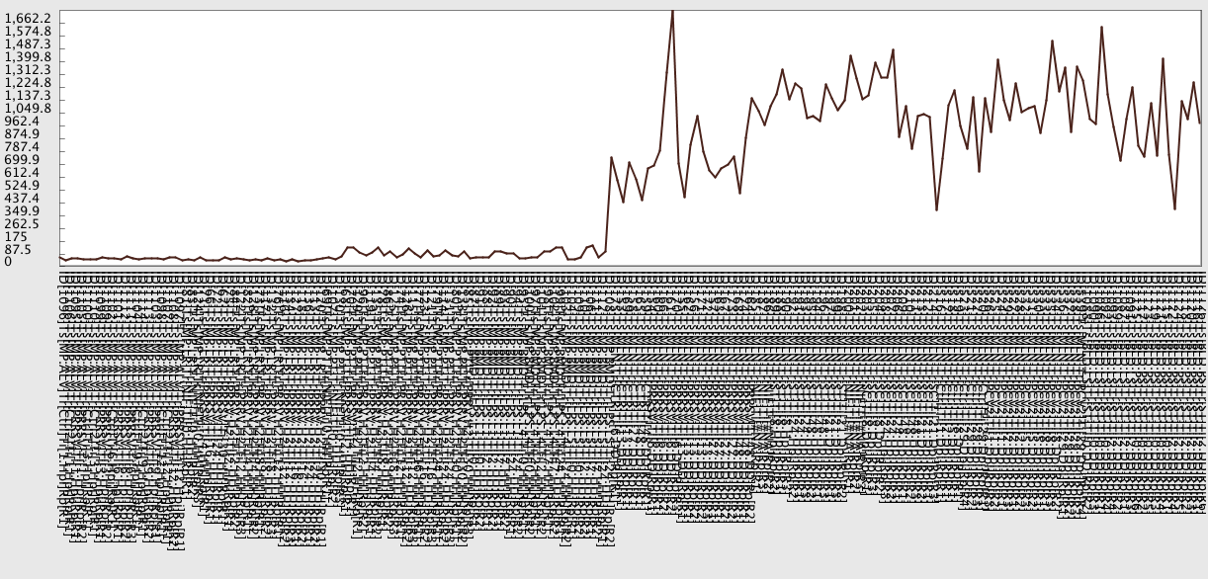
Alveolar Macrophage cells infected with PRRSv
E-MEXP-1350 E-MTAB-505
Landrace origin Pietrain origin
Bone Marrow Derived-Macrophage cells treated with LPS
GSE30956
LN from PRRSV infected pigs
Ait-Ali, et al.,
unpublished
data
Mesenteric LN from Salmonella choleraesuis infected pigs
GSE7314
Mesenteric LN from Salmonella typhimurium infected pigs
GSE7314
LN from PCV2 infected pigs
GSE14791
Whole Blood from Salmonella infected pigs
GSE27000

