Slide 1
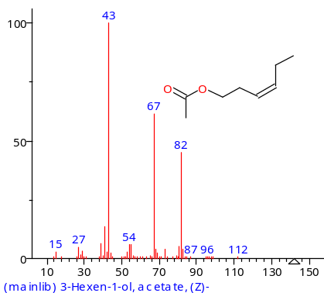
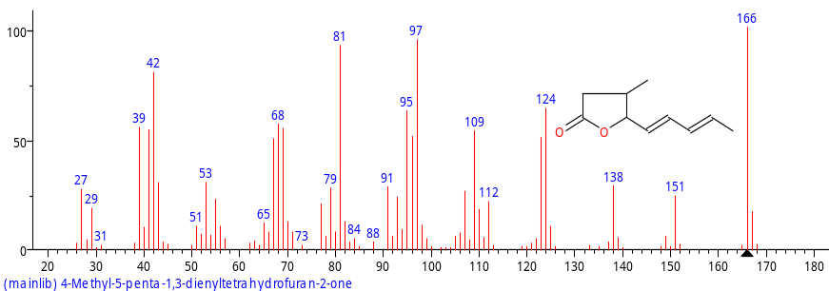
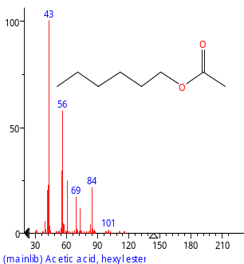
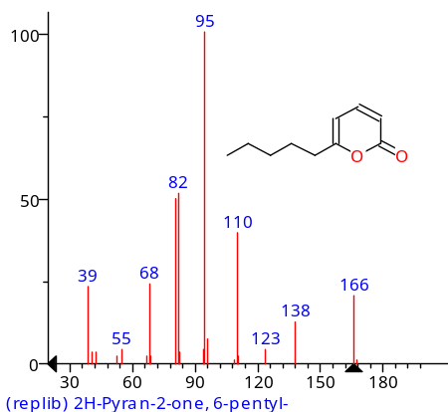
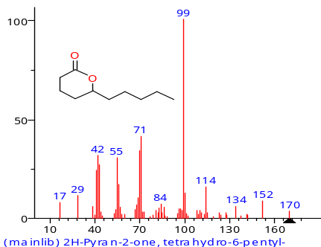
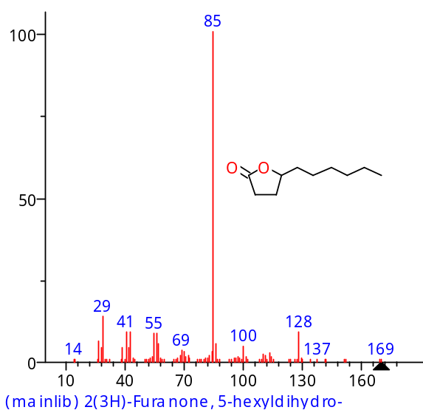
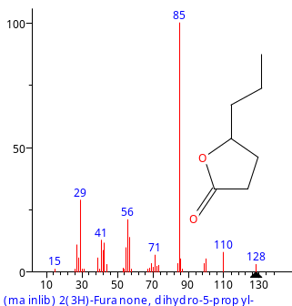
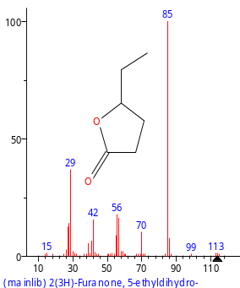
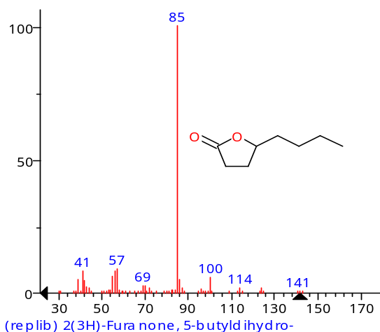
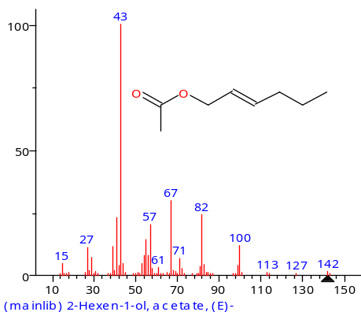
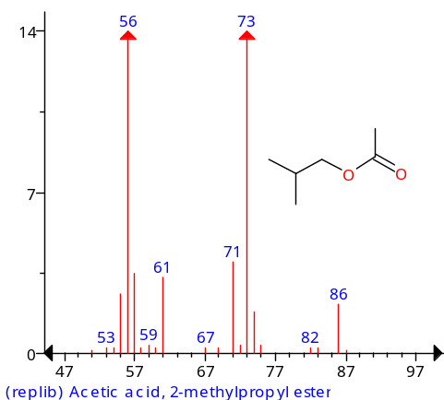
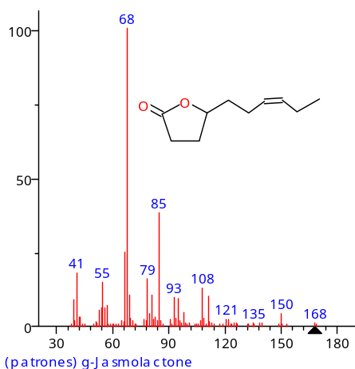
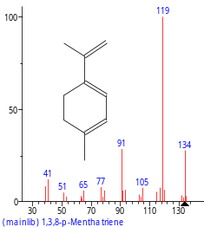
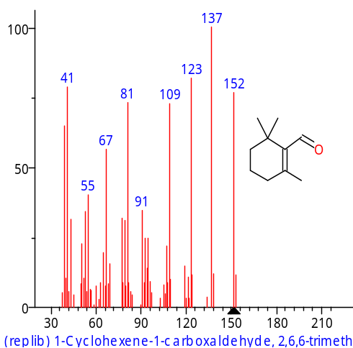
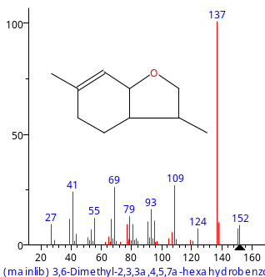
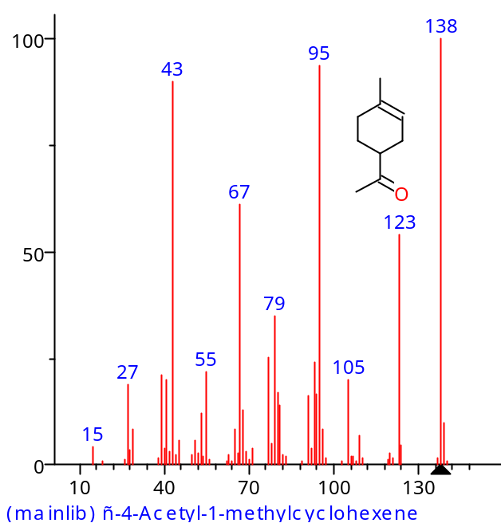
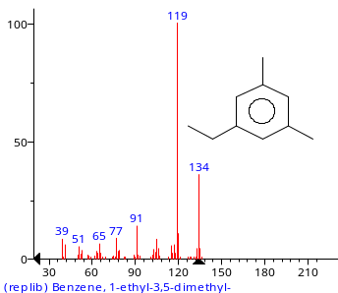
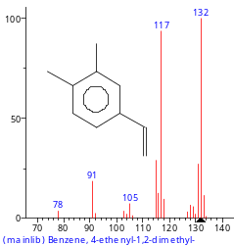
Nº VOCs* Structure CAS Nº Group Odor description**
C1
1 3-Hexen-1-ol, acetate, (Z)- 3681-71-8 Ester fruity¹
2 4-Methyl-5-penta-1,3- 185211 Lactone
dienyltetrahydrofuran-2-one
3 Acetic acid, hexyl ester 142-92-7 Ester fruity^{W}
C2
4 2H-Pyran-2-one, 6-pentyl- 27593-23-3 Lactone coconut-like¹
5 δ-Decalactone 705-86-2 Lactone coconut-like¹
6 γ-Decalactone 706-14-9 Lactone peach-like¹
7 γ-Heptalatone 105-21-5 Lactone coconut-like^{w}
8 γ-Hexalactone 695-06-7 Lactone coconut-like, fruity¹
9 γ-Octalactone 104-50-7 Lactone coconut-like¹
C3
10 2-Hexen-1-ol, acetate, (E)- 2497-18-9 Ester fruity^{w}
11 Acetic acid, 2-methylpropyl ester 110-19-0 Ester fruity^{w}
12 γ-Jasmolactone 93787-95-2 Lactone peach-like¹
C4
1,3,8-p-Menthatriene 21195-59-5 Terpenoid
1-Cyclohexene-1-carboxaldehyde 432-25-7
-2,6,6-trimethyl-
3,6-Dimethyl-2,3,3α,4,5,7 70786-44-6
α-hexahydrobenzofuran
4-Acetyl-1-methylcyclohexene 70286-20-3 Terpenoid
Benzene, 1-ethyl-3,5-dimethyl- 934-74-7
18 Benzene, 4-ethenyl-1,2-dimethyl- 27831-13-6

Slide 2
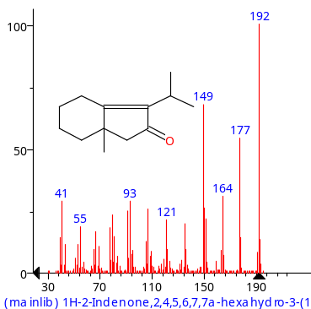
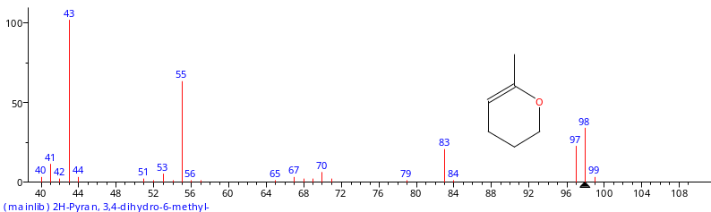
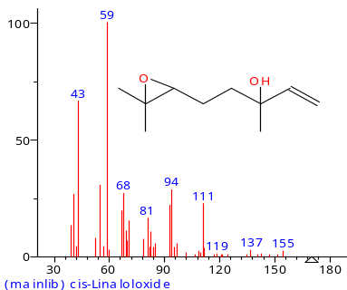
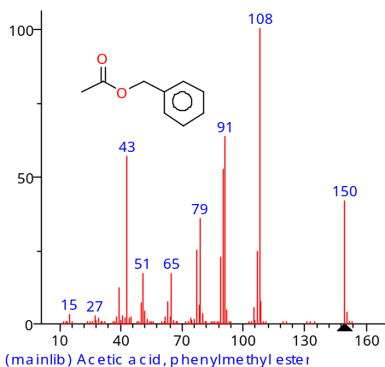
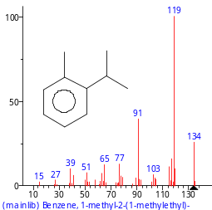
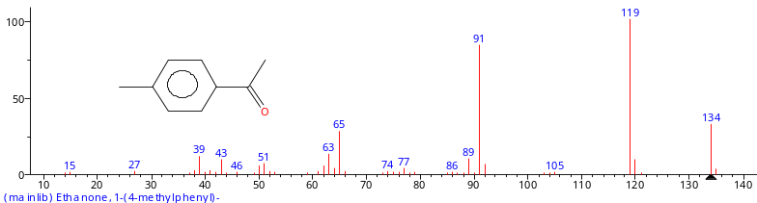
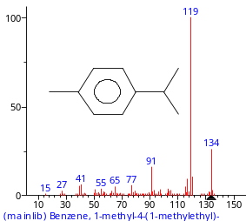
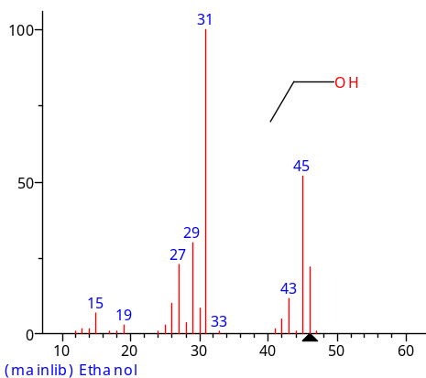
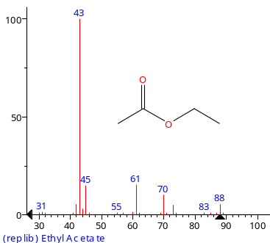
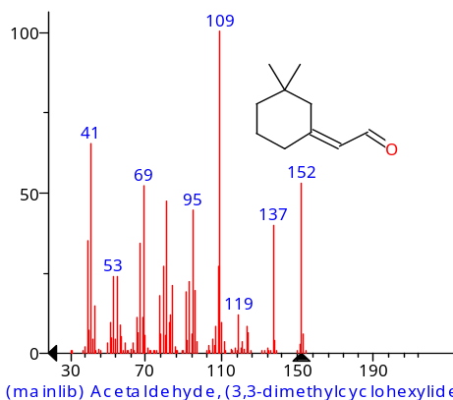
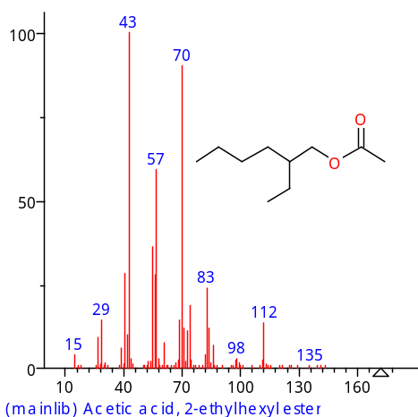
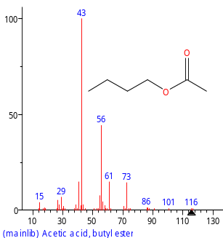
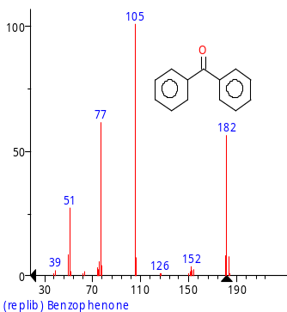
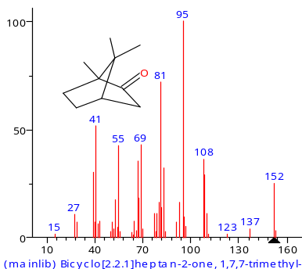
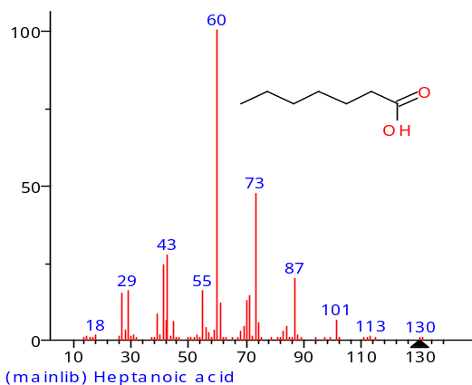
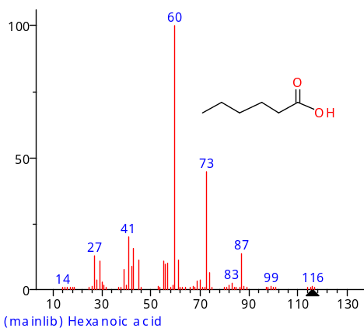
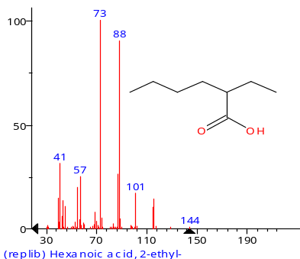
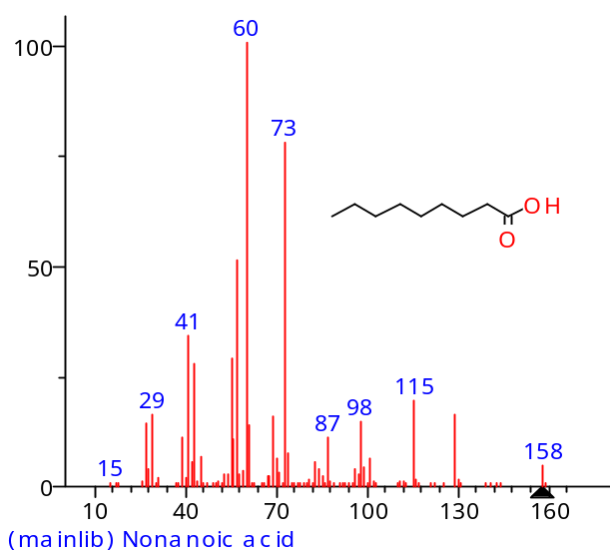
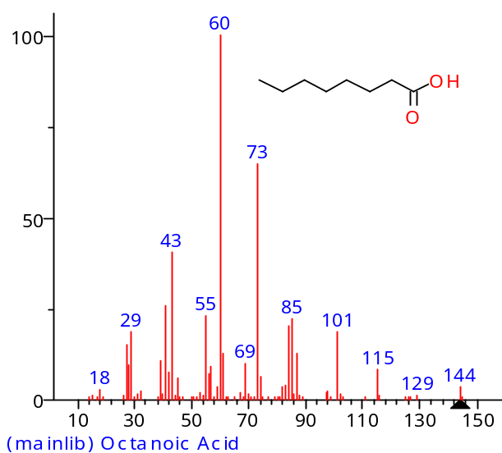
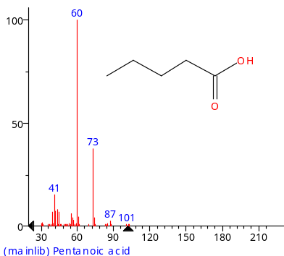
C5
1H-2-Indenone,2,4,5,6,7,7 n.a.
α-hexahydro-3-(1-methylethyl)-7α-methyl
2H-Pyran, 3,4-dihydro-6-methyl- 16015-11-5
21 cis-Linaloloxide n.a . Terpenoid
C6
22 Acetic acid, phenylmethyl ester 140-11-4 Ester floral ^{w}
Benzene, 1-methyl-2-(1-methylethyl)- 535-77-3
Ethanone, 1-(4-methylphenyl)- 122-00-9
25 p-Cymene 99-87-6 Terpenoid
C7
26 Ethanol 64-17-5
27 Ethyl Acetate 141-78-6 Ester fruity²
C8
Acetaldehyde, 26532-25-1
(3,3-dimethylcyclohexylidene)-, (E)-
29 Acetic acid, 2-ethylhexyl ester 103-09-3 Ester
Acetic acid, butyl ester 123-86-4 Ester
31 Benzophenone 119-61-9 balsamic^{w}
Bicyclo[2.2.1]heptan-2-one 464-48-2
1,7,7-trimethyl-, (1S)-
C9
33 Heptanoic acid 111-14-8 Carboxilic acid
34 Hexanoic acid 142-62-1 Carboxilic acid
35 Hexanoic acid, 2-ethyl- 149-57-5 Carboxilic acid
36 Nonanoic acid 112-05-0 Carboxilic acid
37 Octanoic Acid 124-07-2 Carboxilic acid fatty^{w}
38 Pentanoic acid 109-52-4 Carboxilic acid

Slide 3

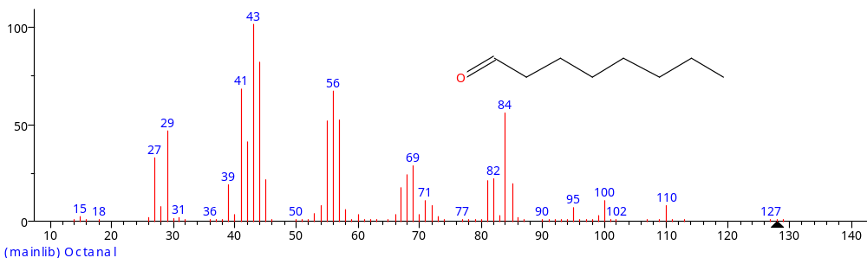

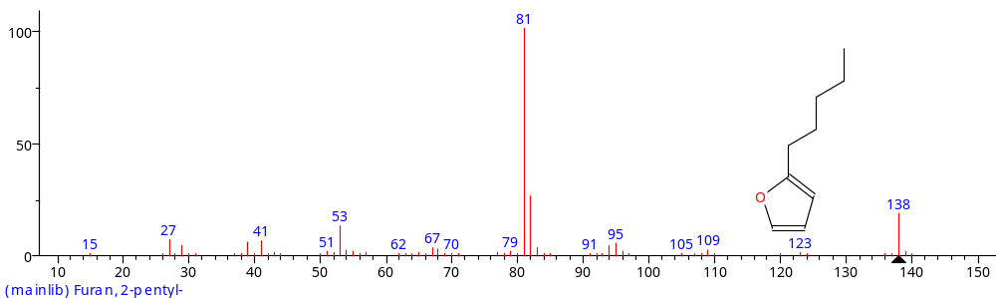

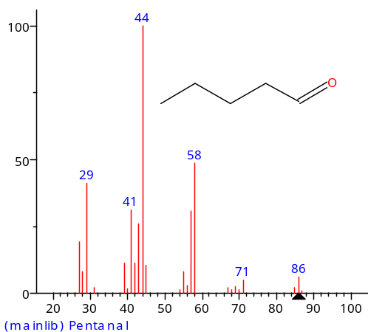
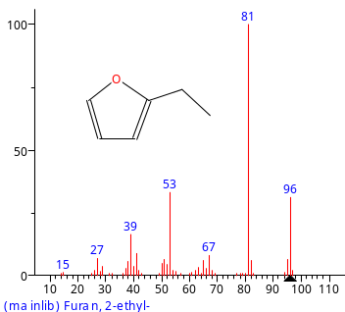
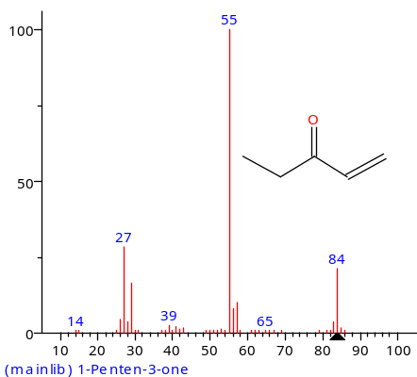
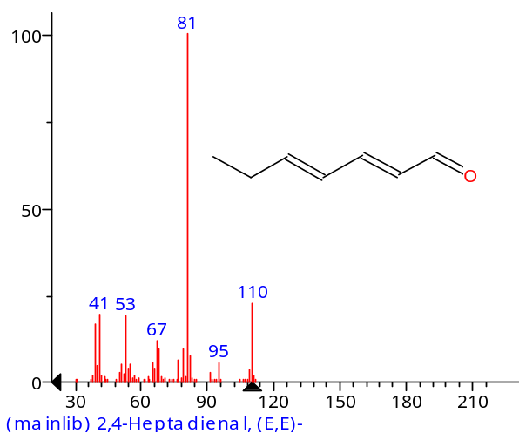
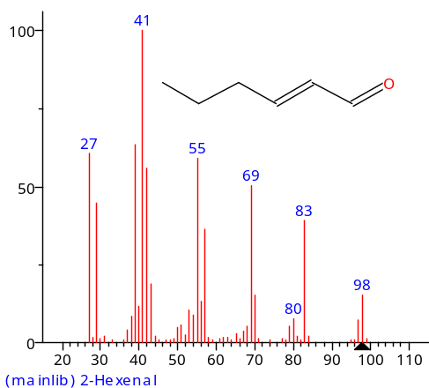
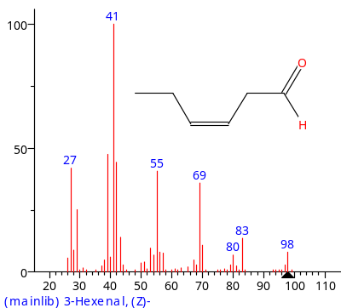
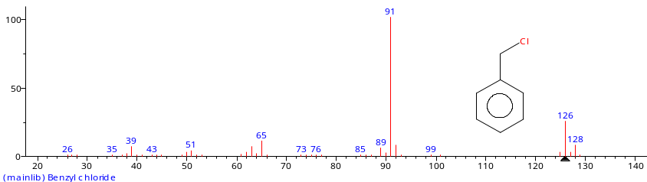


C10
39 Nonanal 124-19-6 Long chain aldehydic^{w} aldheyde
40 Octanal 124-13-0 Long chain aldehydic^{w} aldheyde
41 2-Nonenal 2463-53-8 Long chain fatty ^{w} aldheyde
C11
42 Furan, 2-pentyl- 3777-69-3 Lipid derivative fruity^{w}
43 Hexanal 66-25-1 Lipid derivative green^{w}
44 Pentanal 110-62-3 Lipid derivative fermented^{w}
C12
45 Furan, 2-ethyl- 3208-16-0 Lipid derivative chemical^{w}
46 1-Penten-3-one 1629-58-9 Lipid derivative spicy^{w}
47 2,4-Heptadienal, (E,E)- 881395 Lipid derivative fatty^{w}
48 2-Hexenal 6728-26-3 Lipid derivative green, banana-like ¹
49 3-Hexenal, (Z)- 6789-80-6 Lipid derivative green, apple-like ^{w}
C13
Benzyl chloride 100-44-7 Phenolic
51 Benzaldehyde 100-52-7 Phenolic
52 Benzeneacetaldehyde 122-78-1 Phenolic green^{w}
Cl

