Slide 1
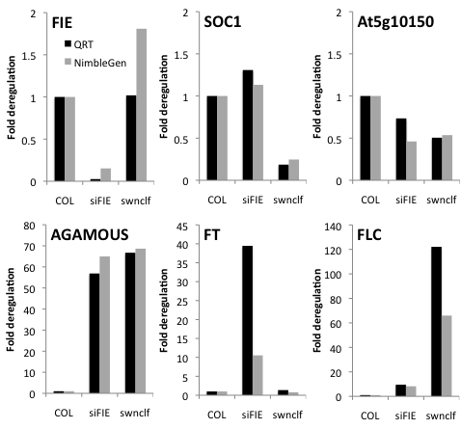
Additional file Figure S2. RT-qPCR verification of microarray data.
All genes except FIE and At5g10150 are PRC2 targets. Data is the mean of three biological replicates for QRT-PCR. De-regulation compared to wildtype is shown.

