Slide 1
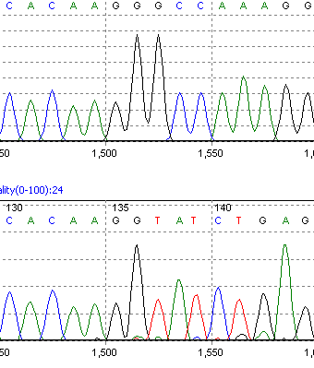
Additional data file 1
Exon 4
Exon 5
GSDMB WT sequence
GSDMB NV sequence
Exon 4
Exon 9
Notes:
Electropherogram showing changes to the GSDMB transcript at the sequence level. The figure shows the GSDMB WT sequence at the exon 4-5 boundary and underneath the NV sequence showing a deletion of exons 5-8 in the sequence.

