Slide 1
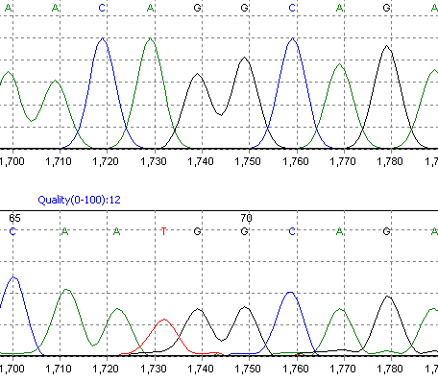
Additional data file 3
Exon 2
Exon 3
TSFM WT sequence
TSFM NV sequence
Exon 2A
Exon 3
Notes:
Electropherogram showing the changes to the TSFM transcript at the sequence level. The figure shows the TSFM WT sequence at the exon 2-3 boundary, and underneath the NV sequence showing inclusion of the alternate exon 2A preceding exon 3.

