Slide 1
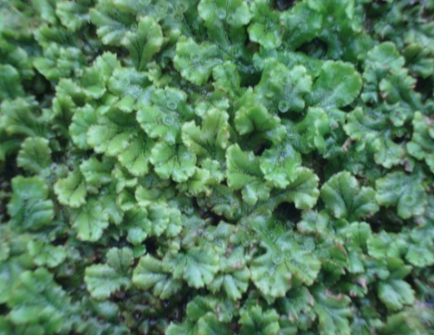
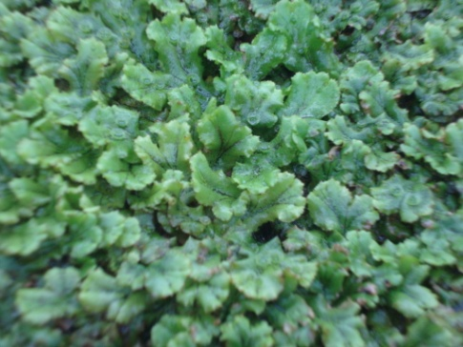
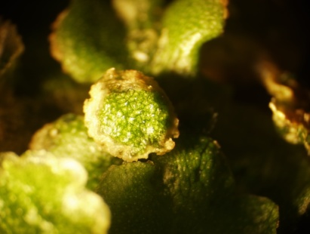
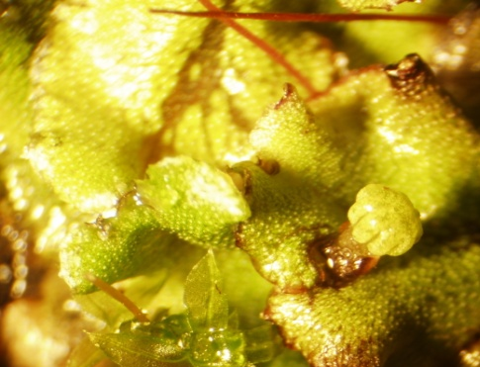
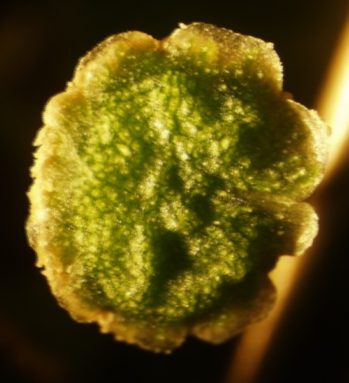
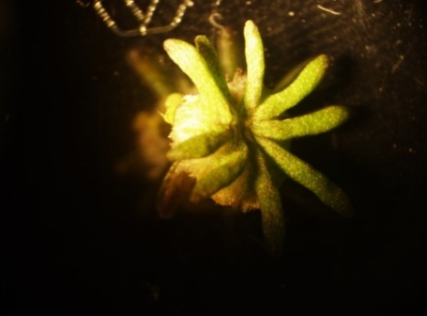
Samples for RNA sequencing
2)
Female Vegetative Thallus - VF
1)
Male Vegetative Thallus - VM
4) Immature Archegoniophore stage - IMF
3) Immature Antheridiophore stage - IMM
5) Mature Antheridiophore stage -MM
6) Mature Archegoniophore stage - MF

