Slide 1
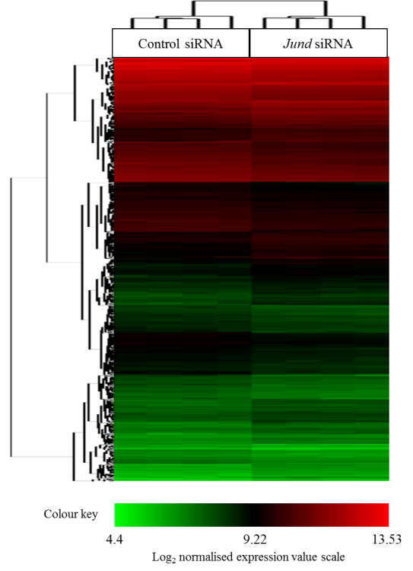
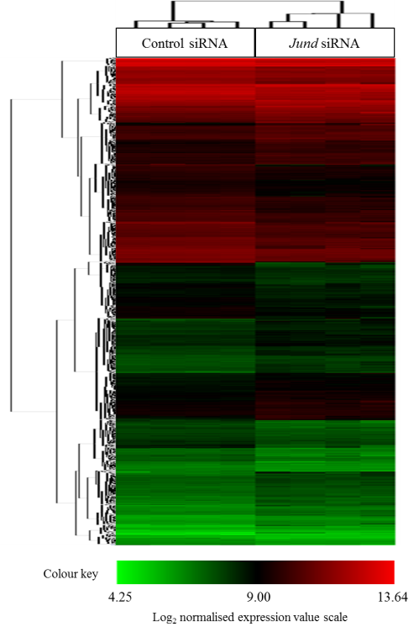
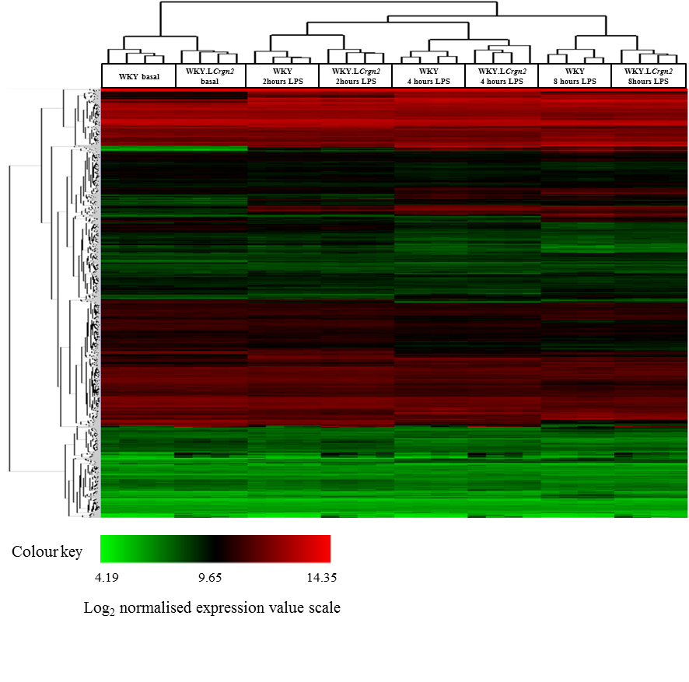
Supplementary figure 1
A
B
C

Slide 2
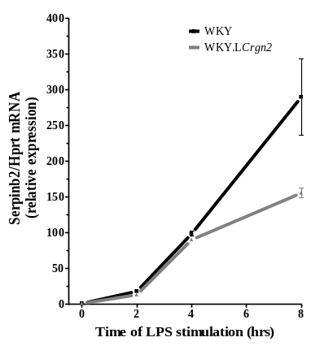
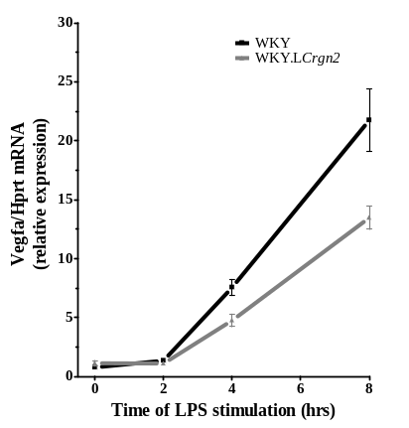
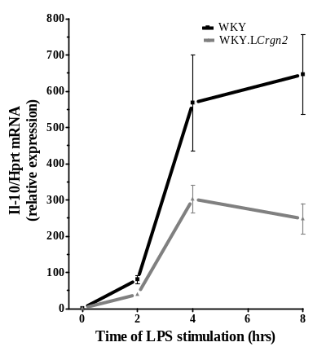
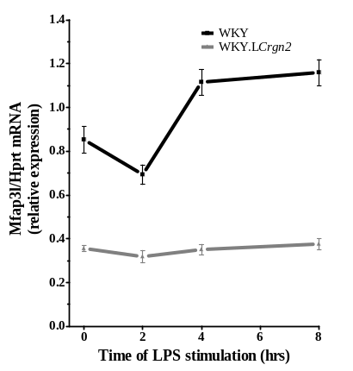
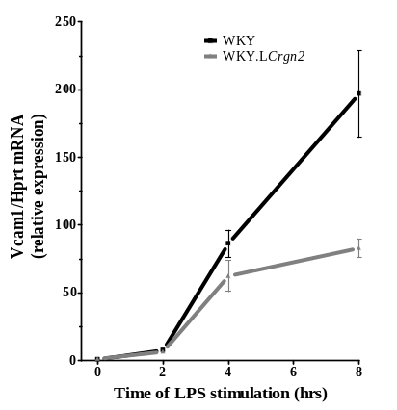
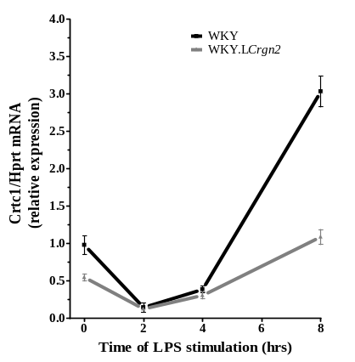
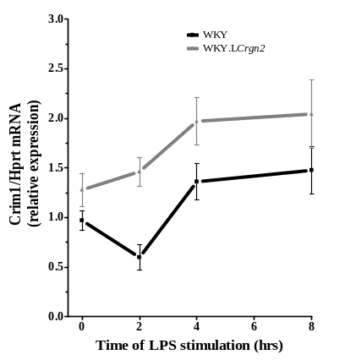
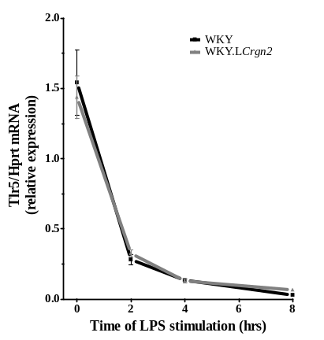
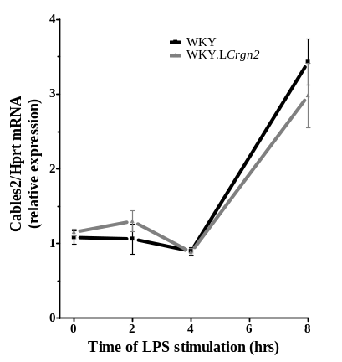
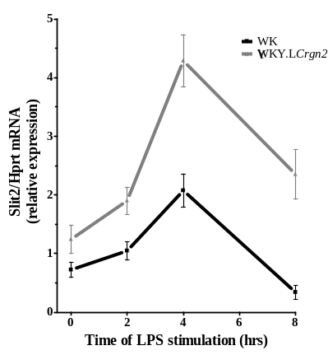
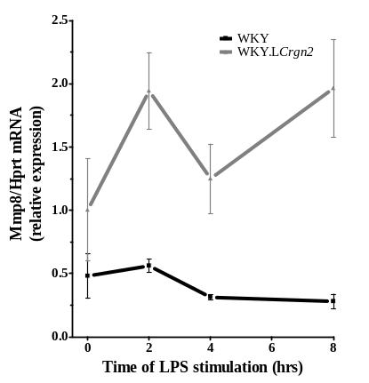
Supplementary figure 2
***
*
***
***
***
***
***
***
***
***
**
*
***
**
***
***

Slide 3
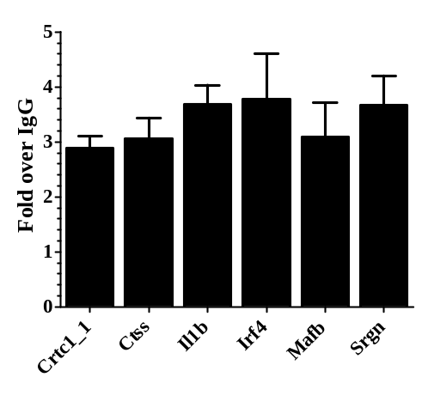
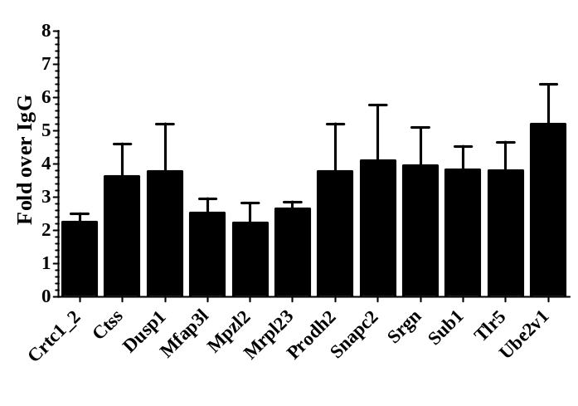
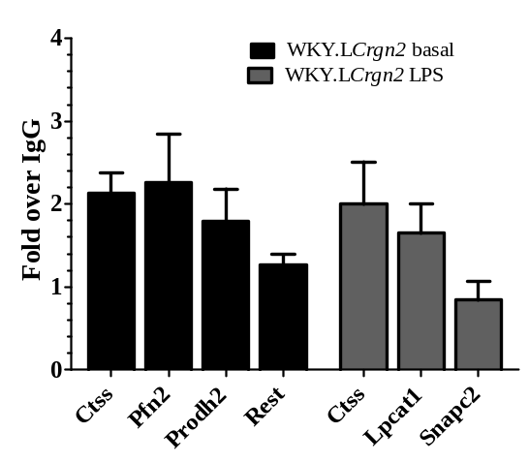
Supplementary figure 3
A
**
*
*
**
ns
*
B
*
**
*
*
*
ns
ns
*
ns
*
*
*
C
ns
ns
*
ns
ns
ns
ns

Slide 4
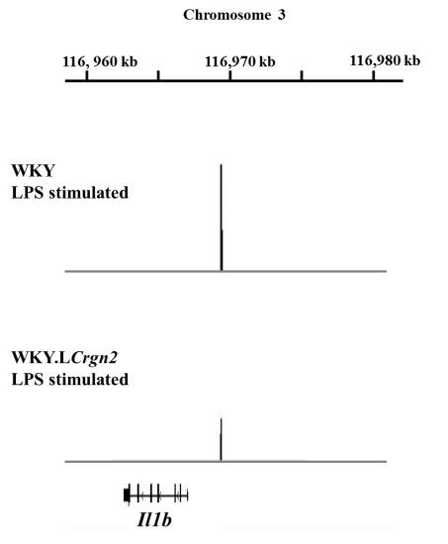
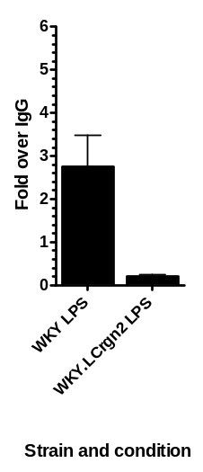
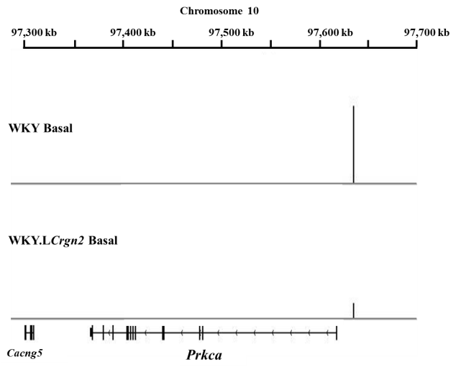
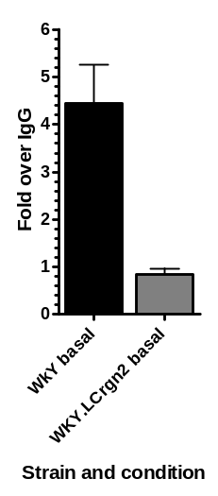
Supplementary figure 4
A
Il1b
**
B
Prkca
**

Slide 5
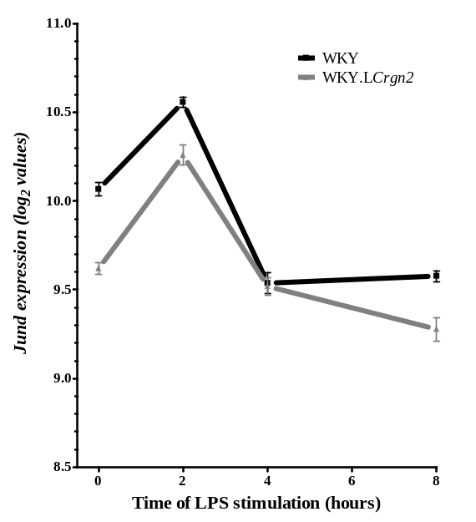
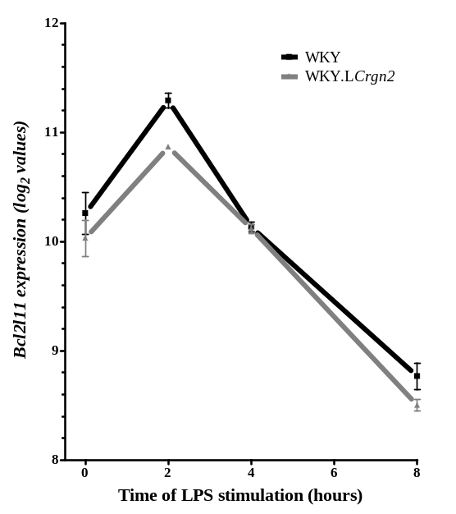
Supplementary figure 5
A
B
C
Gene symbol | Gene name | Chr. | Fold change | FDR (%)
Bcl2l11 | BCL2-like 11 (apoptosis facilitator) | 3 | 1.24 | 4.37
D
Chromosome | Peak start | Peak end | Peak Location | Distance from TSS
Chr3 | 1.16E+08 | 1.16E+08 | promoter | -16492
Chr3 | 1.16E+08 | 1.16E+08 | intron 2 | 27695

