Slide 1
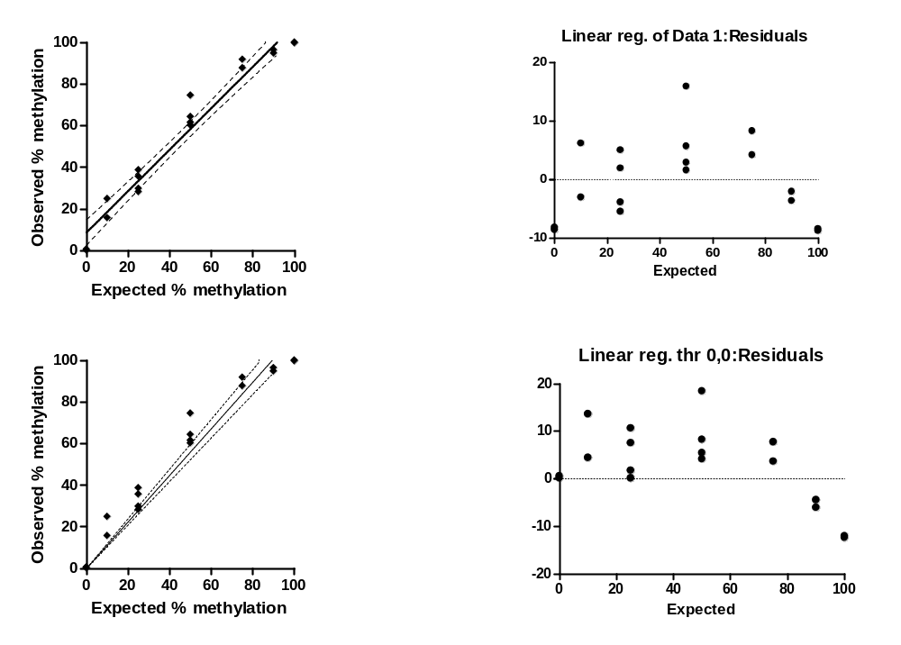
A
C
B
D
Additional file 3. Linear regression analysis of bisulfite amplicon NGS data. Linear regression was performed (A) without constraining x,y intercept (as Figure 5B) or (B) setting the intercept as (0,0). Residuals of the regression for each method are plotted in (C) and (D) respectively. A runs test for non-linearity gave p-values of 0.11 and 0.0007 for (C) and (D) respectively indicating that regression (B) is significantly non-linear.

