Slide 1
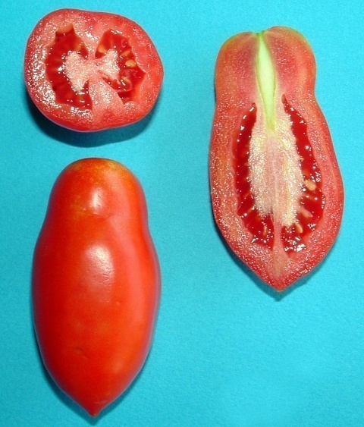
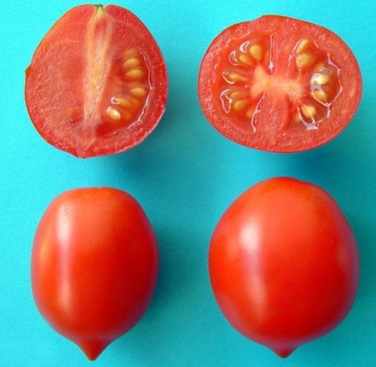
a) San Marzano
b) Vesuviano
Figure S1 Fruit morphological characteristics: a) San Marzano b)Vesuviano

