Slide 1
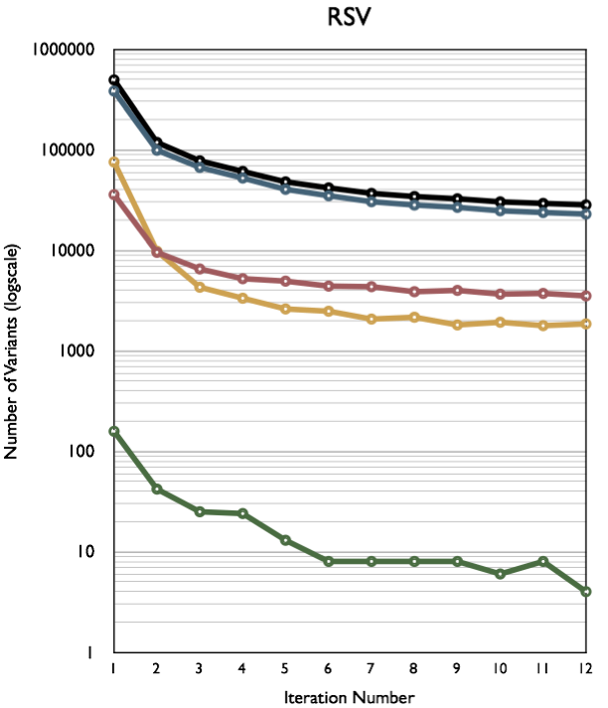
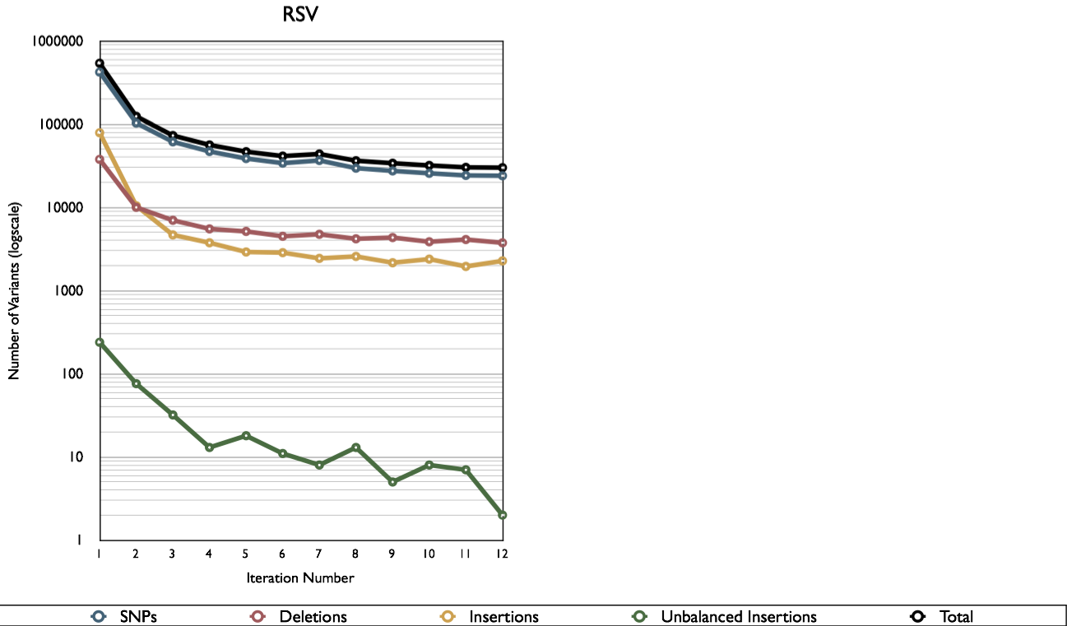
SM
Supplementary Figure S2. Assembly accuracy (y axis; number of base substitution errors) at 12 stages of the iterative mapping against the reference genome SL2.40.

