Slide 1
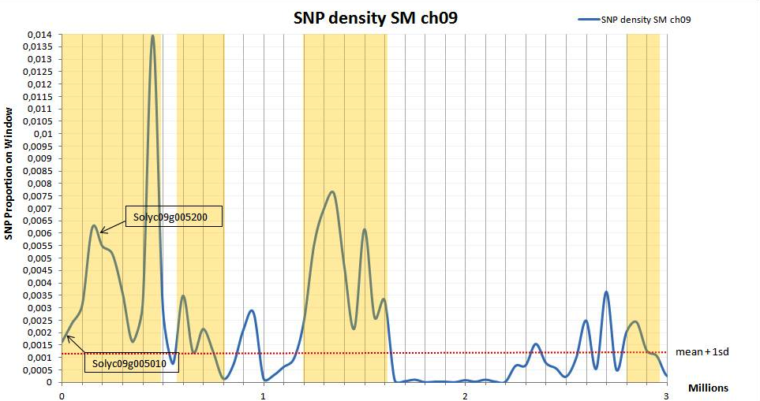
Supplementary Figure S3. Distribution of San Marzano genome (SM) chromosome 9 SNP density

