Slide 1
Figure S1. Thamil Arasan et al. 2014

Slide 2
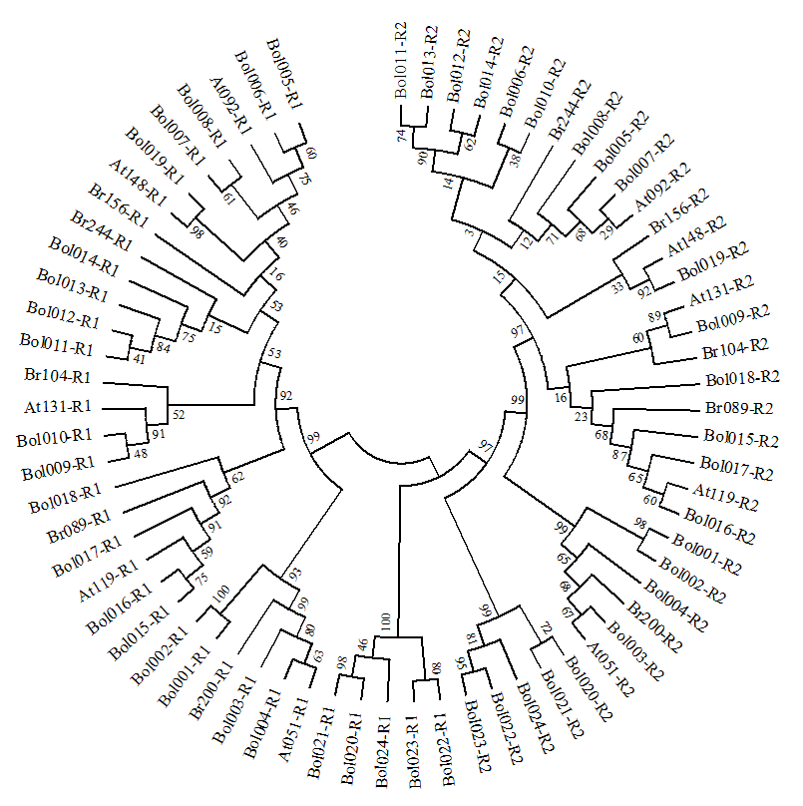
Figure S2. Thamil Arasan et al. 2014

Slide 3
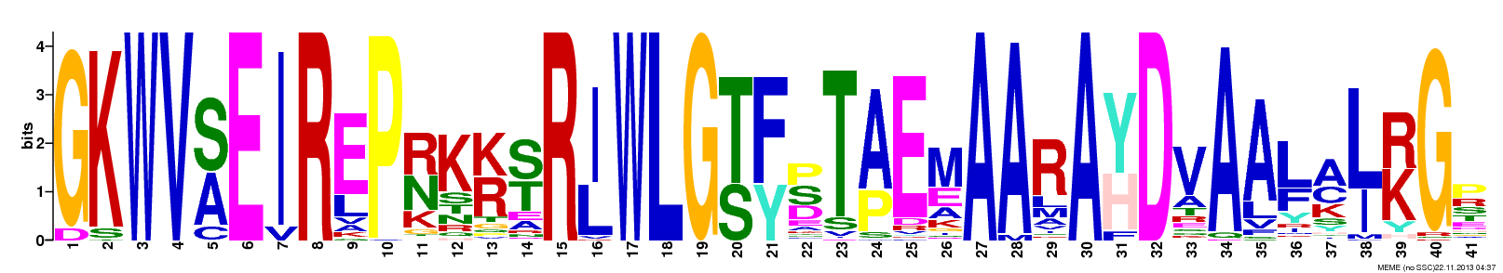
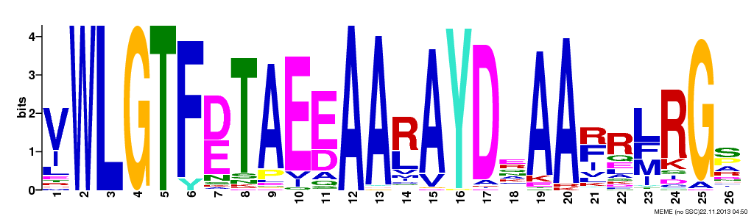
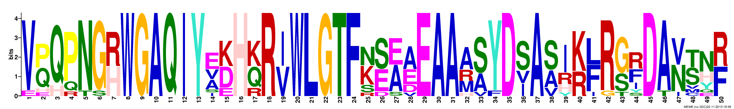
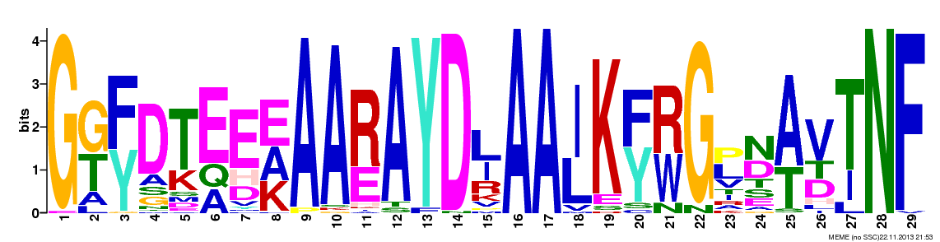
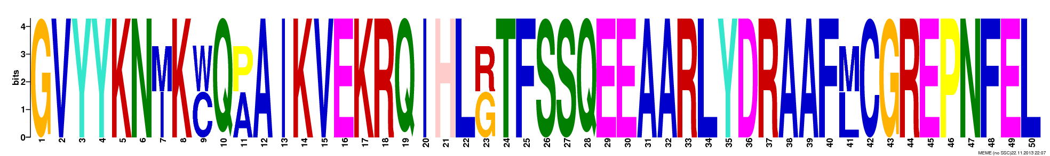
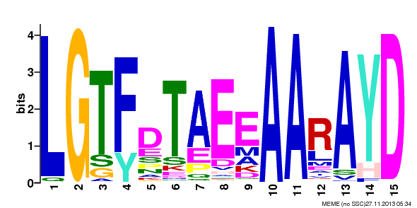
DREB
ERF
RAV
AP2
Soloist
AP2/ERF
Figure S3. Thamil Arasan et al. 2014

Slide 4
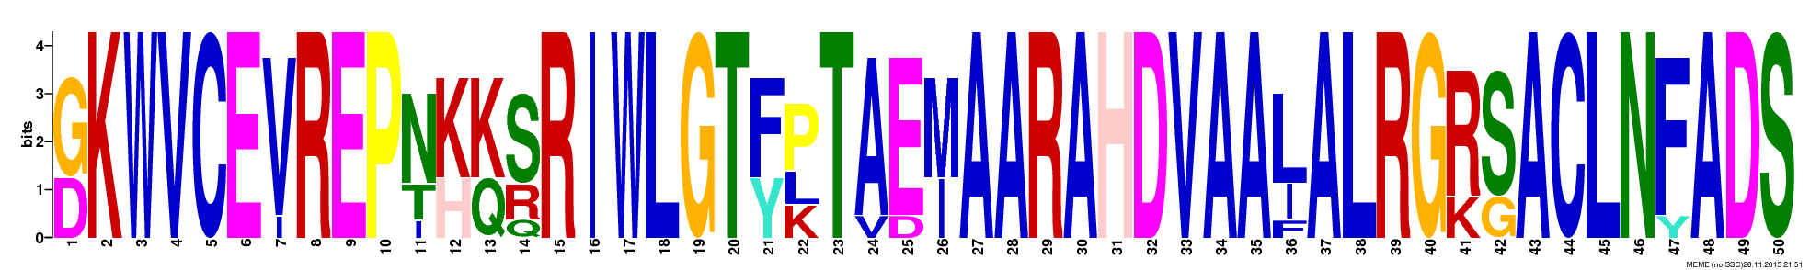
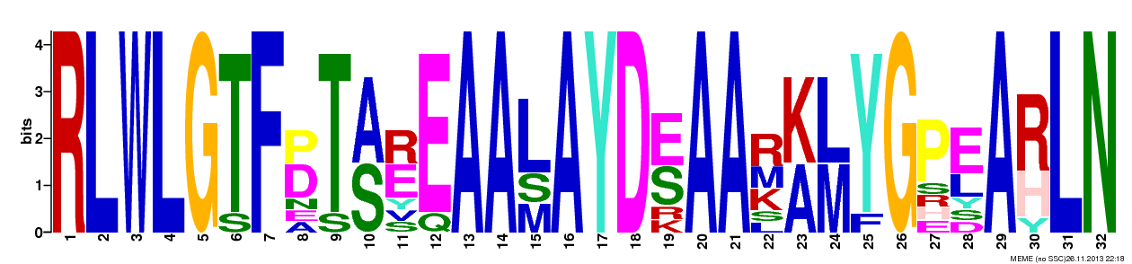
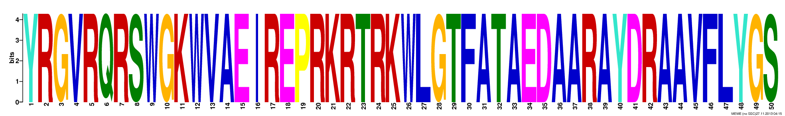
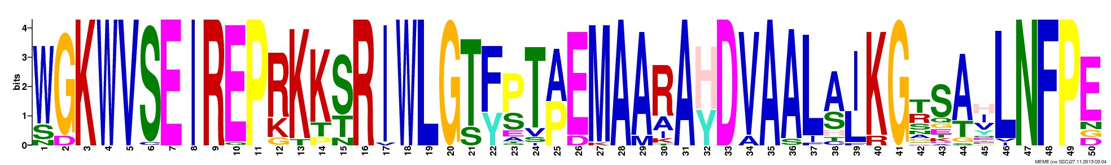
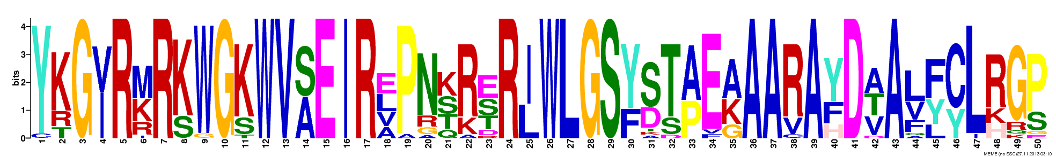
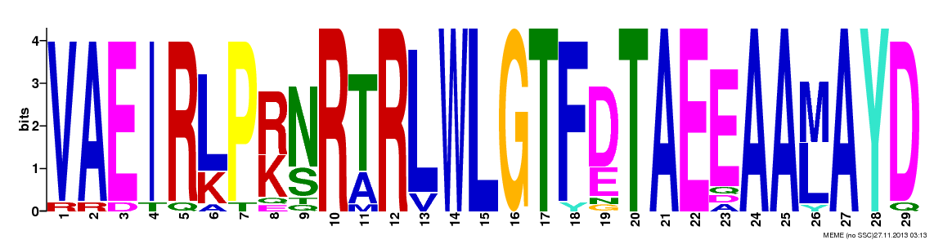
DREB-A1
DREB-A2
DREB-A3
DREB-A4
DREB-A5
DREB-A6
Figure S4. Thamil Arasan et al. 2014

Slide 5
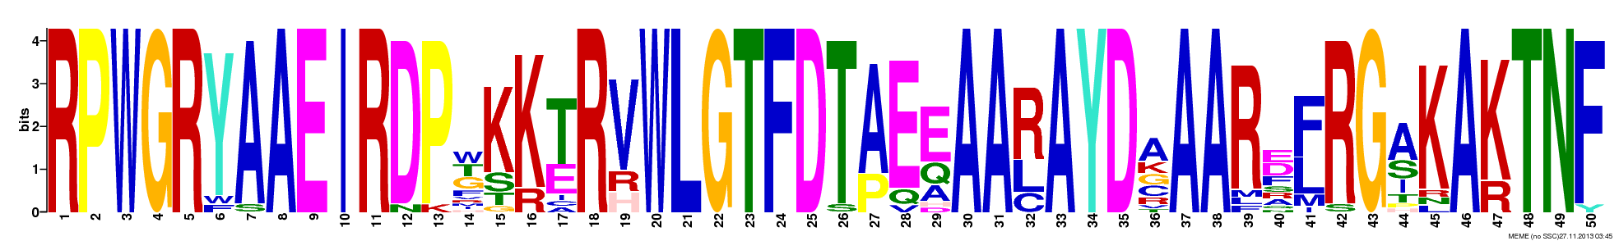
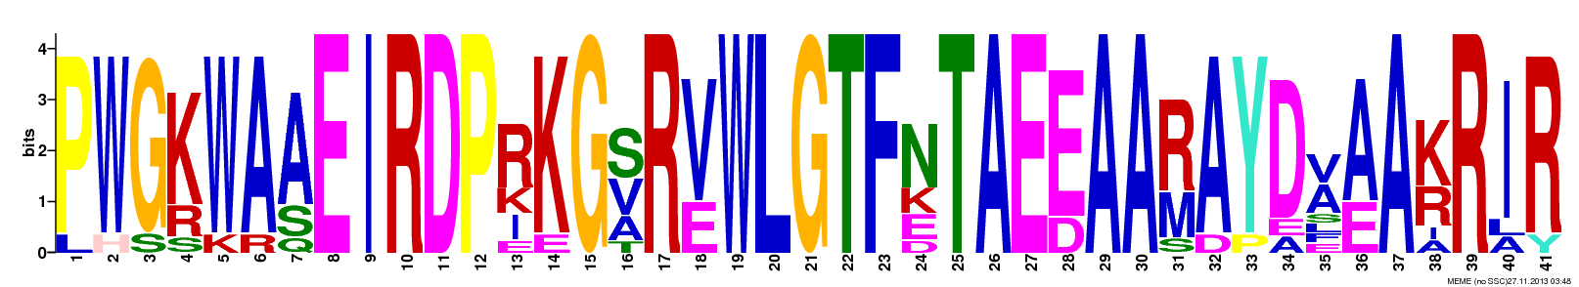
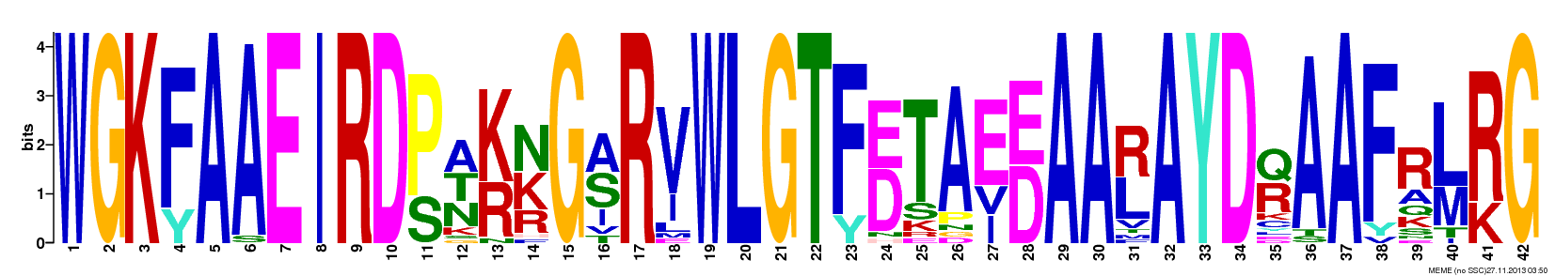
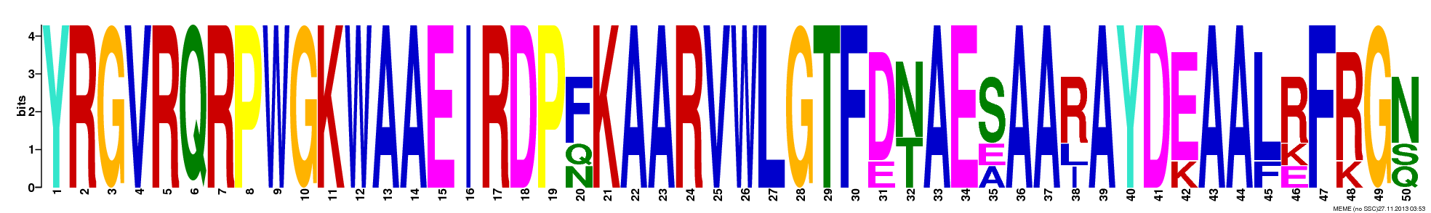
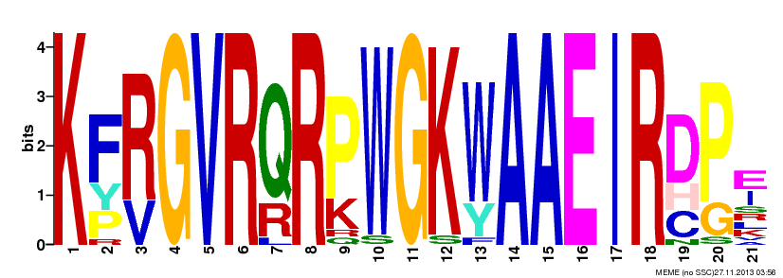
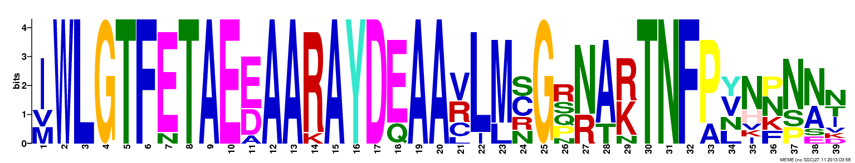
ERF-B1
ERF-B2
ERF-B3
ERF-B4
ERF-B5
ERF-B6
Figure S5. Thamil Arasan et al. 2014

Slide 6
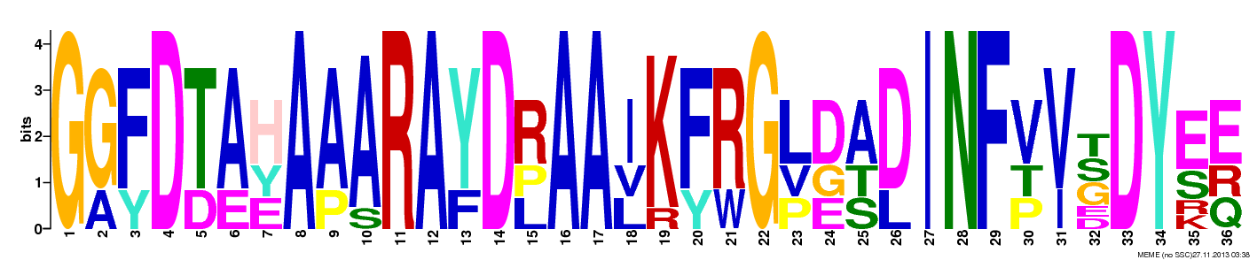
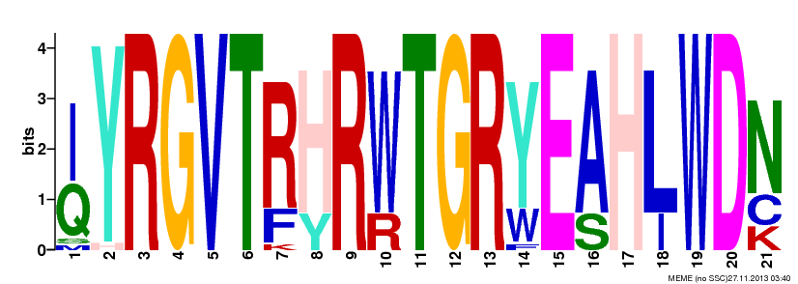
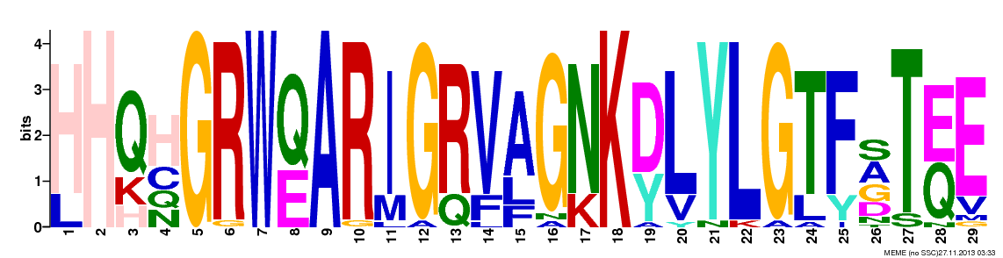
AP2
AP2-R1
AP2-R2
RAV
Soloist
Figure S6. Thamil Arasan et al. 2014

Slide 7
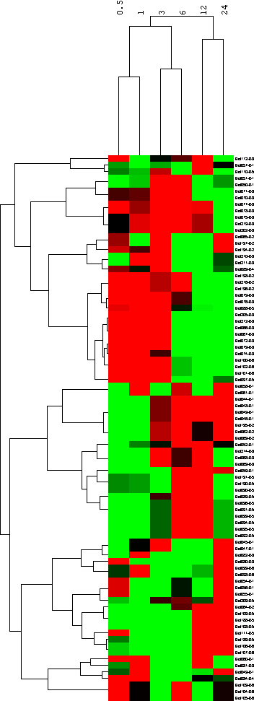

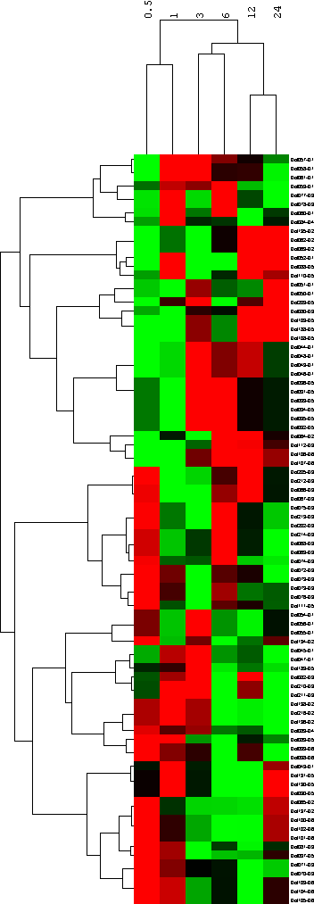
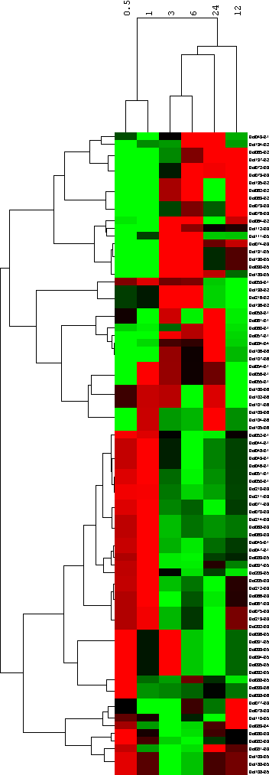
Cold
Salt
Drought
ERF subfamily
Figure S7. Thamil Arasan et al. 2014

Slide 8
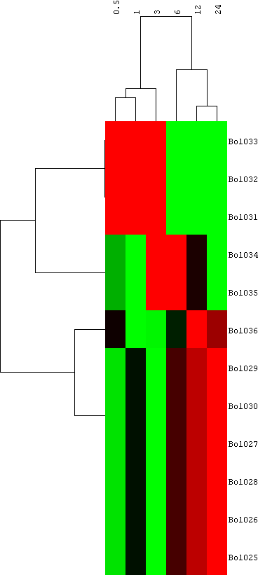
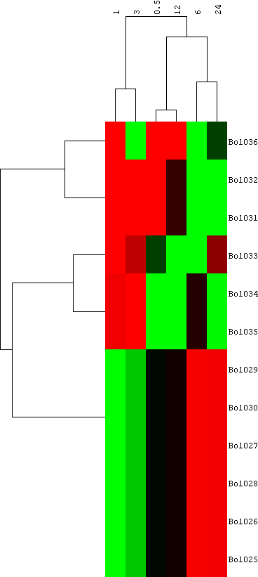
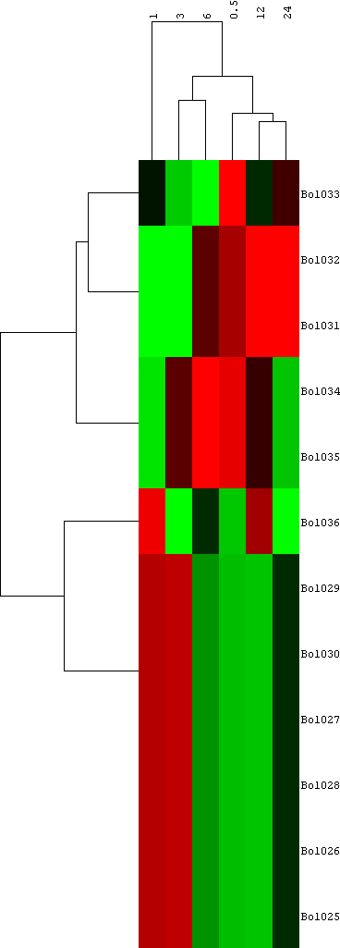
RAV subfamily
Cold
Salt
Drought
Figure S8. Thamil Arasan et al. 2014

Slide 9
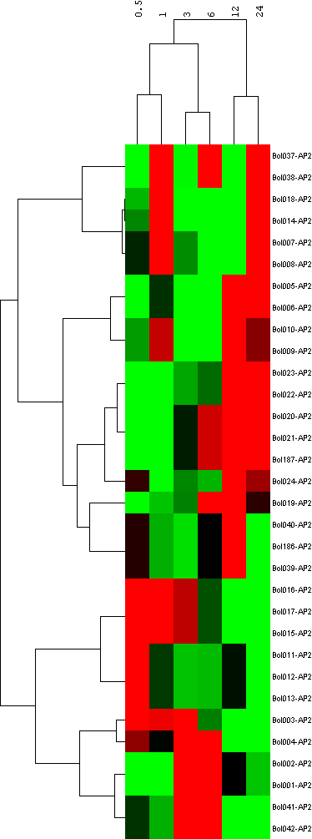
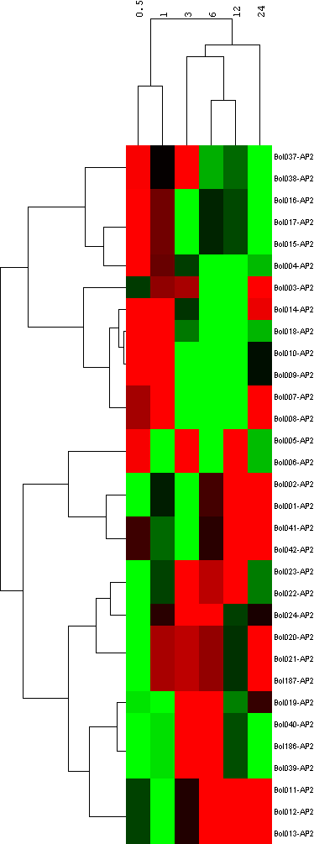
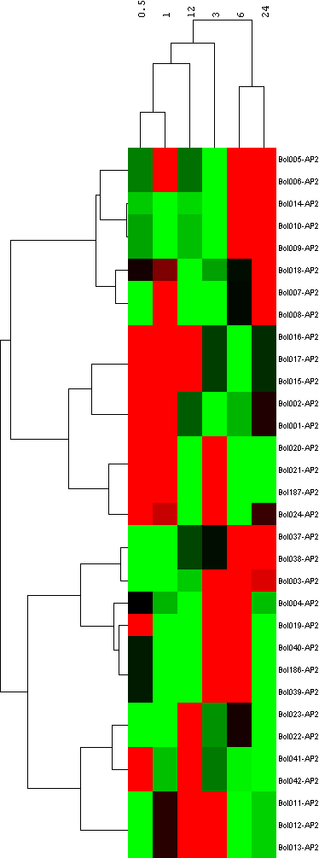
AP2 subfamily
Cold
Salt
Drought
Figure S9. Thamil Arasan et al. 2014

Slide 10
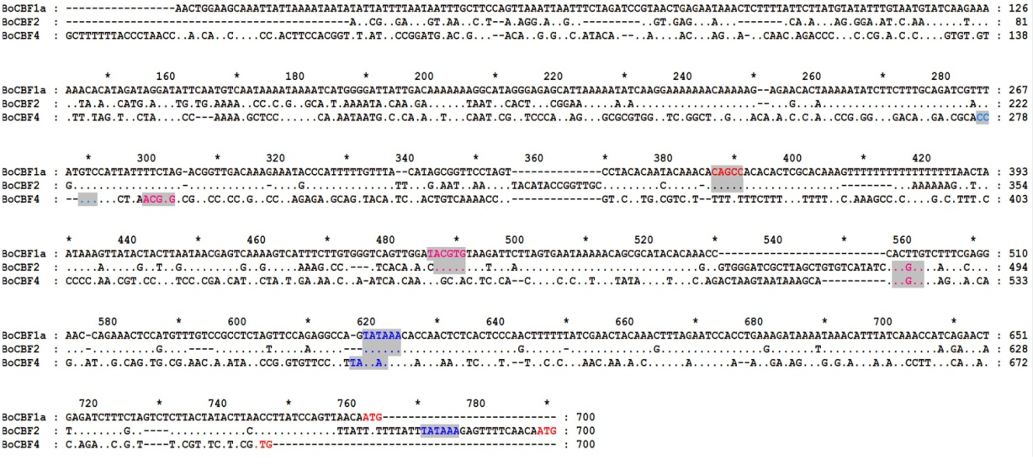
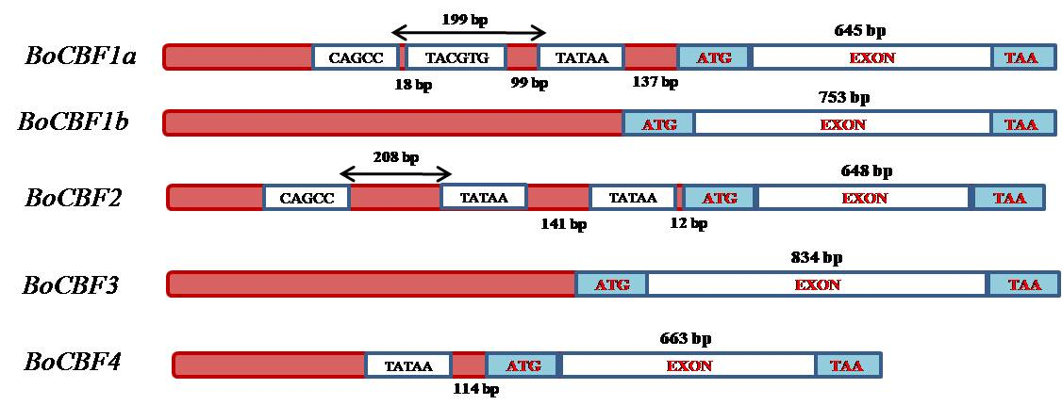
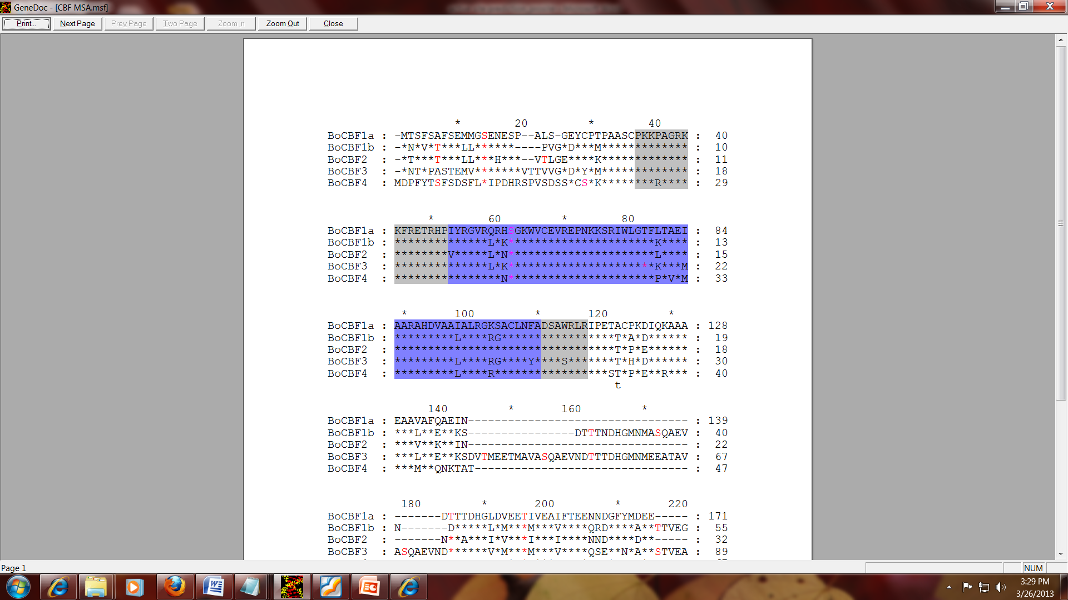
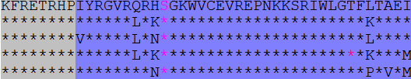




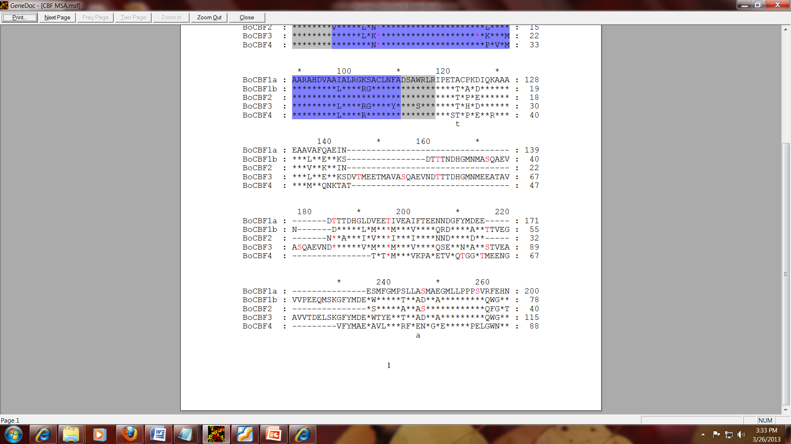
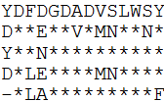

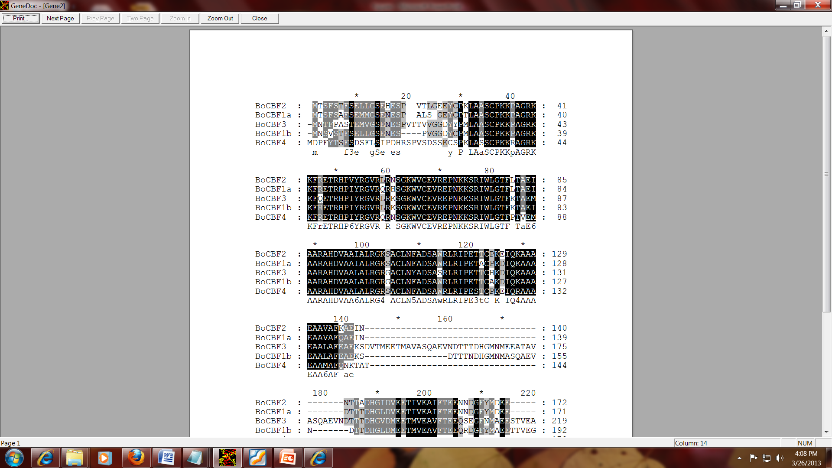
a)
b)
c)
e)
a
AP2
BoCBF1a
BoCBF1b
b
BoCBF2
BoCBF3
BoCBF4
d)
YRG element
RAYD element
Strand 1
Strand 2
Strand 3
α- helix
Figure S10. Thamil Arasan et al. 2014
Notes:
a. Alignment of the 5’ upstream sequences of BoCBF1a, BoCBF2, and BoCBF4. Seven hundred basepairs of the 5’-untranslated region of BoCBF1a were aligned with 700 and 700 bases of the corresponding regions of BoCBF2 and BoCBF4. Dots indicate nucleotides identical to the BoCBF1a sequence. Hyphens indicate gaps inserted in the sequences for better alignment. The initiation ATGs and putative TATA boxes (TATAAA) are double underlined. CANNTG motifs and related sequences CACGTC and TACGTG are shown in gray boxes with pink color. Black boxes highlight the CAGCC pentamers with red color. b. Gene structure of BoCBF family genes. c. Amino acid sequences alignment of BoCBF1a, BoCBF1b, BoCBF2, BoCBF3 and BoCBF4 proteins, residues identical to the BoCBF1a sequence at a given position are indicated by asterisks. Points represent gaps inserted in the sequences for better alignment. Grey boxes correspond to the potential nuclear localization signals. Blue boxes highlight the AP2 domains. Red color amino acids indicate potential recognition sites for protein kinase C (●) and casein kinase II (♦). d. Comparison of the AP2 domains from BoCBF1a, BoCBF1b, BoCBF2, BoCBF3 and BoCBF4 proteins and the Arabidopsis ethylene-responsive element-binding protein AtEBP [48]. Identical amino acids are highlighted in black boxes. Points represent gaps inserted in the sequences for better alignment. Residues belonging to the conserved AP2 domain elements YRG and RAYD [49] are indicated. Amino acids in the RAYD conserved element predicted to form an amphipatic a-helix that might promote DNA binding [48] are underlined. e. Prediction of secondary structures of BoCBF genes helix, turn, strand, and coil were indicated in line with decreased length in turn, respectively.

