Slide 1
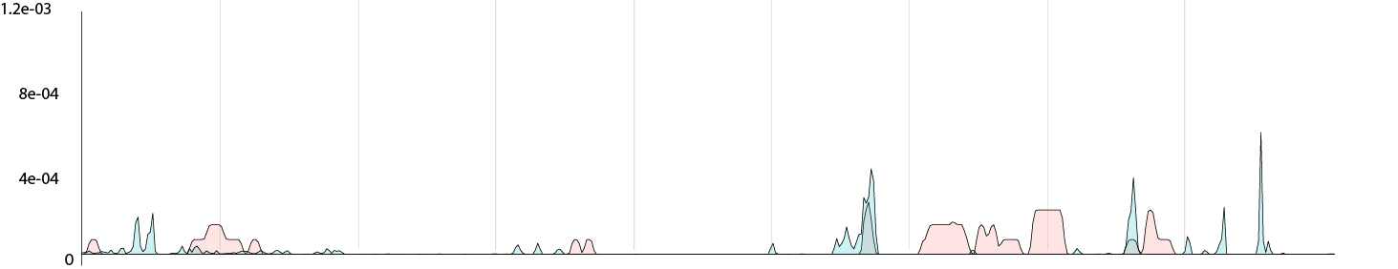
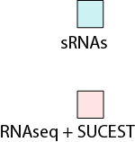
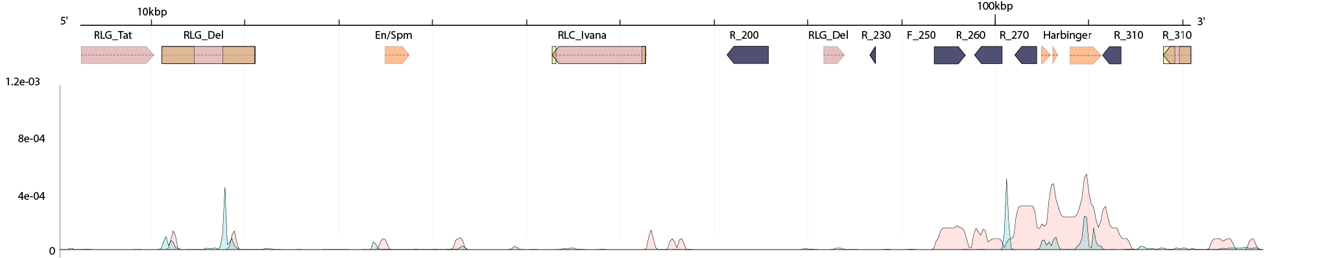
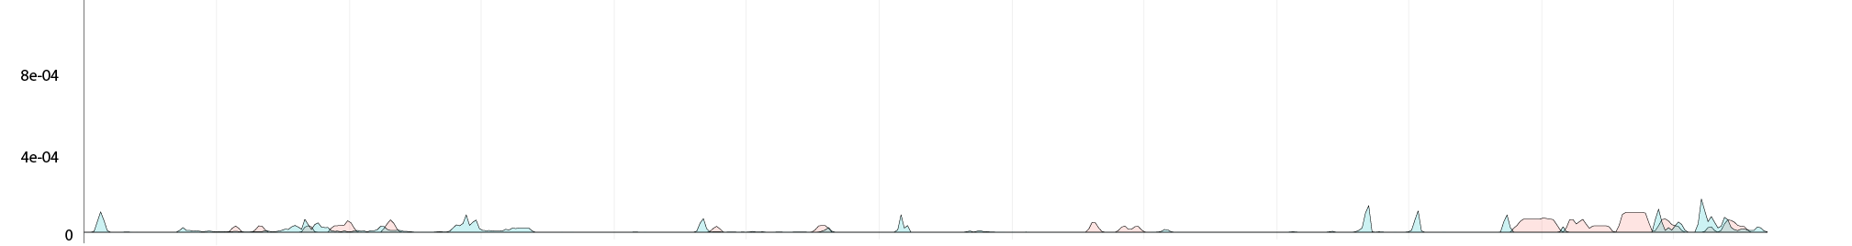
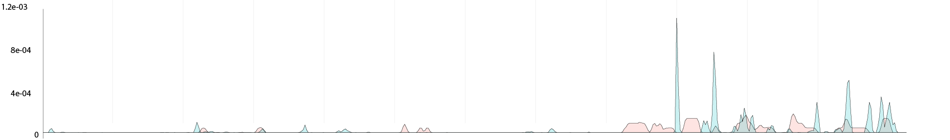
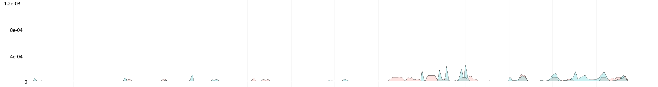
de Setta et al, Figure 7B
SHCRBa_035_B09
sRNA
RNAseq + EST
1
2
3
4
5
6
LTR retrotransposons
SHCRBa_196_O13
DNA transposons
Genes
i.
RPA1a
Harbinger transposons
SHCRBa_101_B12
ii.
10 kb
i.
SHCRBa_201_D09
i.
ii.
SHCRBa_232_H22
ii.
i.

