Slide 1
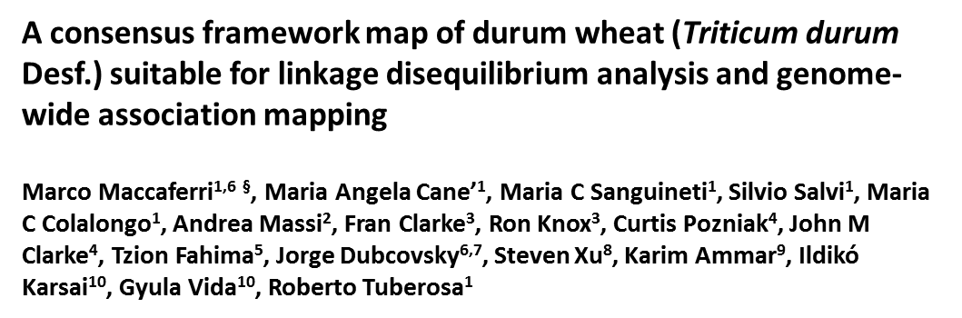
Additional file 3 – Figure S2 Projection plots of the six core component maps on the consensus
The core component linkage group maps are reported in the X axes of the projection plots while the consensus map is reported in the Y axes. Spearman rank correlations are reported as ro (ρ) coefficients.

Slide 2
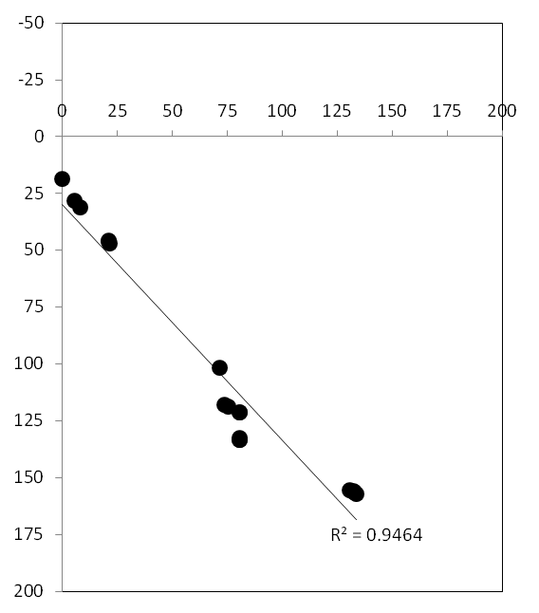
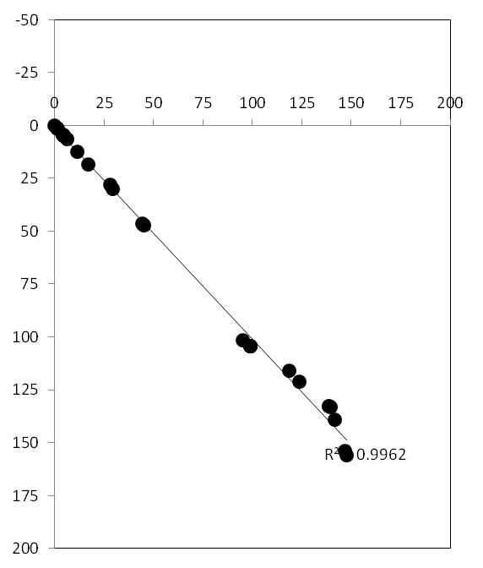
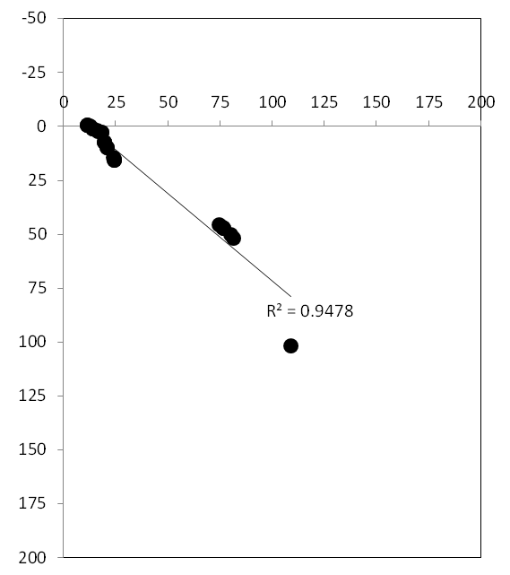
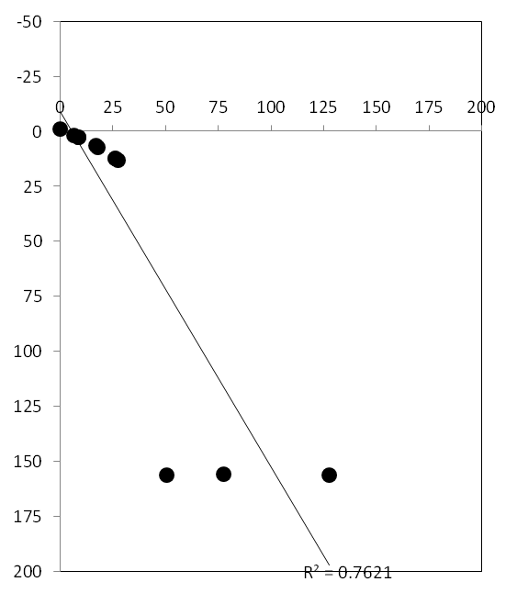
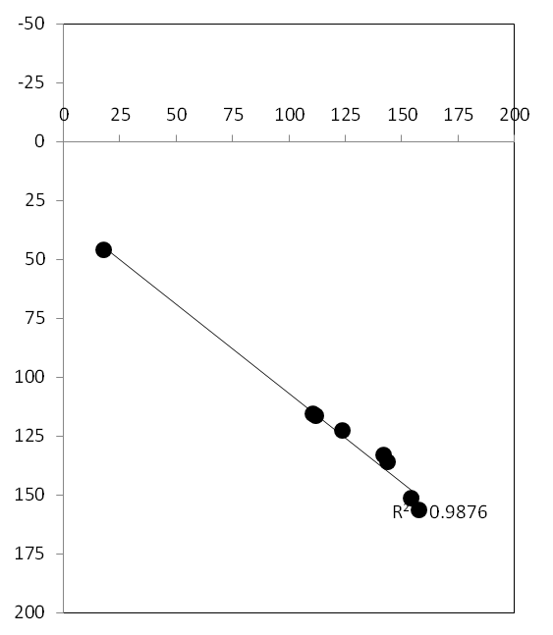
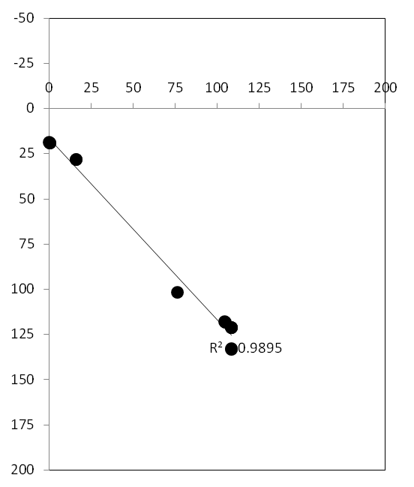
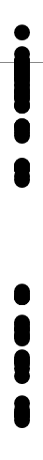
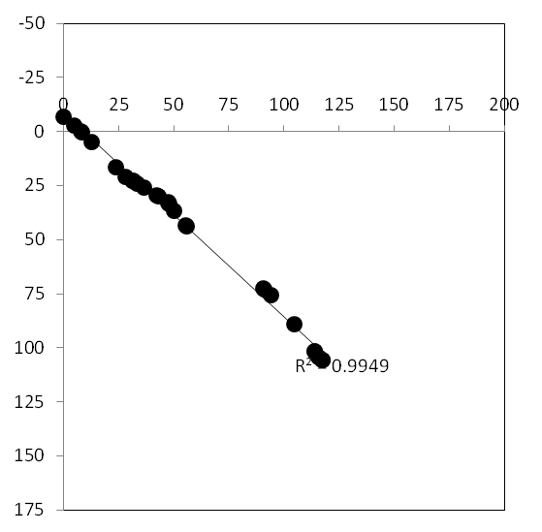
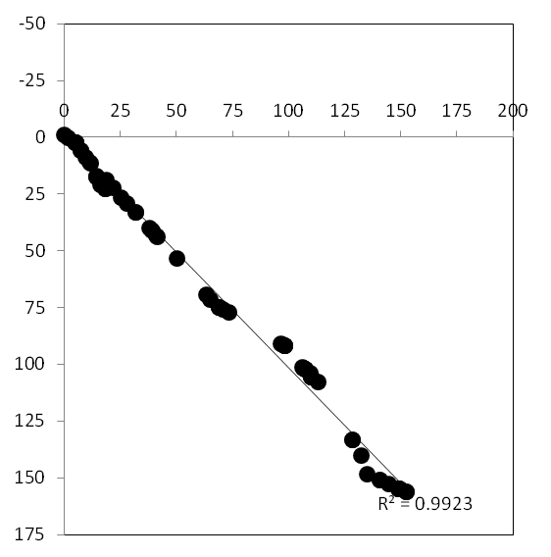
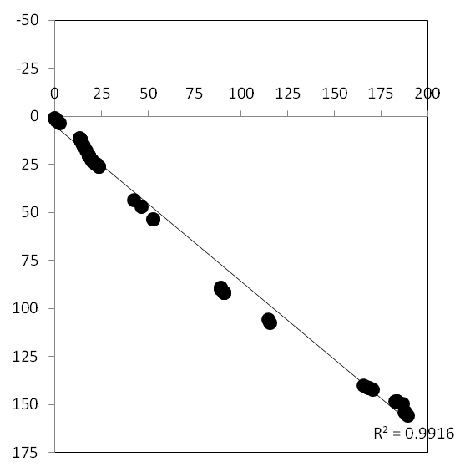
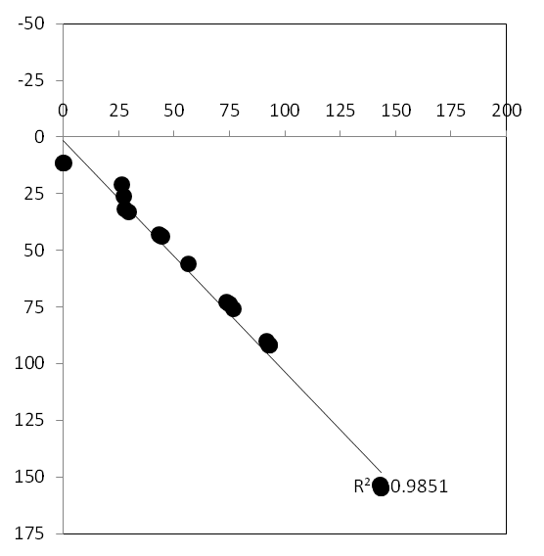
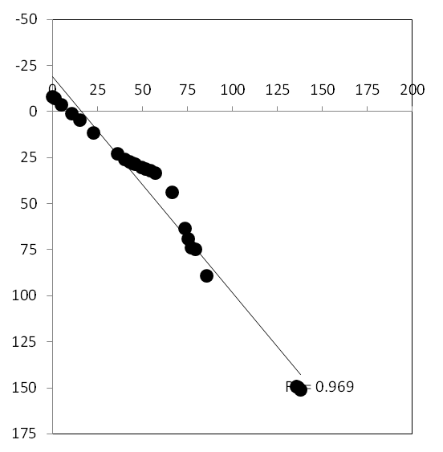
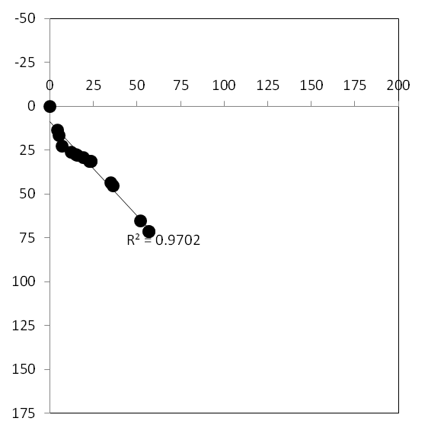
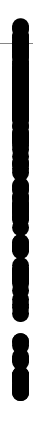
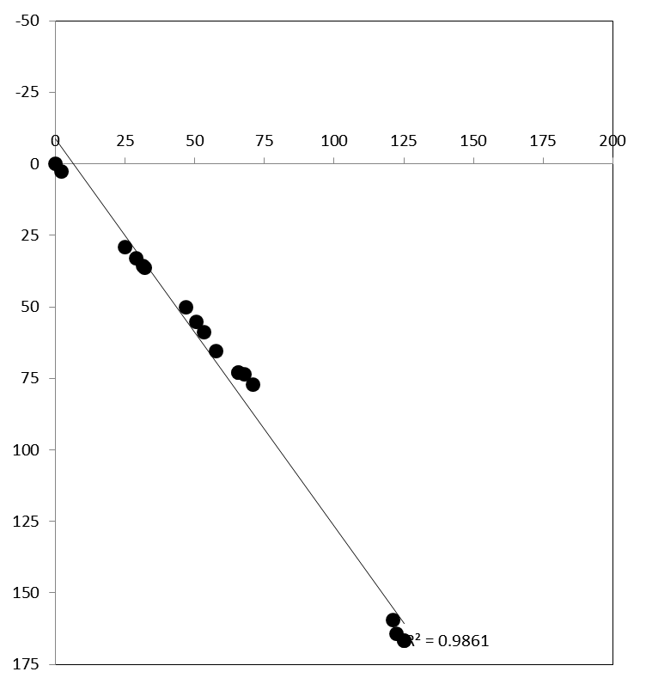
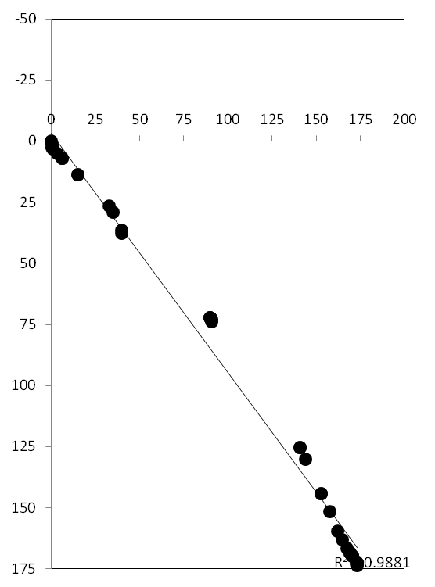
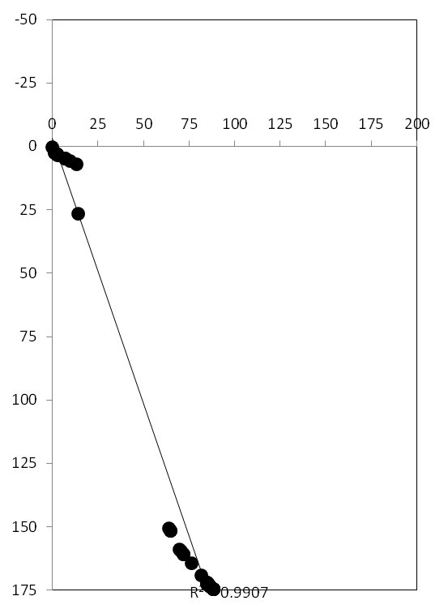
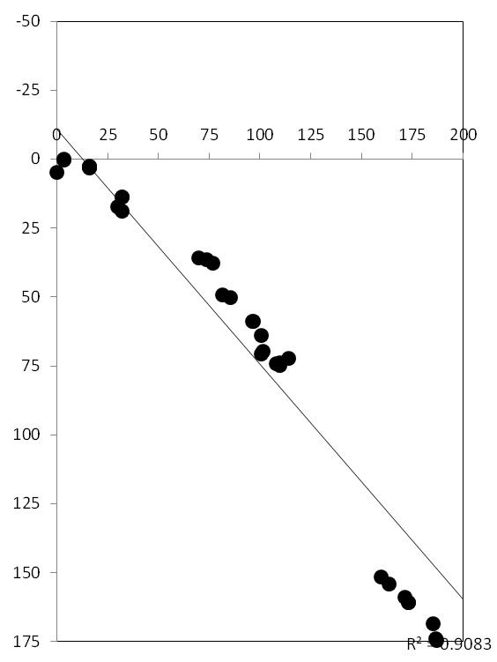
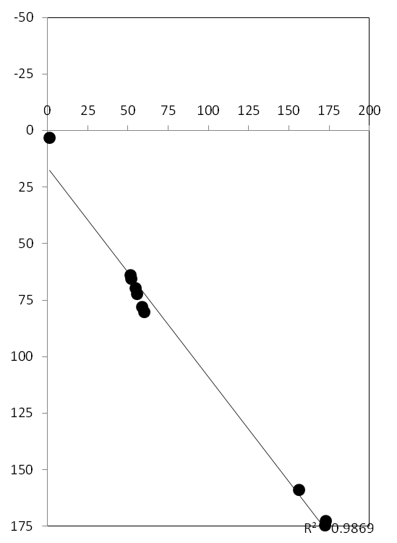
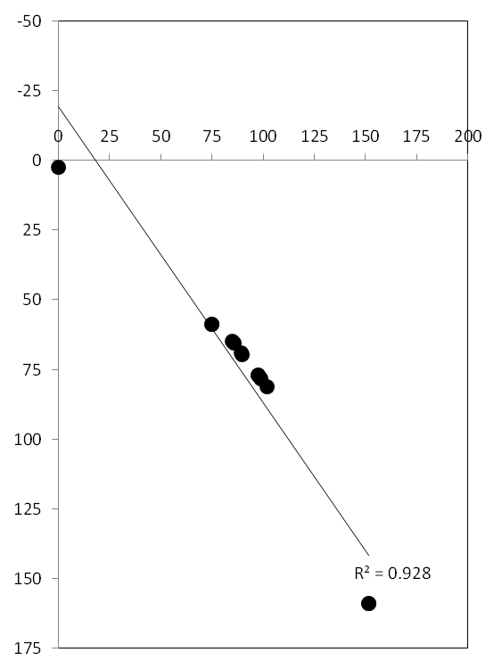
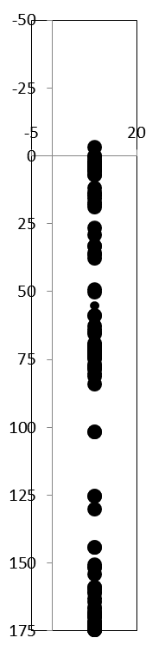
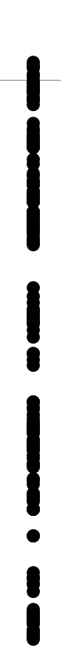
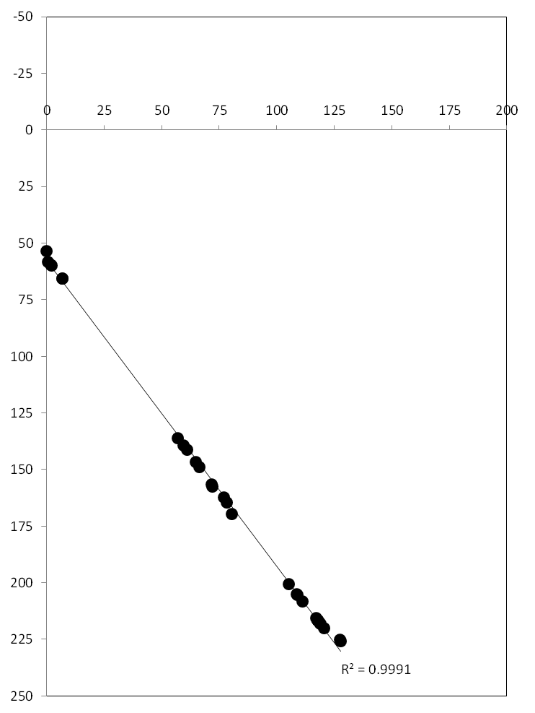
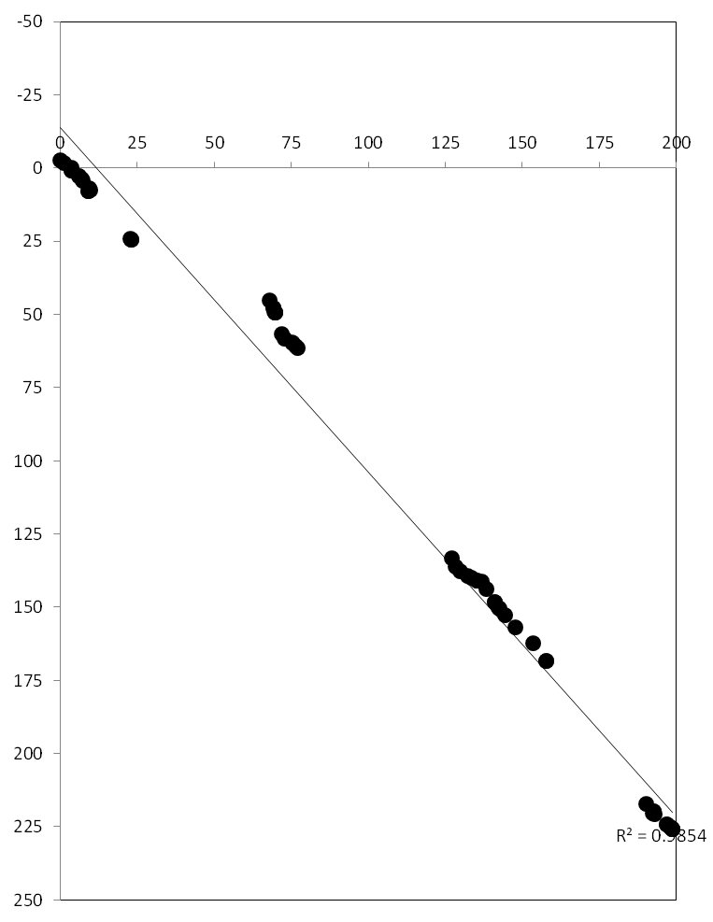
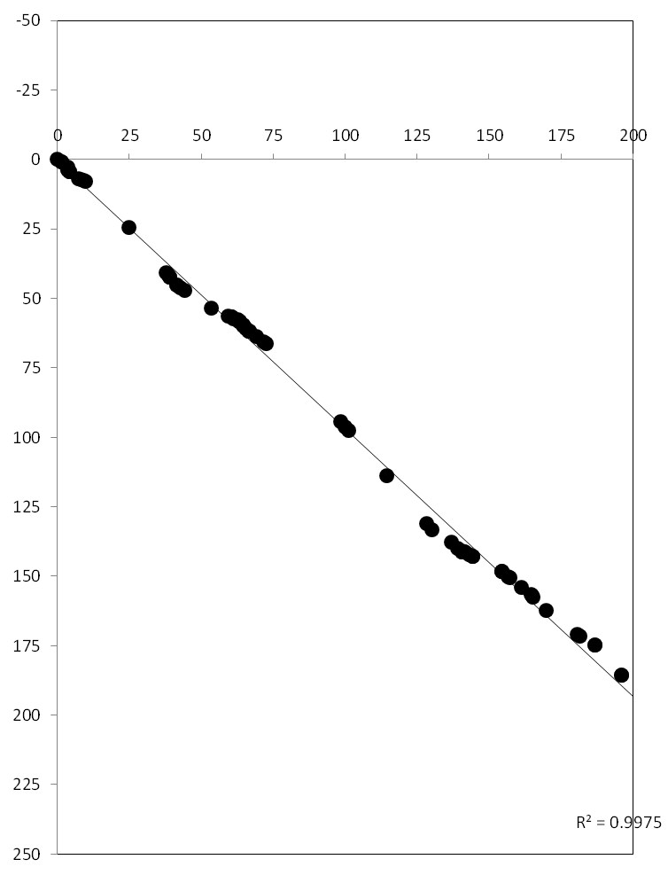
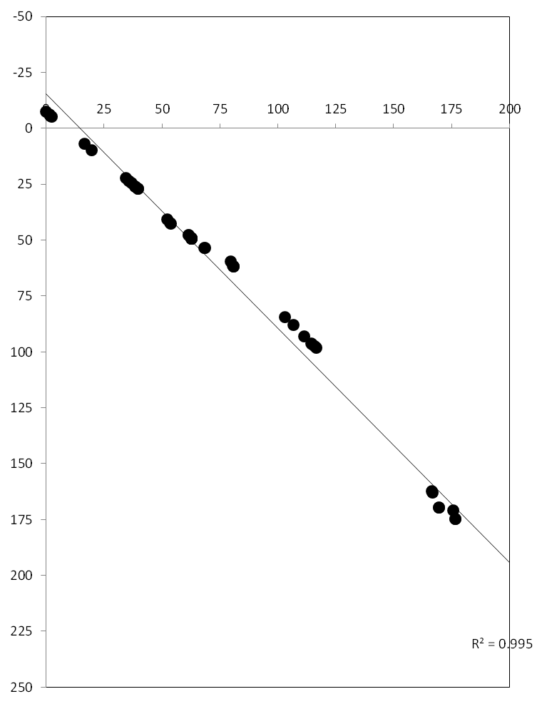
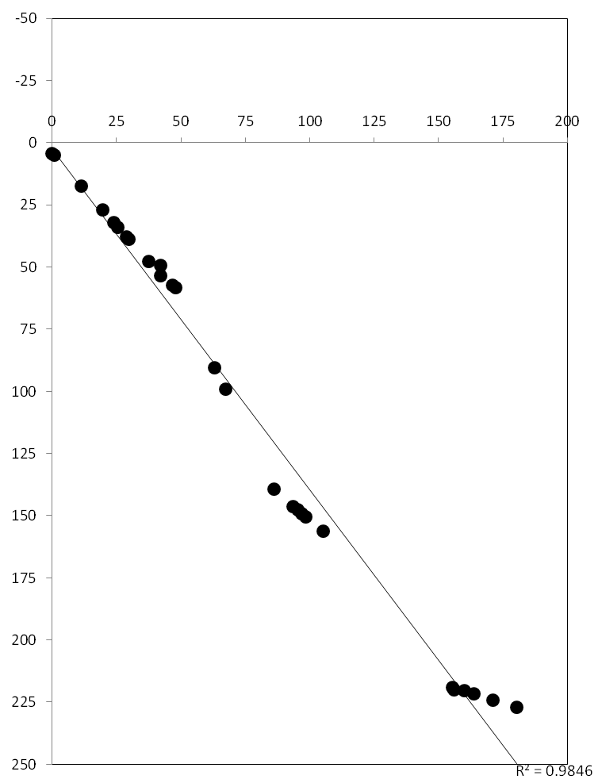
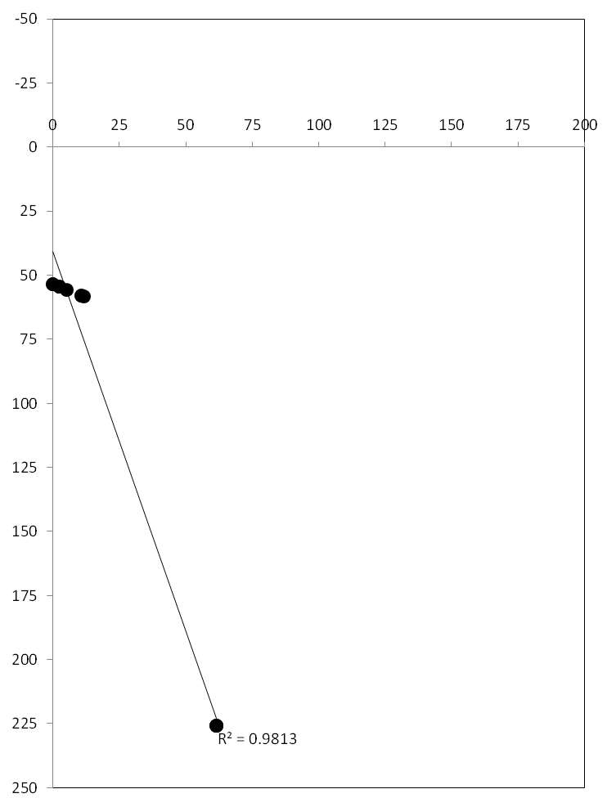
Kf x Sv
Co x Ll
Mr x Cl
Sm x Lv
Lg x G18-16
Kf x UC
Chr. 1A
ρ = 0.994
ρ = 0.998
ρ = 0.997
ρ = 0.988
ρ = 1.000
ρ = 0.978
Chr. 1B
ρ = 0.999
ρ = 0.998
ρ = 0.999
ρ = 1.000
ρ = 1.000
ρ = 1.000
Chr. 2A
ρ = 1.000
ρ = 0.998
ρ = 0.998
ρ = 0.929
ρ = 0.988
ρ = 1.000
Chr. 2B
ρ = 1.000
ρ = 0.999
ρ = 0.999
ρ = 0.999
ρ = 0.999
ρ = 1.000

Slide 3
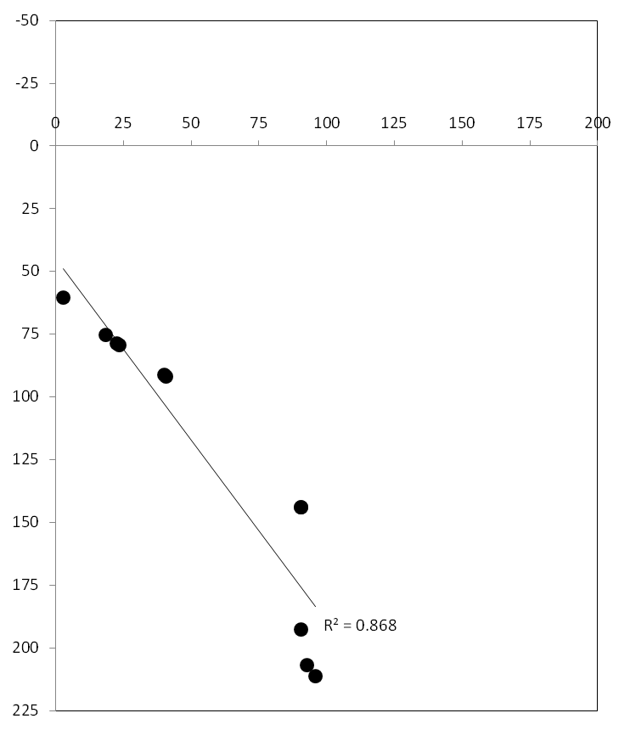
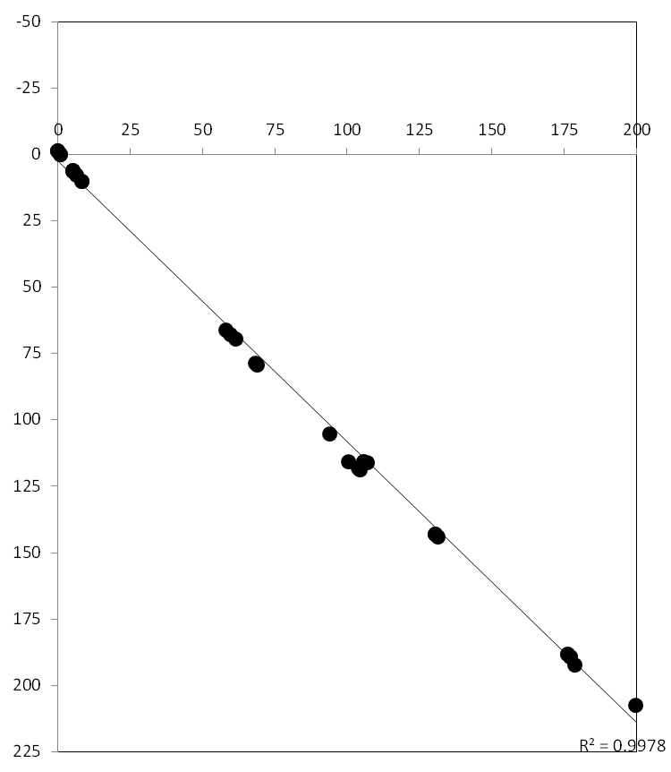
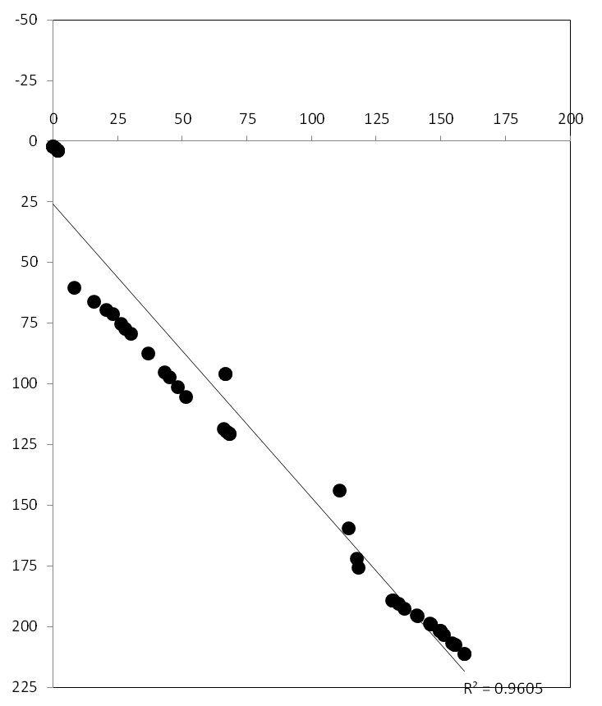
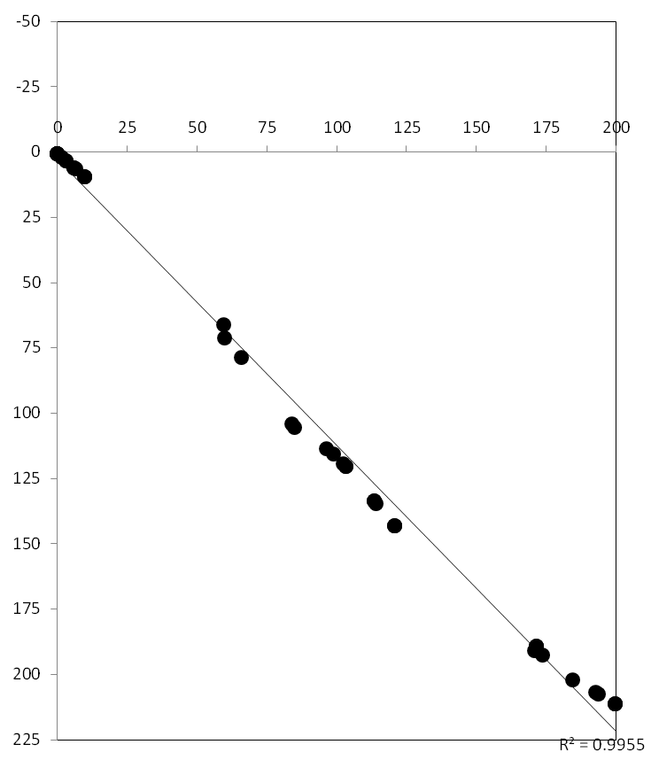
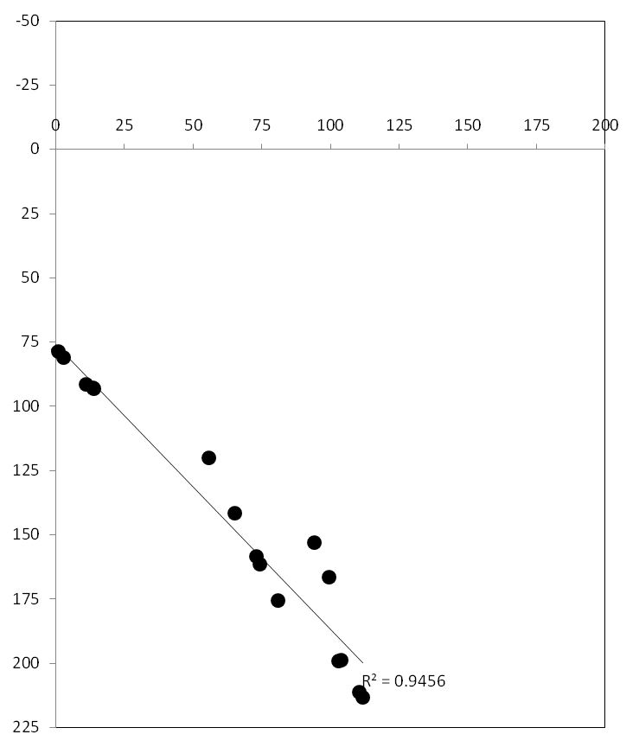
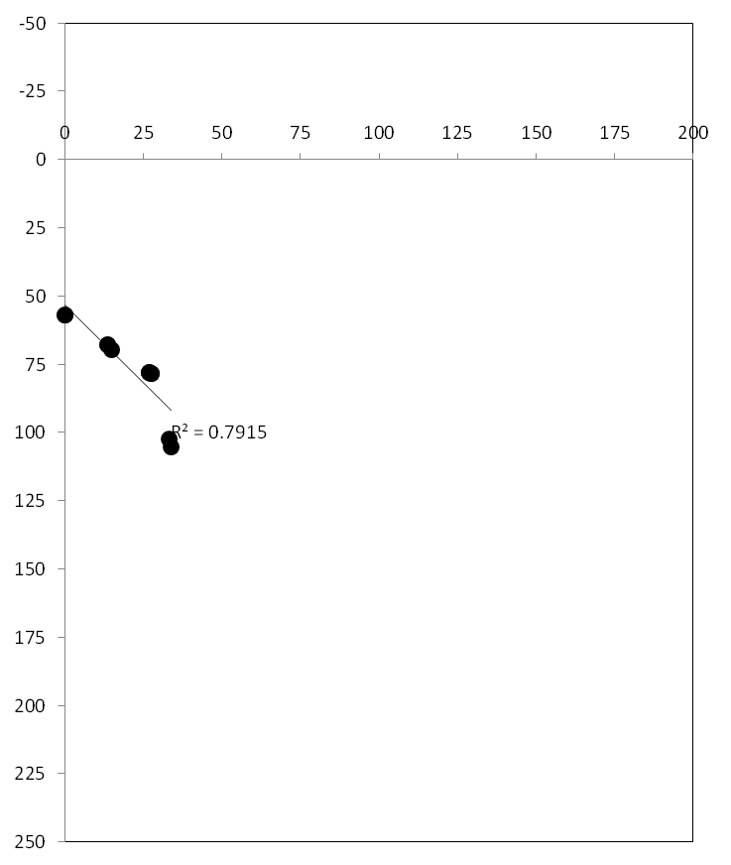
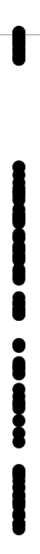
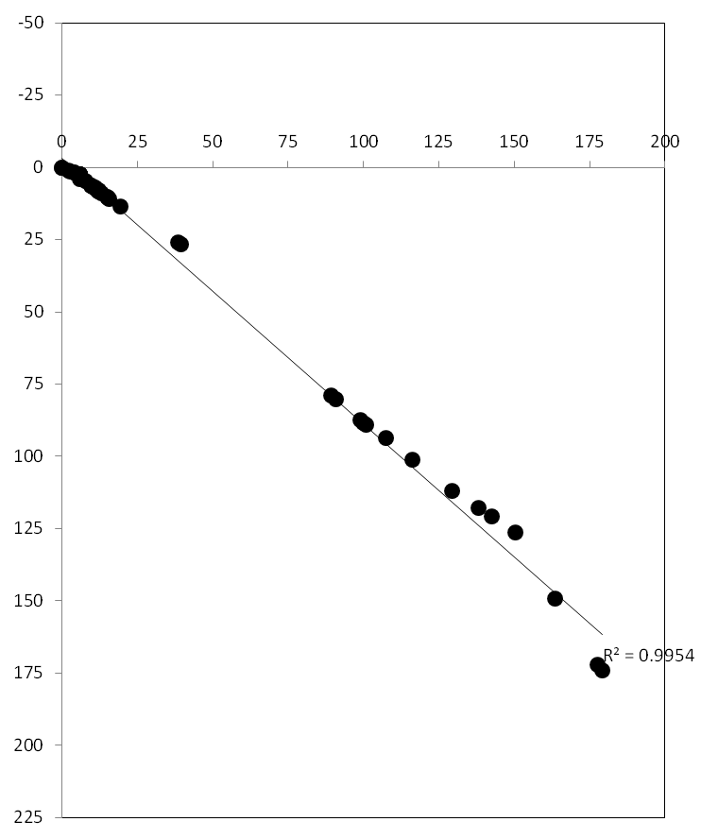
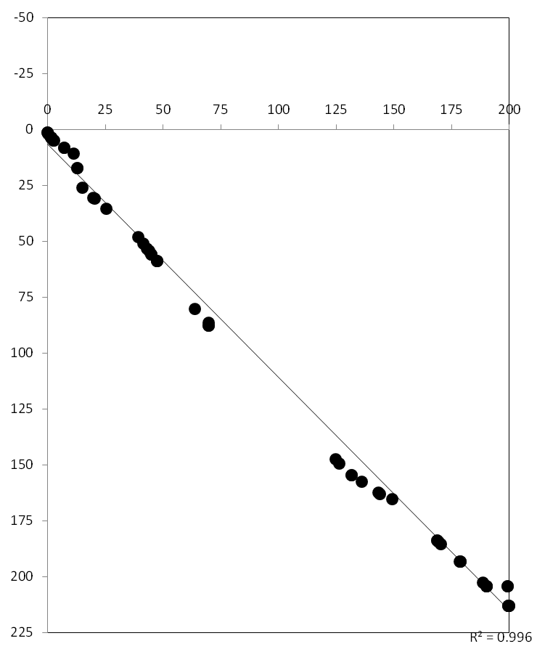
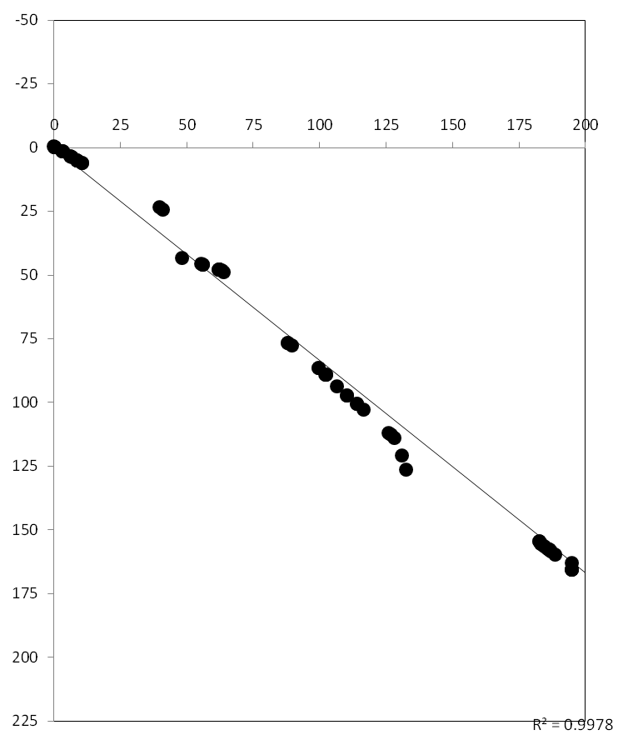
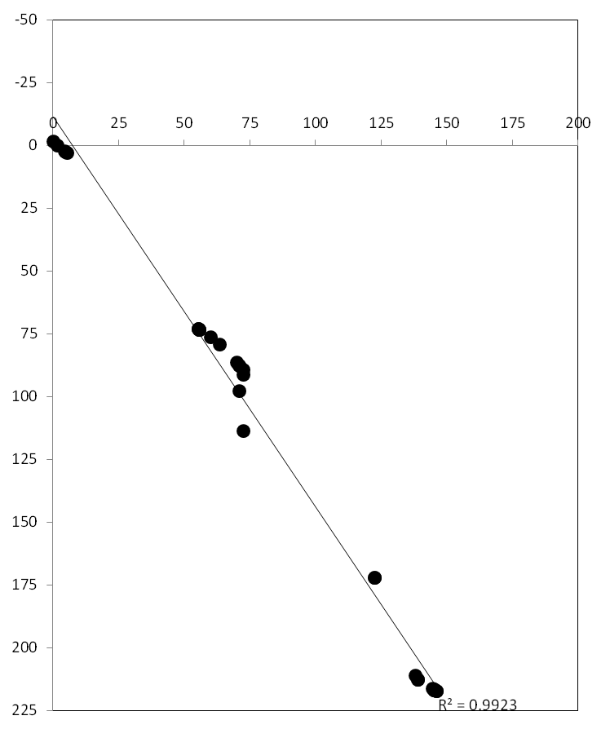
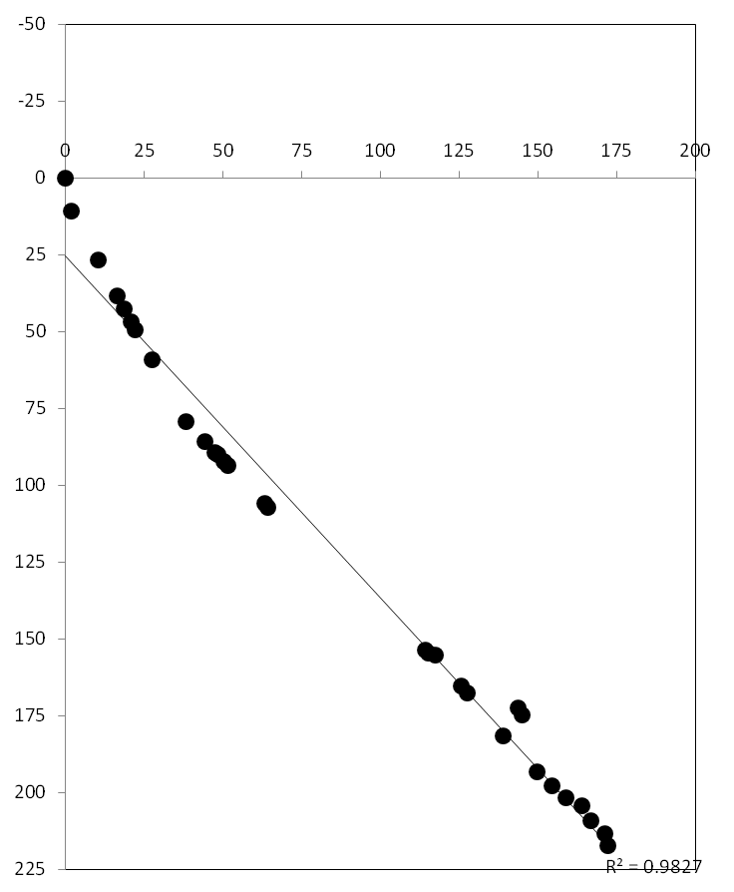
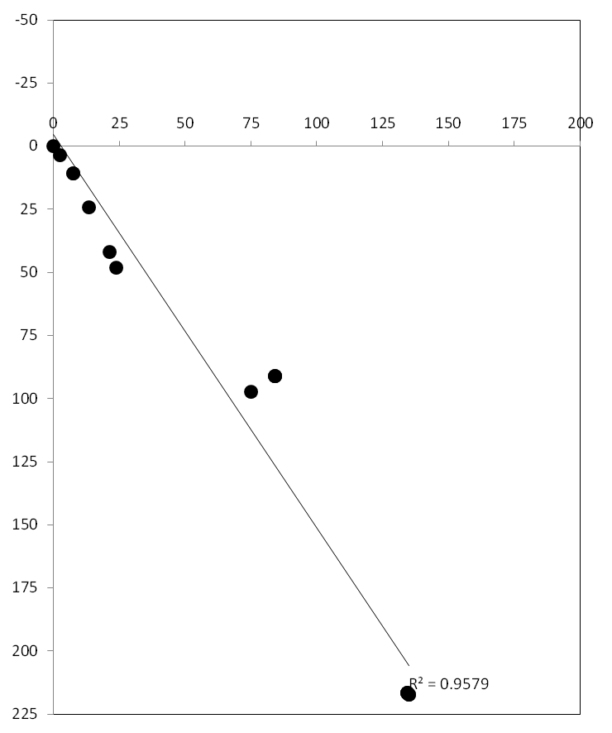
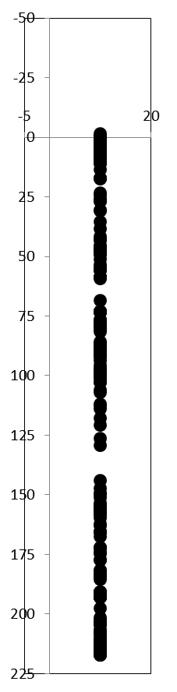
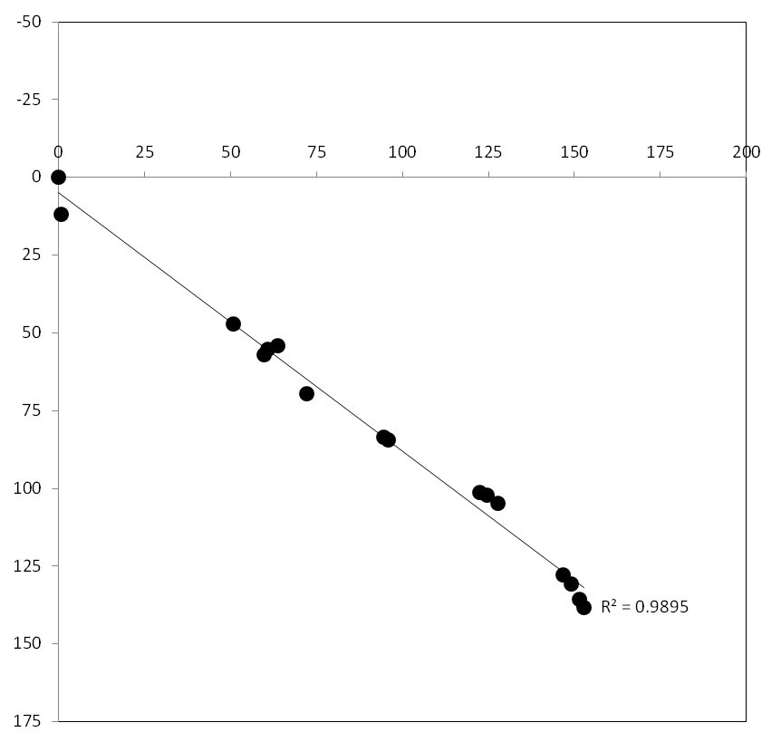
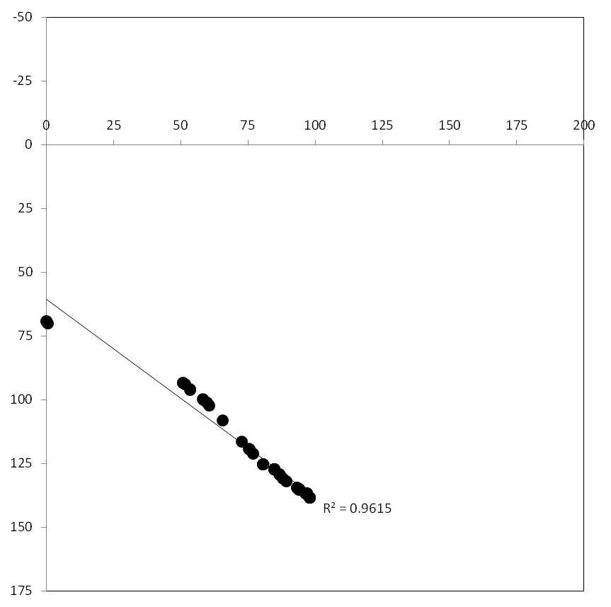
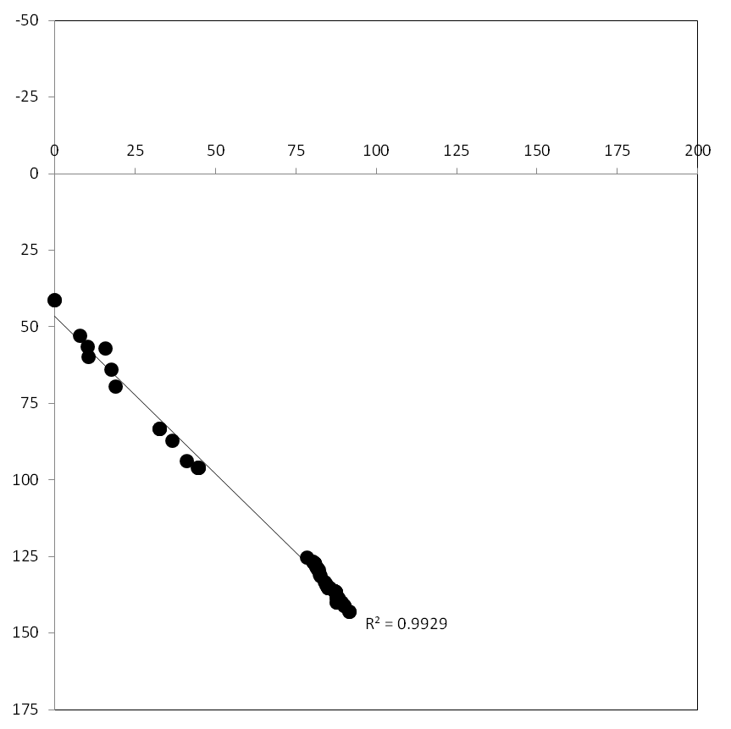
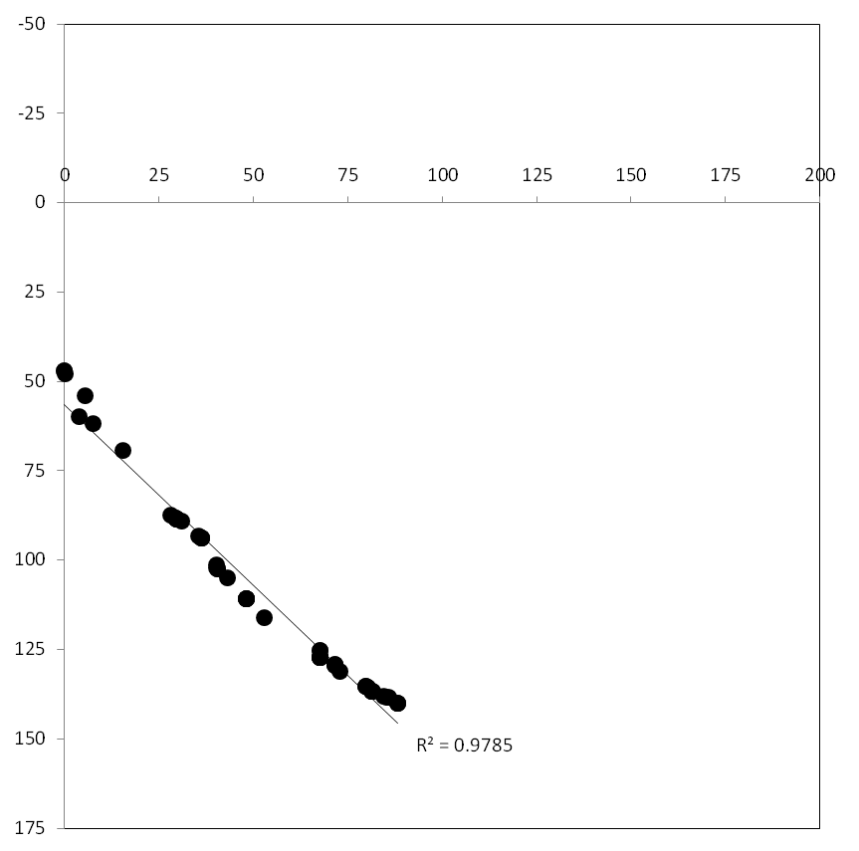
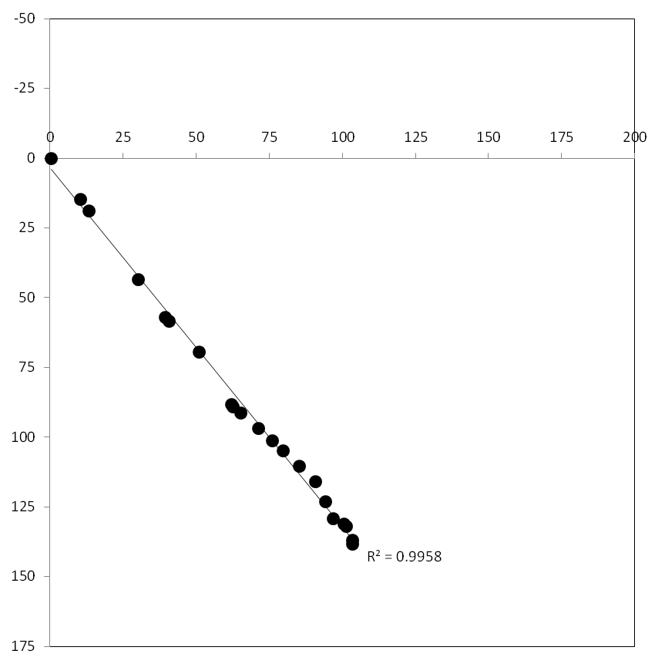
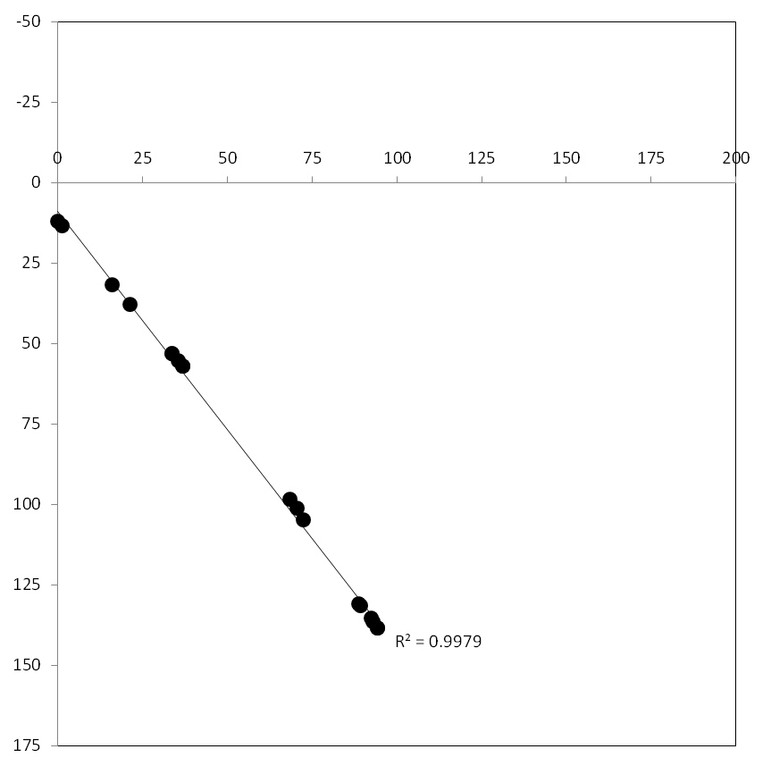
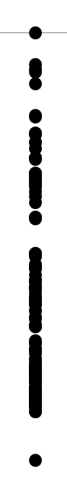







Kf x Sv
Co x Ll
Mr x Cl
Sm x Lv
Lg x G18-16
Kf x UC
Chr. 3A
ρ = 0.993
ρ = 0.994
ρ = 0.998
ρ = 0.999
ρ = 0.978
ρ = 1.000
Chr. 3B
ρ = 0.999
ρ = 0.998
ρ = 0.997
ρ = 0.996
ρ = 0.999
ρ = 0.985
Chr. 4A
ρ = 0.988
ρ = 0.999
ρ = 0.999
ρ = 0.999
ρ = 0.999
ρ = 1.000
Chr. 4B
ρ = 1.000
ρ = 0.999
ρ = 0.996
ρ = 0.999
ρ = 1.000
ρ = 0.999

Slide 4




























Kf x Sv
Co x Ll
Mr x Cl
Sm x Lv
Lg x G18-16
Kf x UC
Chr. 5A
ρ = 1.000
ρ = 0.996
ρ = 0.999
ρ = 0.999
ρ = 1.000
ρ = 1.000
Chr. 5B
ρ = 0.998
ρ = 0.992
ρ = 0.998
ρ = 0.996
ρ = 1.000
ρ = 0.982
Chr. 6A
ρ = 1.000
ρ = 0.997
ρ = 0.996
ρ = 0.999
ρ = 0.999
ρ = 0.999
ρ = 0.997
ρ = 0.999
ρ = 0.999
ρ = 0.999
ρ = 1.000
ρ = 0.998
Chr. 6B

Slide 5














Kf x Sv
Co x Ll
Mr x Cl
Sm x Lv
Lg x G18-16
Kf x UC
ρ = 0.993
ρ = 0.999
ρ = 0.997
ρ = 0.995
ρ = 1.000
ρ = 0.998
Chr. 7A
Chr. 7B
ρ = 0.999
ρ = 0.999
ρ = 0.999
ρ = 0.999
ρ = 0.999
ρ = 0.999

