Slide 1
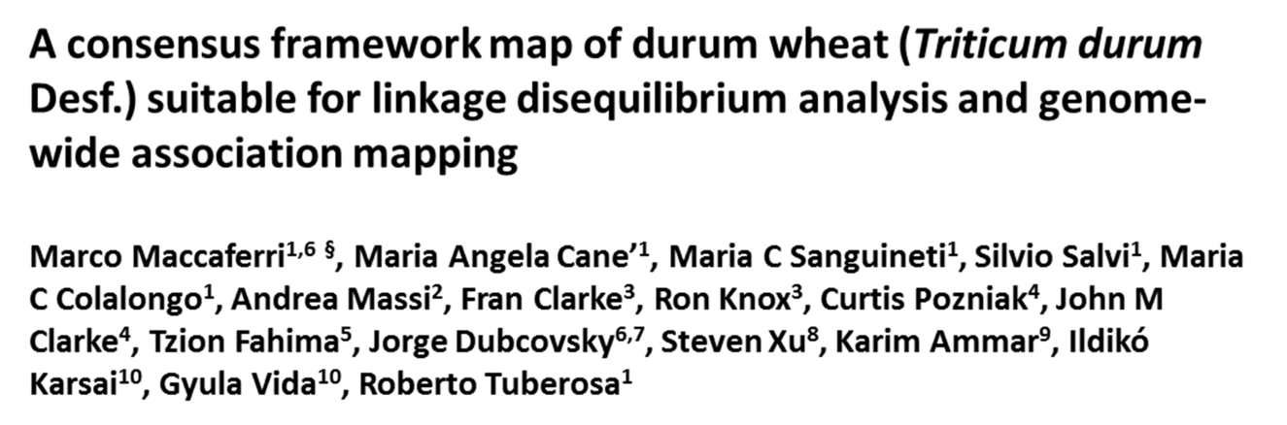
Additional file 4 – Figure S3A Projection plots of the tetraploid wheat consensus map on the hexaploid SSR reference map (Ta-SSR-2004)

Slide 2
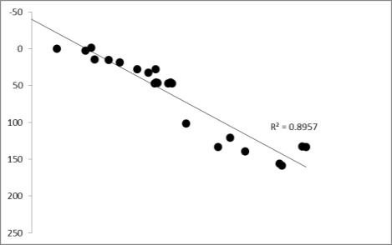
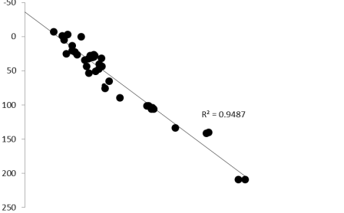
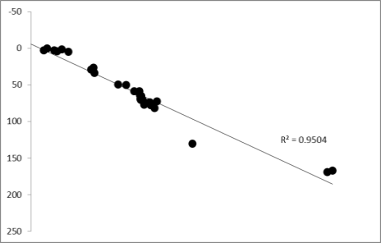
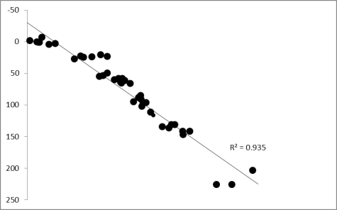
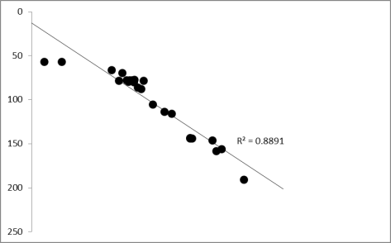
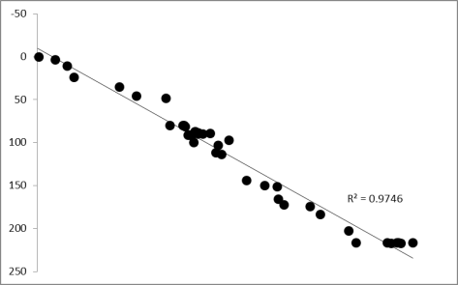
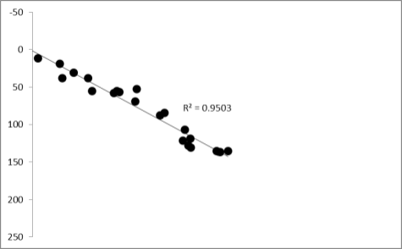
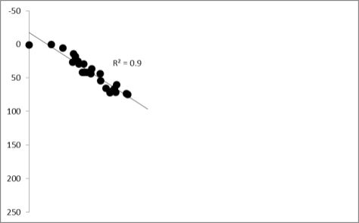
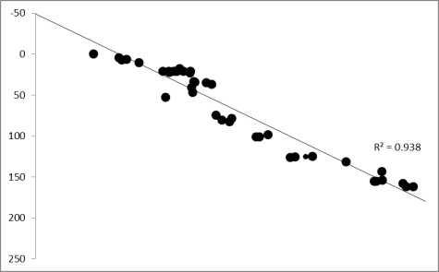
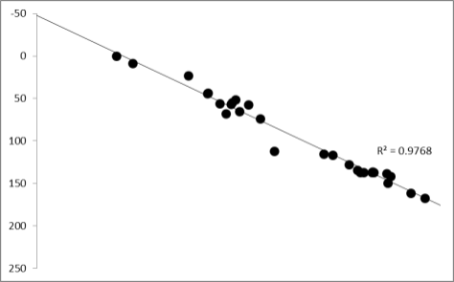
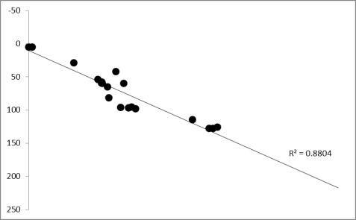
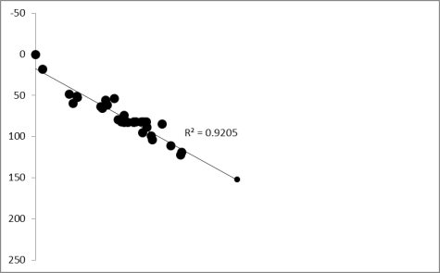
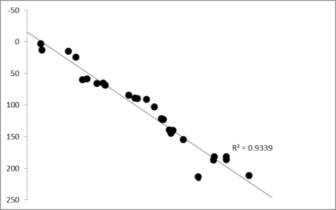
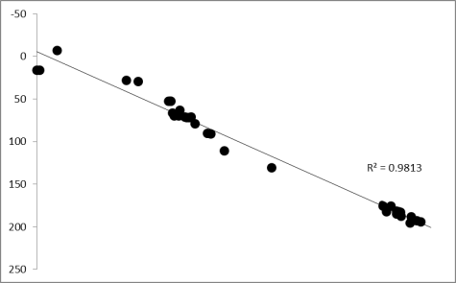
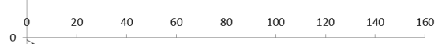
Chr. 1A
Chr. 1B
ρ = 0.956
ρ = 0.930
Chr. 2A
Chr. 2B
ρ = 0.978
ρ = 0.983
Chr. 3A
Chr. 3B
ρ = 0.921
ρ = 0.967
Chr. 4A
Chr. 4B
ρ = 0.939
ρ = 0.963
Tetraploid wheat consensus map
Chr. 5A
Chr. 5B
ρ = 0.956
ρ = 0.982
Chr. 6A
Chr. 6B
ρ = 0.931
ρ = 0.940
Chr. 7A
Chr. 7B
ρ = 0.979
ρ = 0.957
Hexaploid wheat Ta-SSR-2004 map A-genome
Hexaploid wheat Ta-SSR-2004 map B-genome

