Slide 1
Additional File 16. IPA Gene Network Analysis. Top gene networks for differentially expressed miRNAs (maturation/secretory)and their validated predicted gene target candidates were generated by IPA to show their directed interactions, with 140 (Panels A-C) and 70 (Panels D-F) molecules involved in each network.

Slide 2
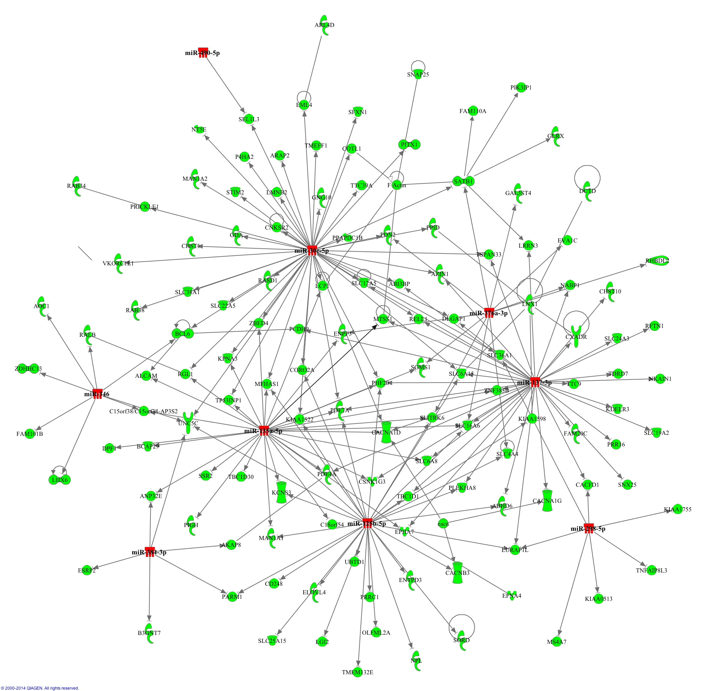
2A
Notes:
Supplemental Figure 2A. Cellular Assembly and Organization, Molecular Transport, Amino Acid Metabolism

Slide 3
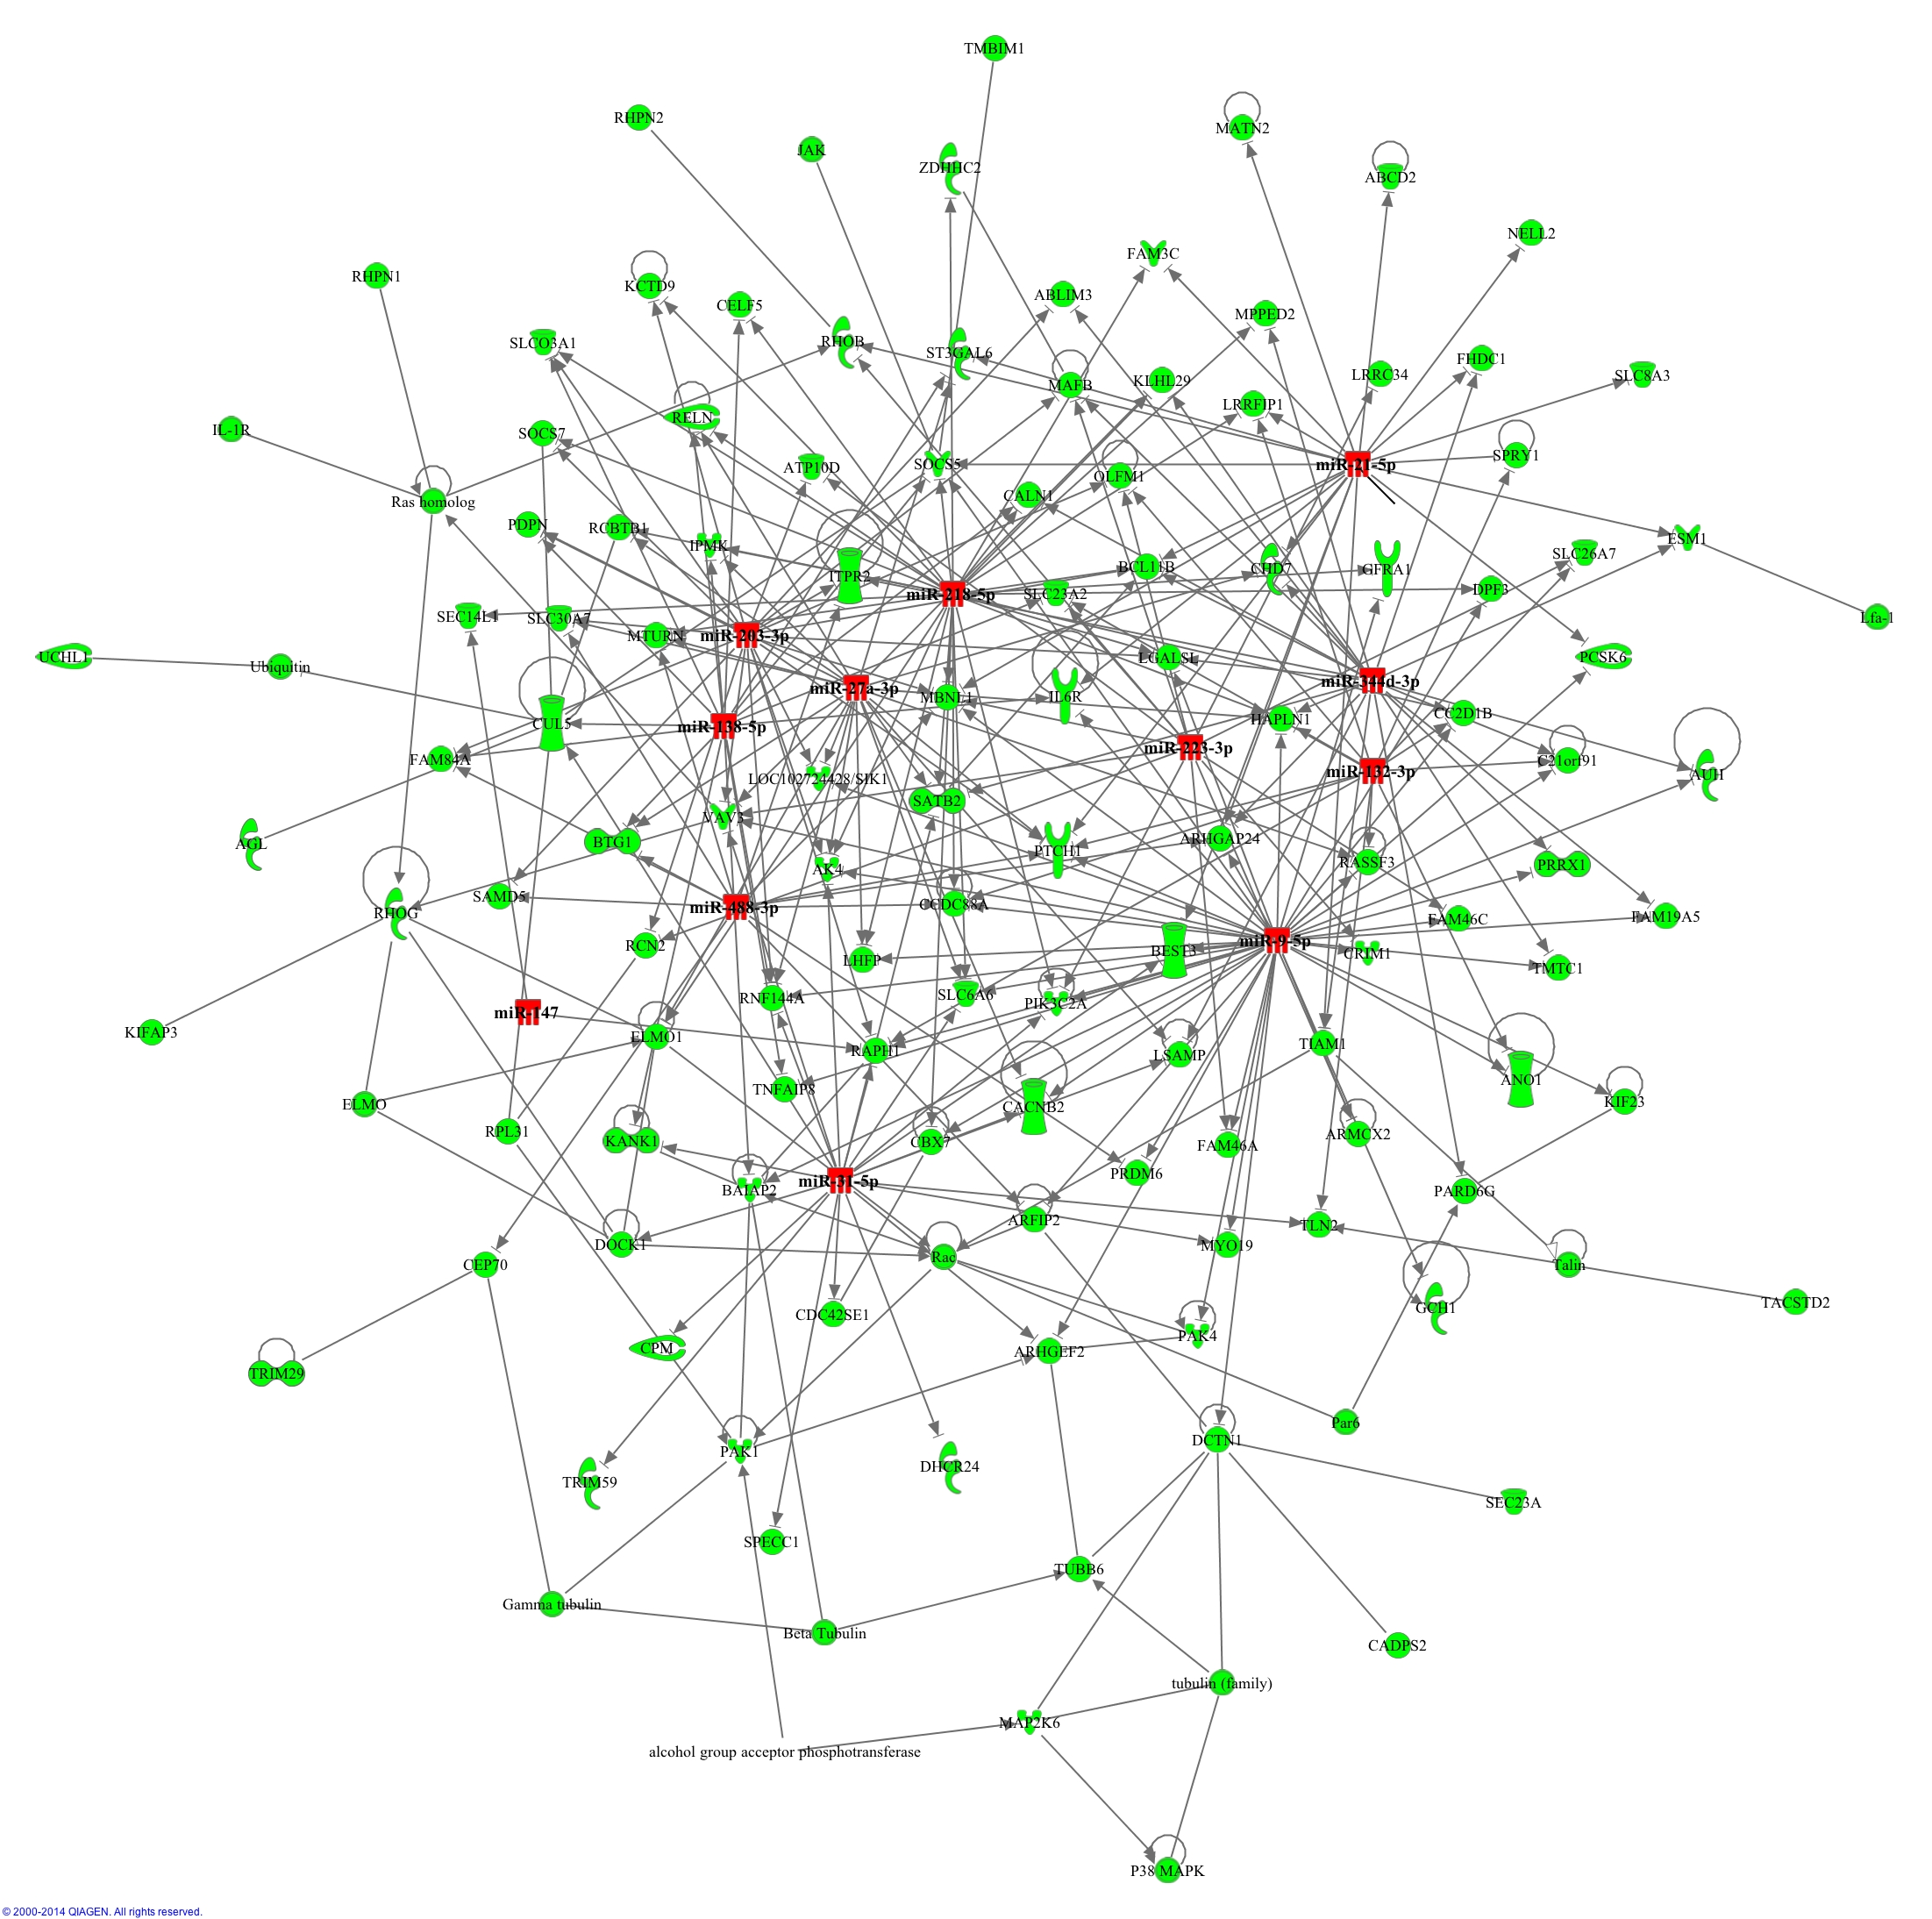
2B
Notes:
Supplemental Figure 2B. Cell Signaling, Cancer, Organismal Injury and Abnormalities

Slide 4
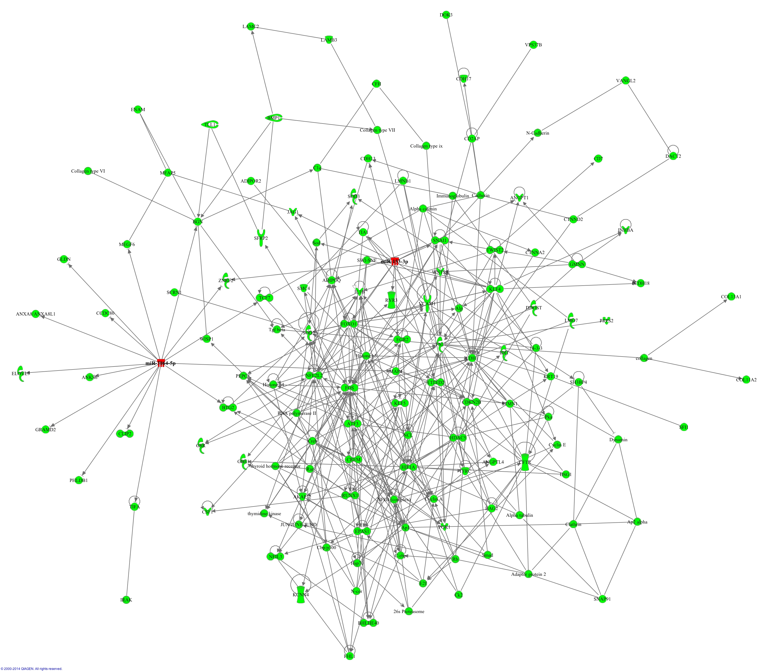
2C
Notes:
Supplemental Figure 2C. Cellular Movement, Cellular Development, Tissue Development

Slide 5
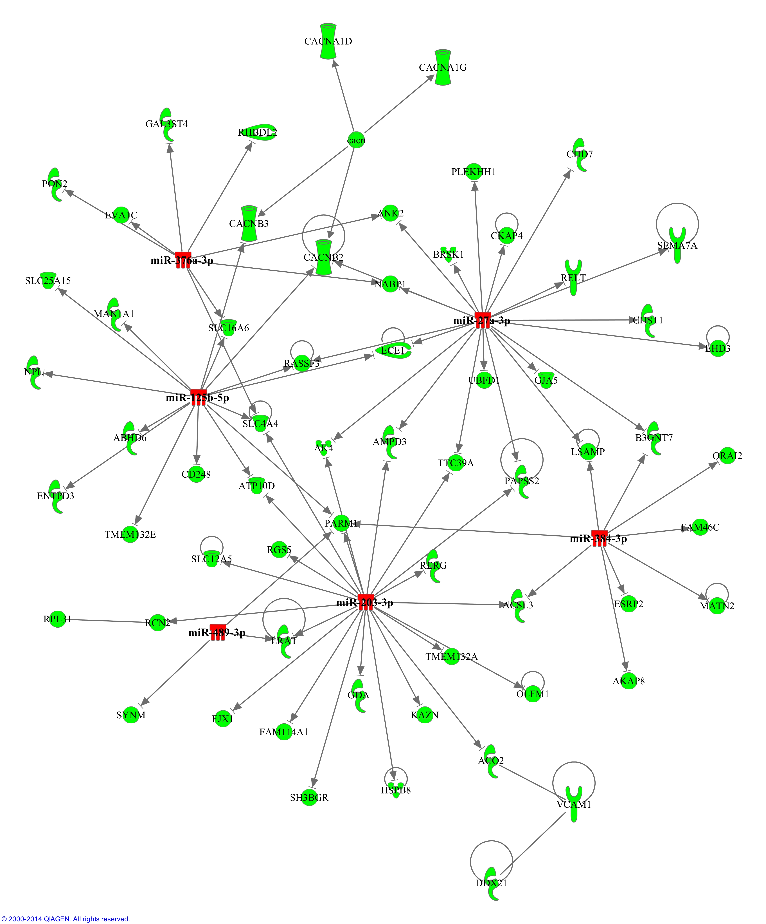
2D
Notes:
Supplemental Figure 2D. Cardiac Dysfunction, Cardiovascular Disease, Heart Failure

Slide 6
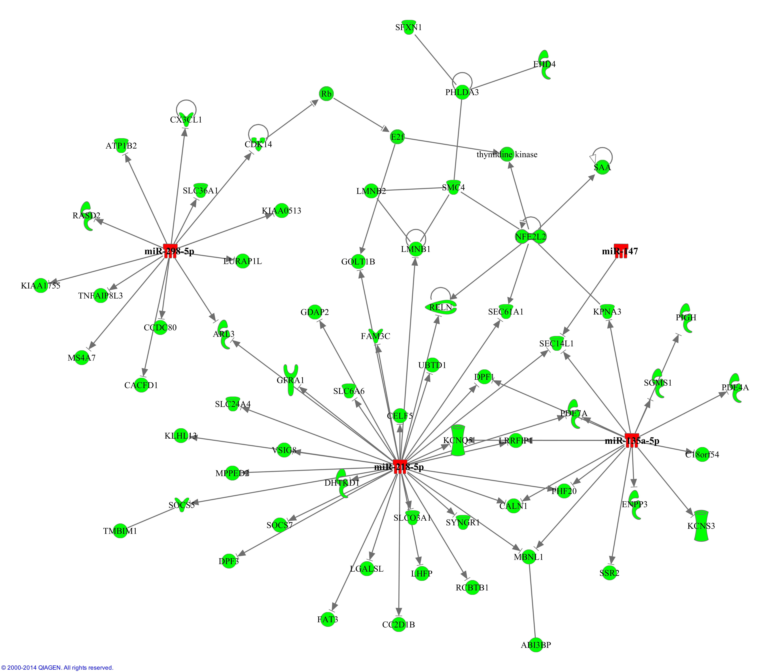
2E
Notes:
Supplemental Figure 2E. Embryonic Development, Nervous System Development and Function, Organ Development

Slide 7
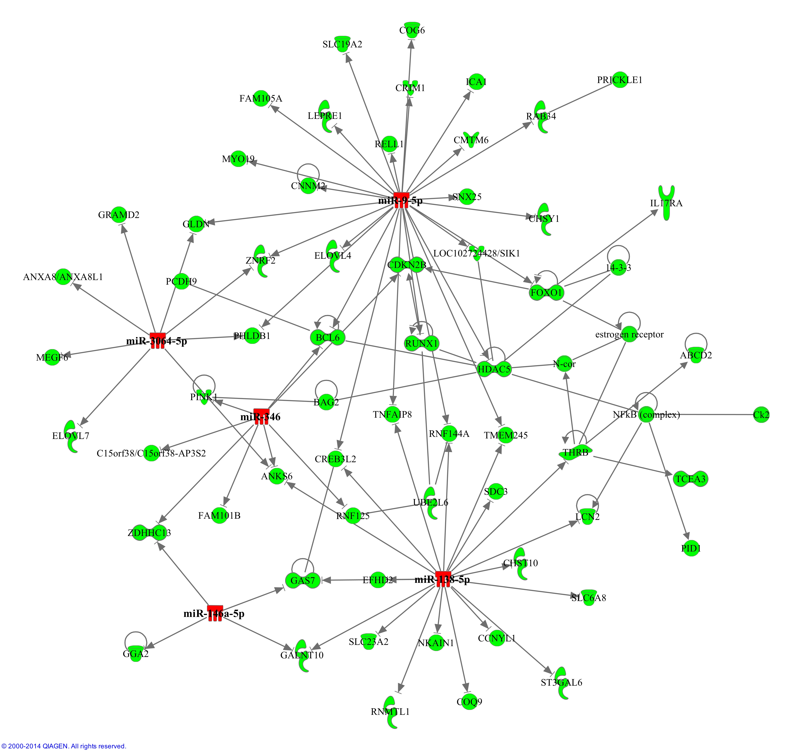
2F
Notes:
Supplemental Figure 2F. Cellular Assembly and Organization, Lipid Metabolism, Small Molecule Biochemistry

