Slide 1
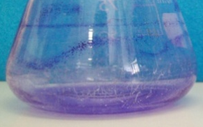
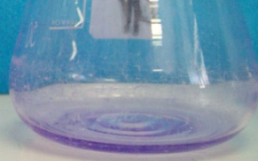
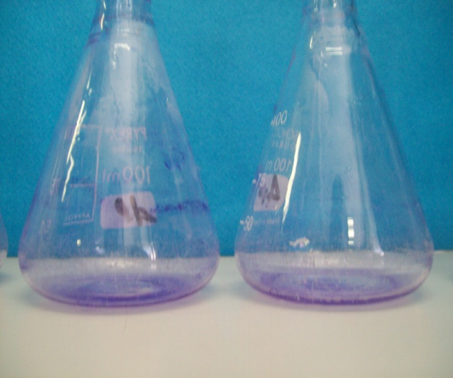
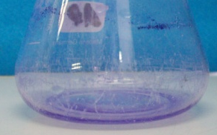
C-1a
C-5636 ΔpgaC
C-5928 ΔbcsA
C-5934 ΔwcaD
C-5930 ΔcsgA
Supplementary Figure 1

