Slide 1
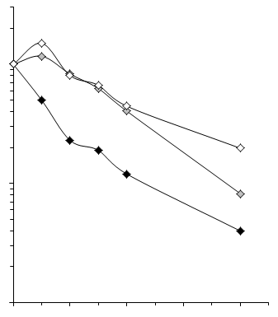
100
C-5938
% of mRNA remaining
10
C-5691
C-1a
1
1 2 3 4
time (min)

