Slide 1
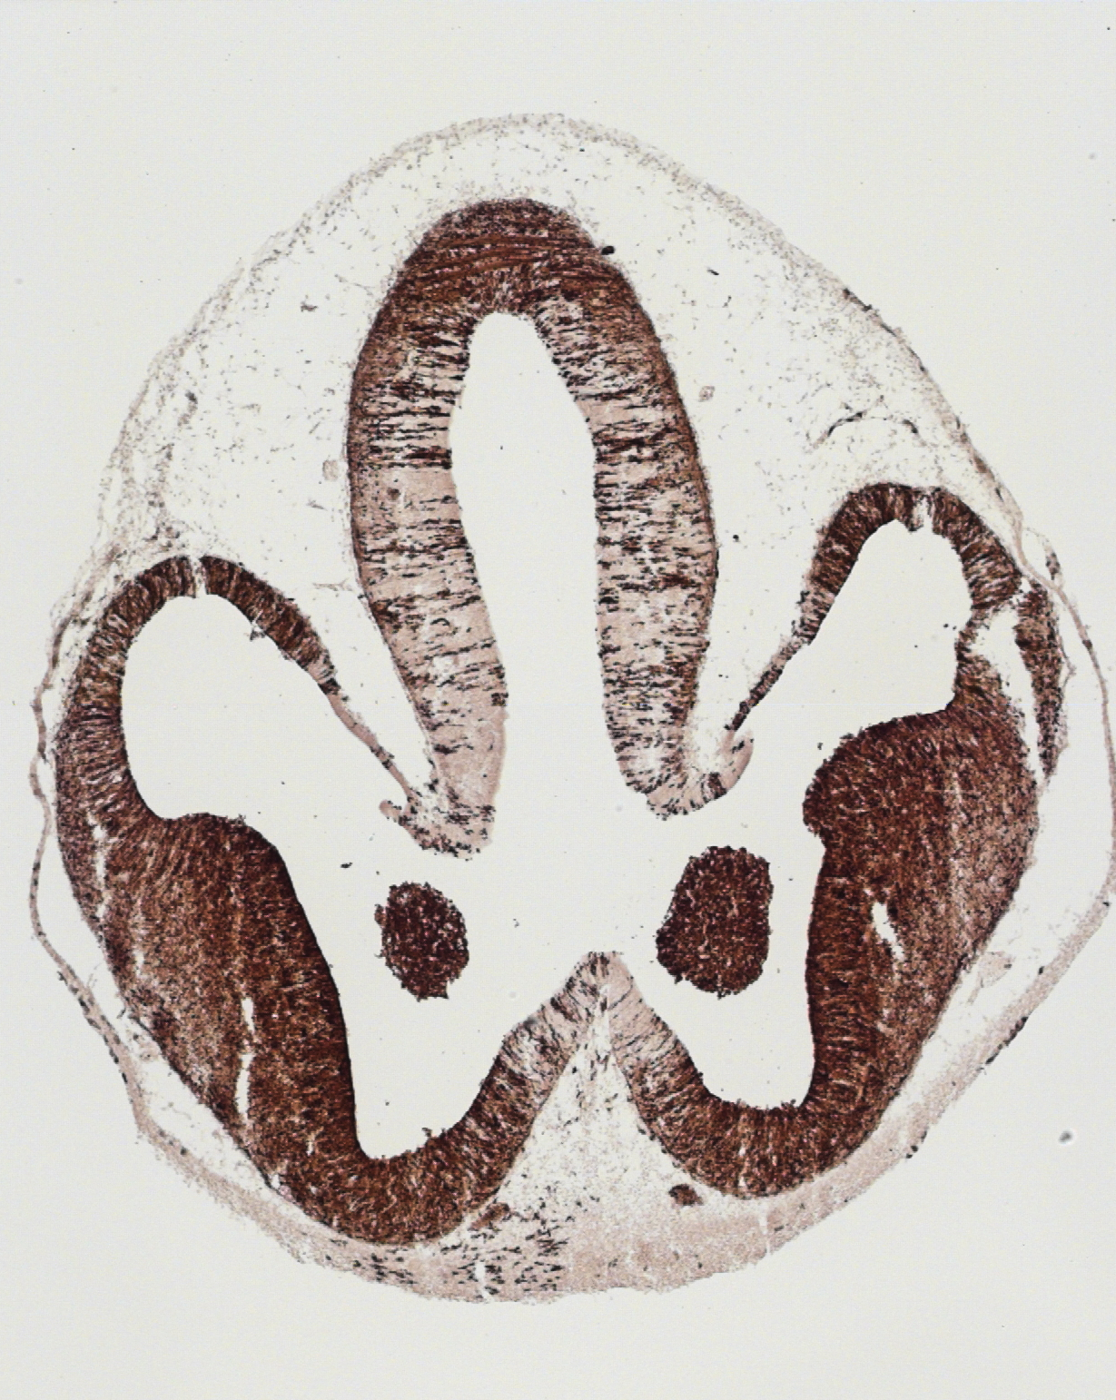
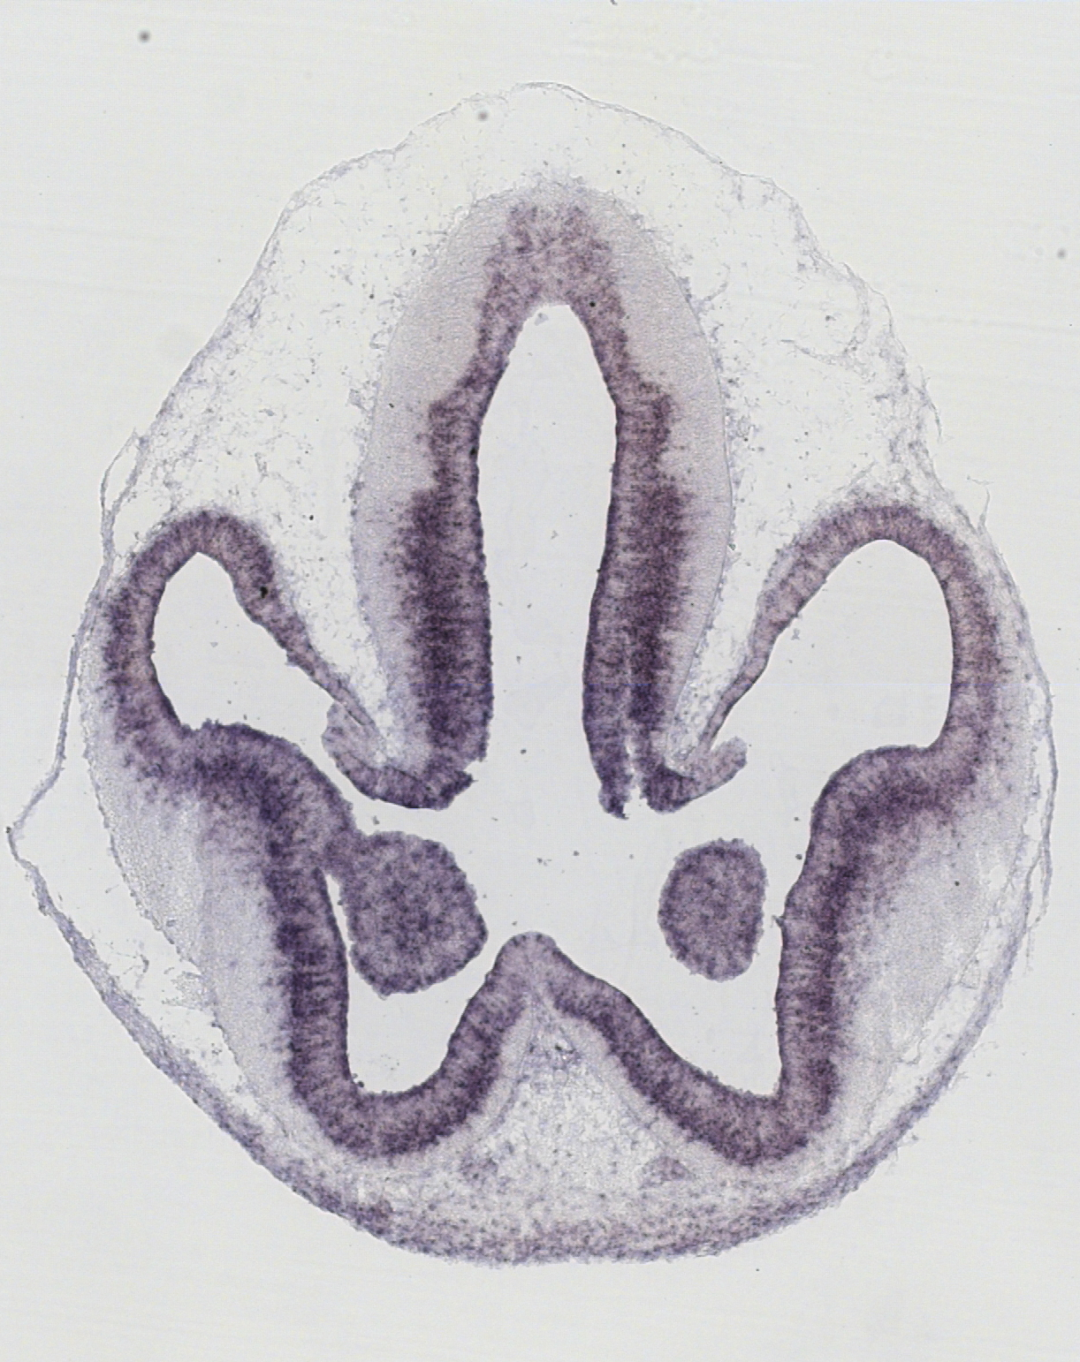
Cre activity
Survivin
NCX
HP
GE
Coremans et al
Supplemental Figure S1

Slide 2
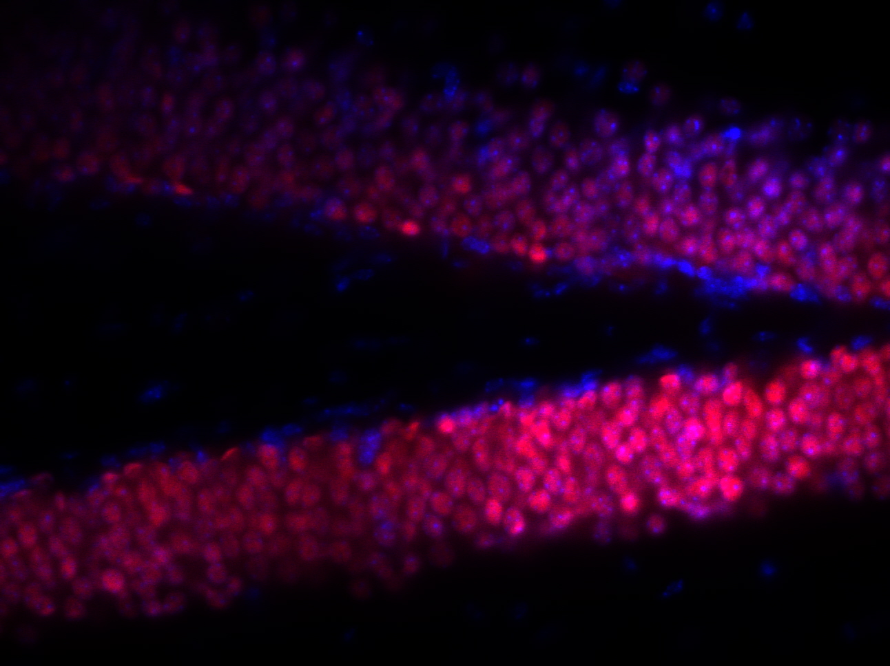
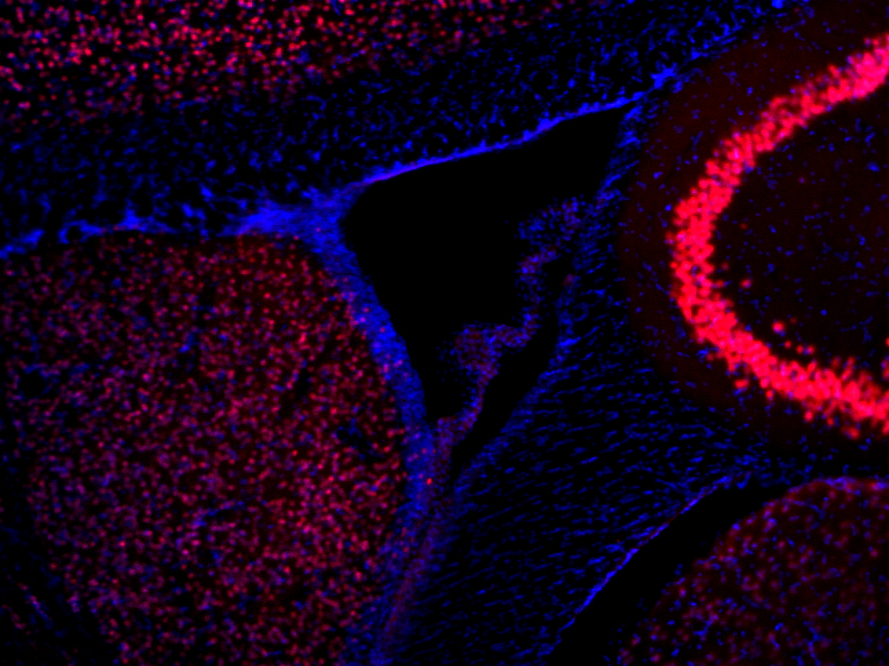
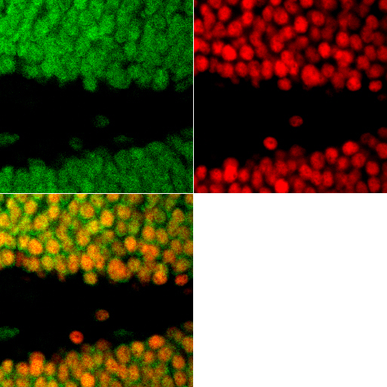
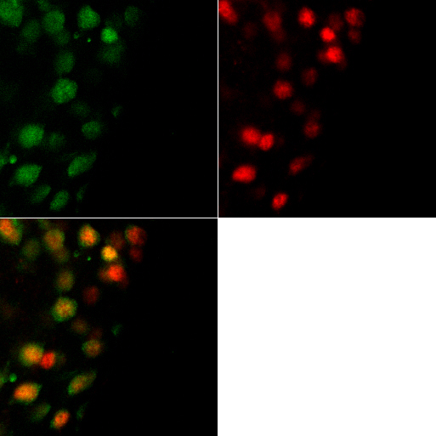
A
B
CTX
LV
SVZ
SGZ
ST
GCL
C
D
E
F
G
H
LV
Coremans et al
Supplemental Figure S2

Slide 3
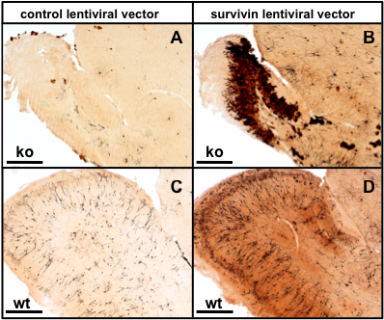
A
B
C
D
Coremans et al
Supplemental Figure S3

Slide 4
Coremans et al
Supplemental Figure S4

Slide 5
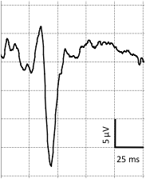
wt
ko
5 μV
25 ms
Coremans et al
Supplemental Figure S5

Slide 6
**
Coremans et al
Supplemental Figure S6

