Slide 1
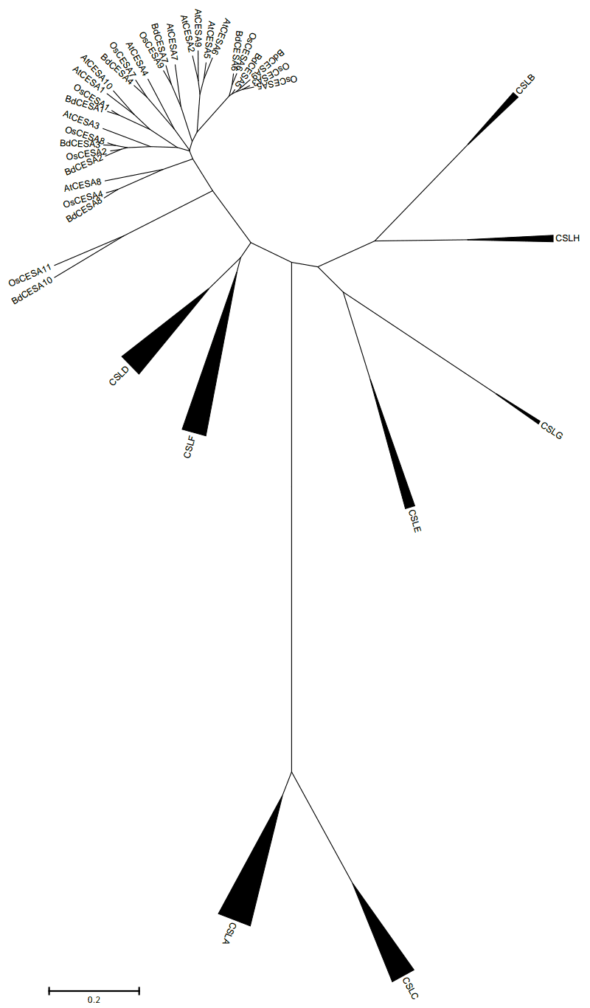
FIGURE S1
100
100
95
94
100
65
99
Figure S1. Phylogenetic analysis of A. thaliana, B. distachyon and rice CESA superfamily amino acid sequences. A consensus phylogeny was constructed with the neighbor-joining method with 1000 bootstrap permutations. The CESA clade is illustrates as an expanded sub-tree and the CSL clades are illustrated as condensed sub-trees.
100

