Slide 1
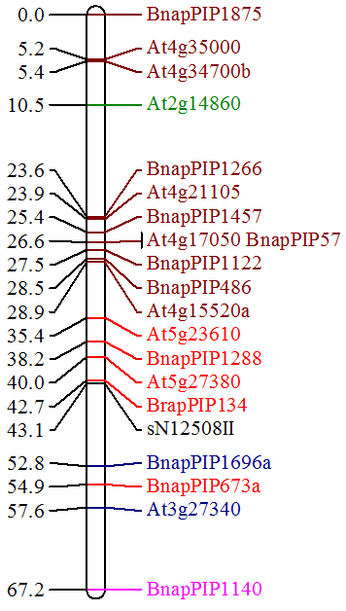
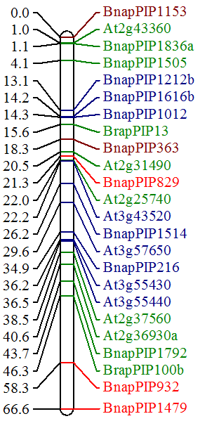
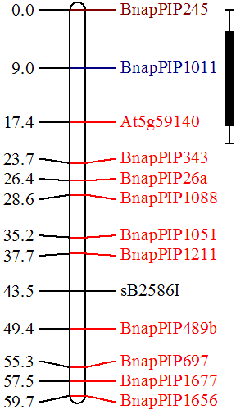
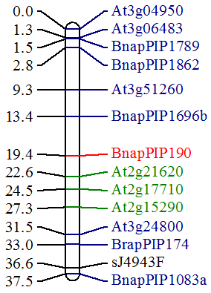
Sal09
Sal10
U
J
p
N
j
u
T
j
q
i
Q
N
n
J
l
r
d
X
Sal11
Sal12
o
F
f
HBUT2
N
w
x
i
h
R
F
At C1
At C2
At C3
At C4
At C5

