Slide 1
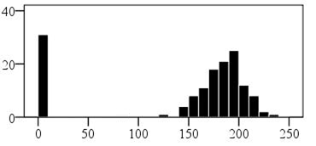
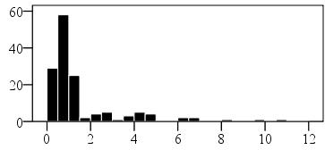
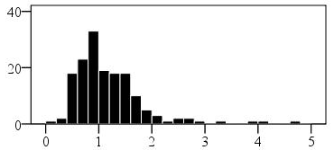
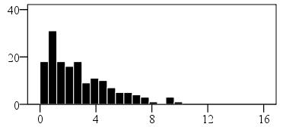
(a)
Y514
Y517
No. of seeds
HBEN GSL content (µmoles g⁻¹ seed)
(b)
Y517
Y514
No. of seeds
IND GSL content (µmoles g⁻¹ seed)
(c)
Y517
Y514
No. of seeds
HIND GSL content (µmoles g⁻¹ seed)
(d)
Y517
Y514
No. of seeds
HBUT GSL content (µmoles g⁻¹ seed)

