Slide 1
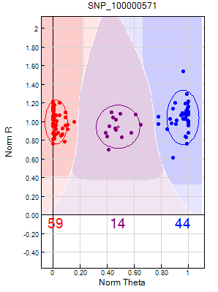
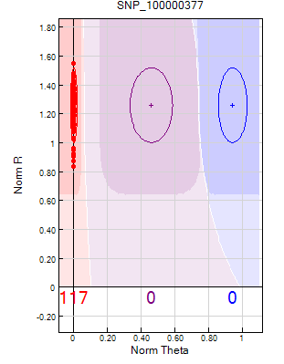
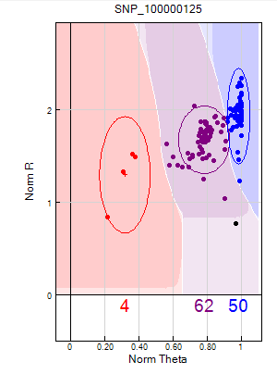
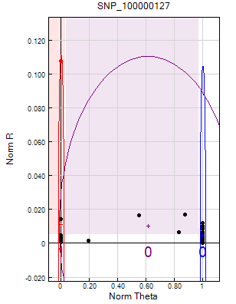
A
B
C
D
Additional file 4: representative clustering patterns generated by the Illumina GoldenGate SNP genotyping assay. The data colour code represent: red, AA (homozygous); blue, BB (homozygous); purple, AB(heterozygous); black no call (missing data)
A) High quality SNP B) Monomorphic SNP C) SNP with high number of heterozygous individuals D) Failed SNP

