Slide 1
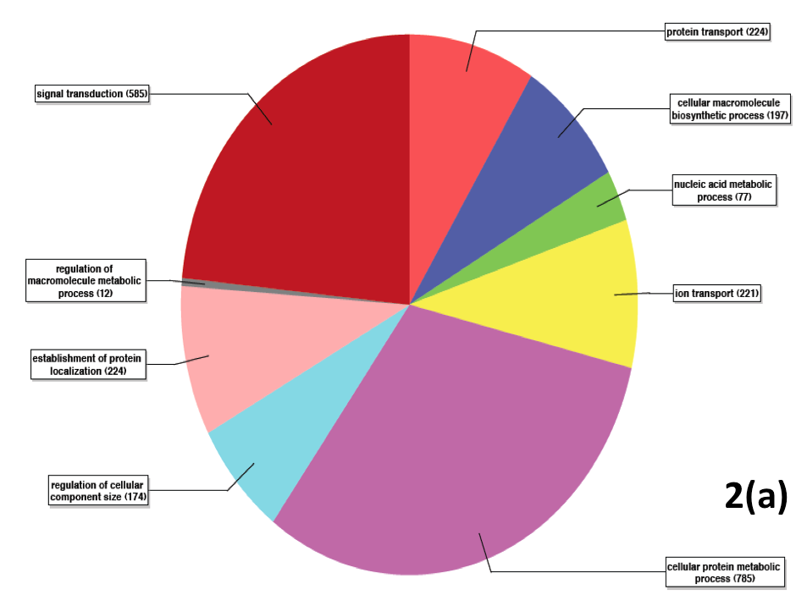
Notes:
Figure 2. GO Terms Distribution for petal transcriptome (a) Biological processes (b) Cellular Component (c) Molecular Processes

Slide 2
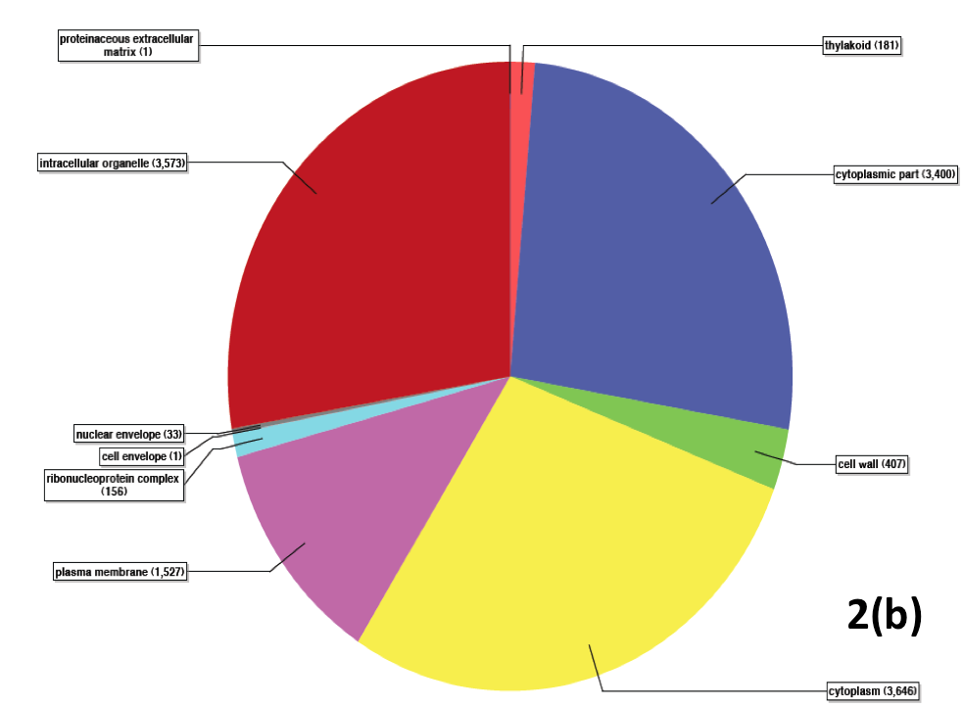
Notes:
Figure 2. GO Terms Distribution for petal transcriptome (a) Biological processes (b) Cellular Component (c) Molecular Processes

Slide 3
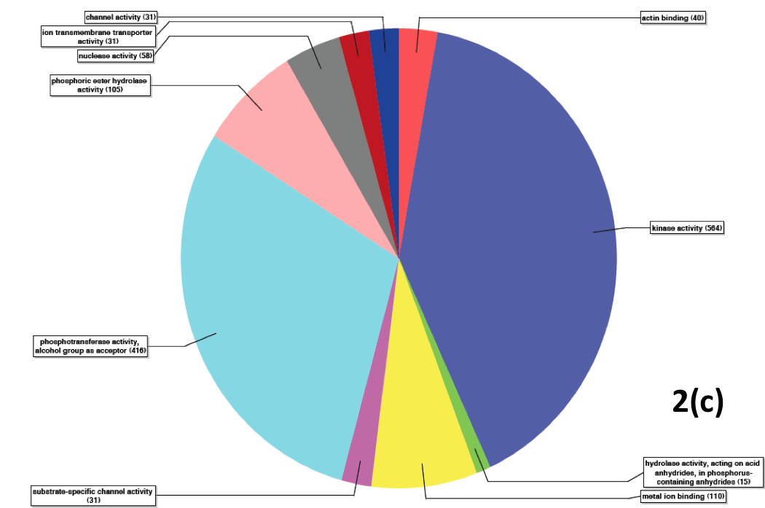
Notes:
Figure 2. GO Terms Distribution for petal transcriptome (a) Biological processes (b) Cellular Component (c) Molecular Processes

