Slide 1
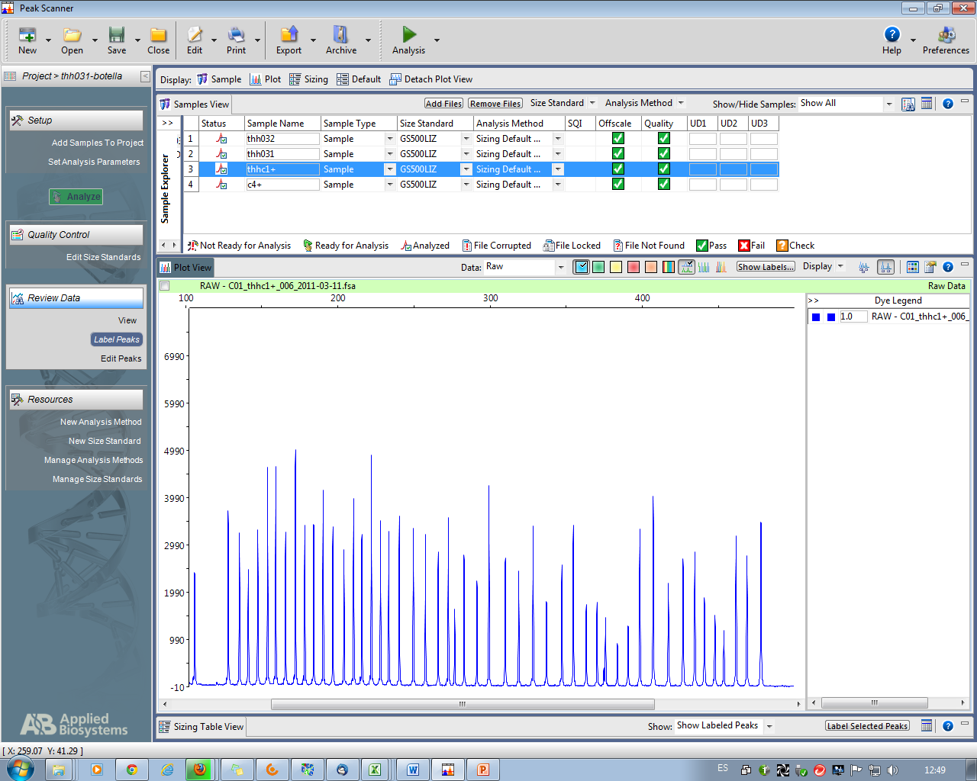
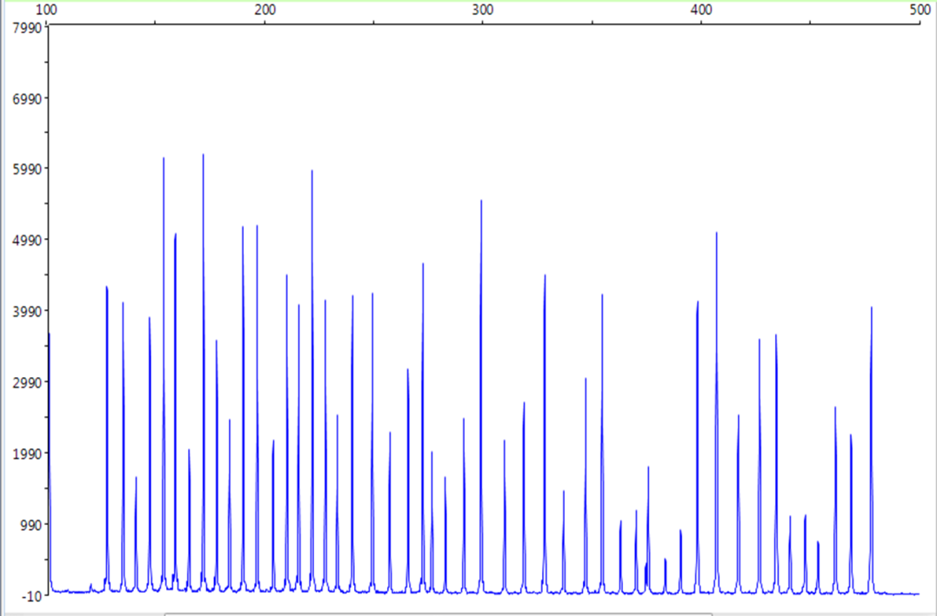

Control
GUM
2
14
1
3
4
6
9
12
5
8
11
13 10
14
14
2
7
P
Fig 2C

