Slide 1
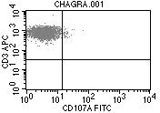
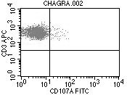
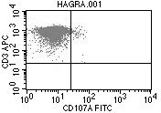
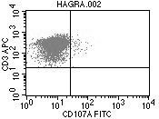
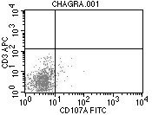
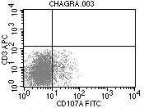
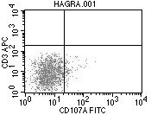
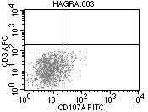
A
Resting
CD3
HC
2.2
3.2
P1
0.4
1.2
CD107a (LAMP-1)
B
Resting
PHA
HC
0.9
9.9
P1
5.4
10.9
CD107a (LAMP-1)

Slide 2
Supplementary Figure 1. Granule release assay (GRA) results are shown for a normal healthy control (HC) and the index case (P1) for cytotoxic T-cells (CTLs) (A) and natural killer (NK) cells (B). Peripheral blood mononuclear cells were stimulated overnight with interleukin 2 followed by incubation with fluorescently-labelled anti-CD107a (LAMP-1) alone (resting; left panel A & B) or with anti-CD3 antibody to activate CTLs (right panel A) or phytohaemagglutinin (PHA) to activate NK cells (right panel B). Samples were analysed by flow cytometry, gating on lymphocytes by forward/side scatter. CD107a expression was analysed on CTLs and NK cells and the %CD107a+ cells are indicated in each histogram. The increase in percentage of CD107a+ cells (Δ %CD107a+ ) between resting and stimulated cells was determined.

