Slide 1
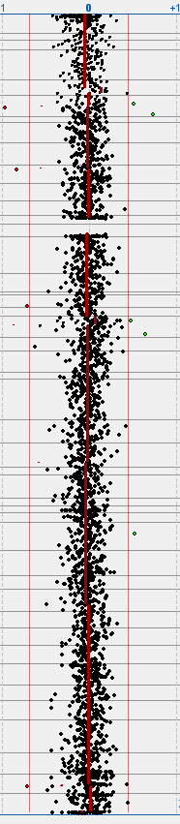
A
-
+
B
Array cGH profile
Chr5

Slide 2
Supplementary Figure 2. Microarray comparative genome hybridisation profile of Chr5 from P1 (A). The expected position of signal from any loss of genetic material in the profile is indicated by (-) and potential gain of material is indicated by (+). A Chr 5 ideogram (B) is shown for comparison.

