Slide 1


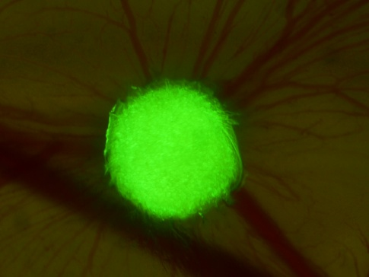
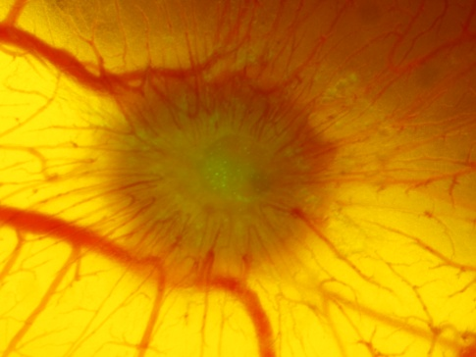
EpCAM ^{high}
T47D
Hs 578t
MCF-7
EpCAM ^{low}
MDA-MB-231
EMT
shRNA
ns-crtl
Cytokeratin ^{high}
shRNA
EpCAM
Control
Vimentin ^{high}
EpCAM
crtl
shRNA
crtl
EpCAM
T
T
CAM
CAM
T
T
T
CAM
CAM
CAM
T
CAM
CAM
•proangiogenic
• invasive
• less angiogenic
• less invasive
• proangiogenic
• invasive
• less invasive
• immune responses
Fig.8

