Slide 1
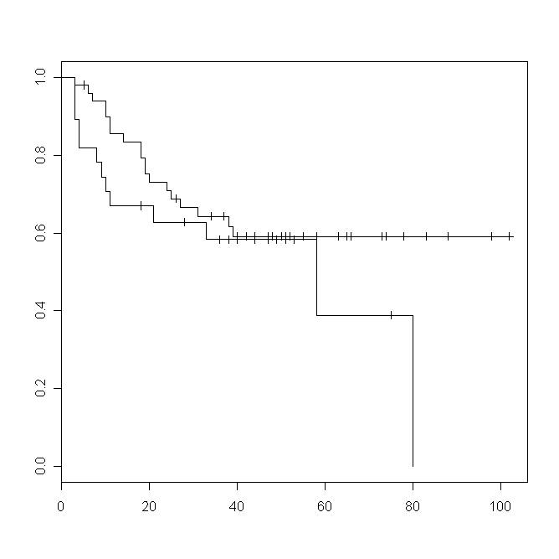
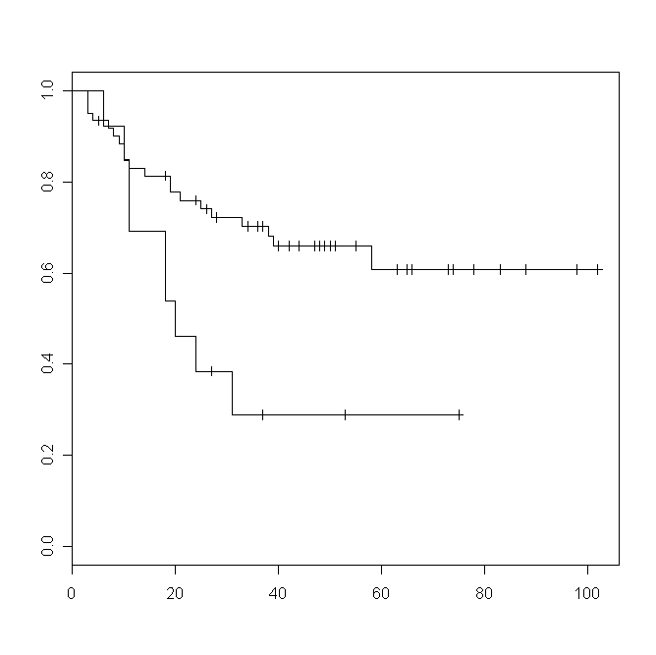
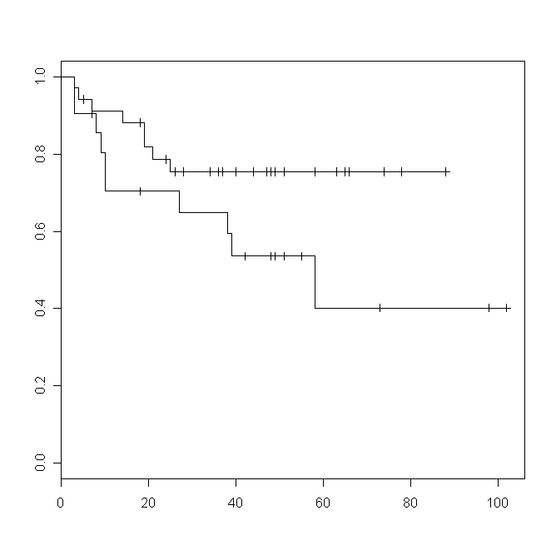
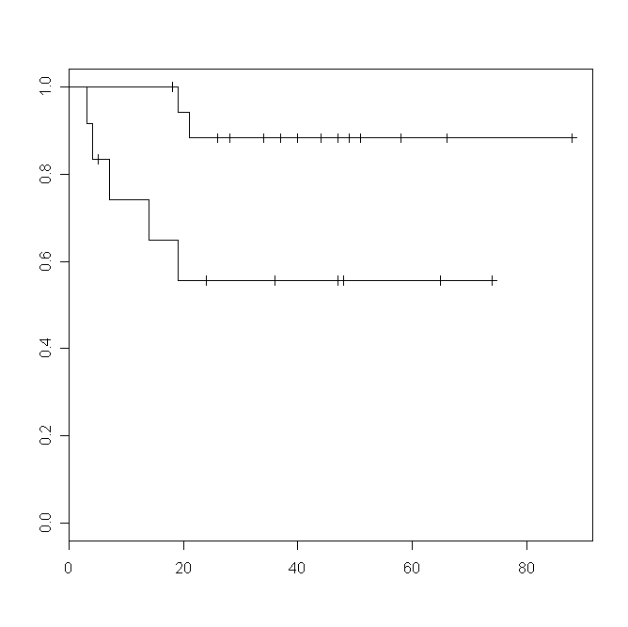
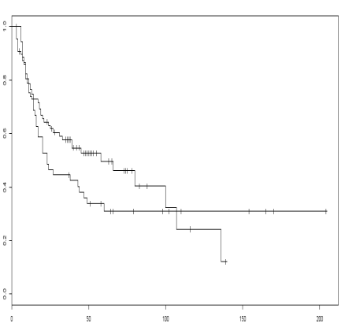
Hemoglobin level
Leucocytes count
Albumin level
(HR 1.53; p=0.25)
(HR 2.66; P=0.016)
(HR 2.28; p=0.082)
normal
normal
normal
high
low
low
Vascular risk factors
Alcohol consumption
(HR 5.3; p=0.047)
(HR 1.25; p=0.32)
absent
low
present
high
Figure 2

