Slide 1
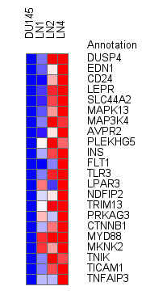
Supplementary Figure 1. Heat map using Ingenuity Analysis
software and the “Cell Signaling” category. The range of difference
between DU145 and DU145LN4 groups are 1.8-16.4 fold.
relative
min
max

Slide 2
Supplementary Table 1. Relative expression levels of PLAU, EPCAM, ITGB4 and housekeeping genes in the metastatic DU145-LN sublines.
 | Protein | Gene name | Cell line
 |  |  | DU145 parental | DU145- LN1 | DU145- LN2 | DU145- LN4
Cell movement and invasion genes | uPA | PLAU | 1.0 | 1.1 | 1.7 | 2.1
 | EpCAM | EPCAM (TACSTD1) | 1.0 | 1.8 | 2.4 | 3.2
 | Integrin β4 | ITGB4 | 1.0 | 8.8 | 16.0 | 18.6
Housekeeping genes | 60S ribosomal protein L11 | RPL11 | 1.0 | 0.9 | 1.0 | 1.0
 | NADH dehydrogenase (ubiquinone) 1 α subcomplex | NFUFA1 | 1.0 | 1.0 | 1.0 | 0.9
 | ATPase, H+ transporting, lysosomal 13kDa, V1 subunit G1 | ATP6V1G1 | 1.0 | 1.1 | 1.1 | 1.1

