Slide 1
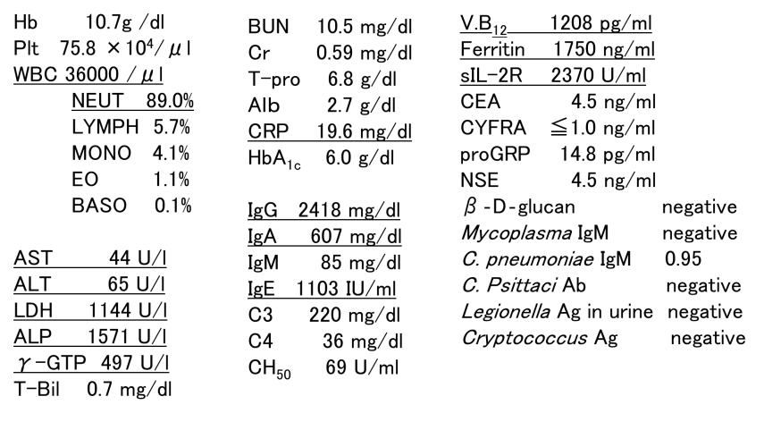
Table 1 Laboratory data on admission

