Slide 1
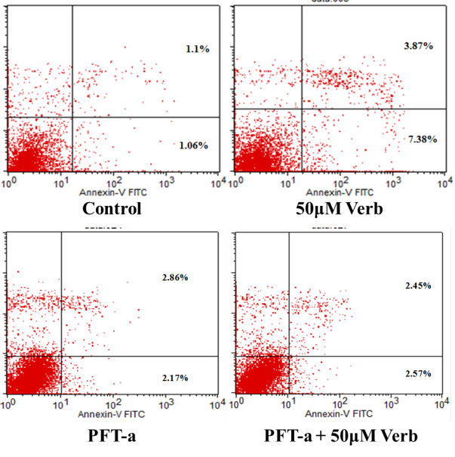
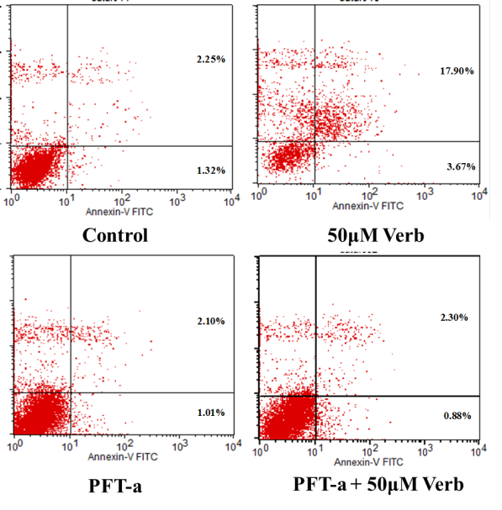
HCT-116 cells
HT-29 cells
Fig 4. D

