Slide 1
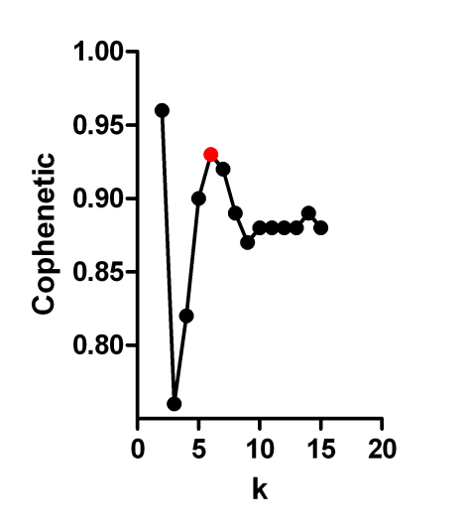
Hallett, et al., - Supplementary Figure 1
A
K=6
Supplementary figure 1. NMF of 298 ER+ breast cancer patients reveals robust statistical support for the existence of 6 subgroups

Slide 2
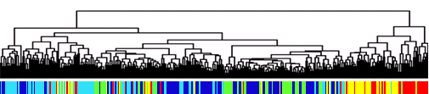
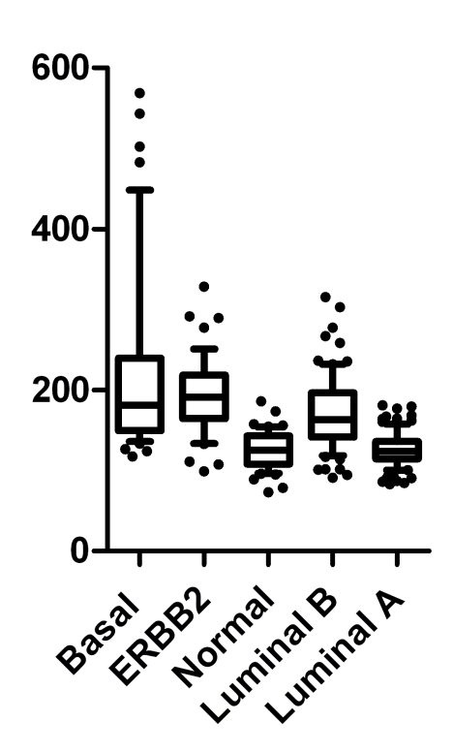
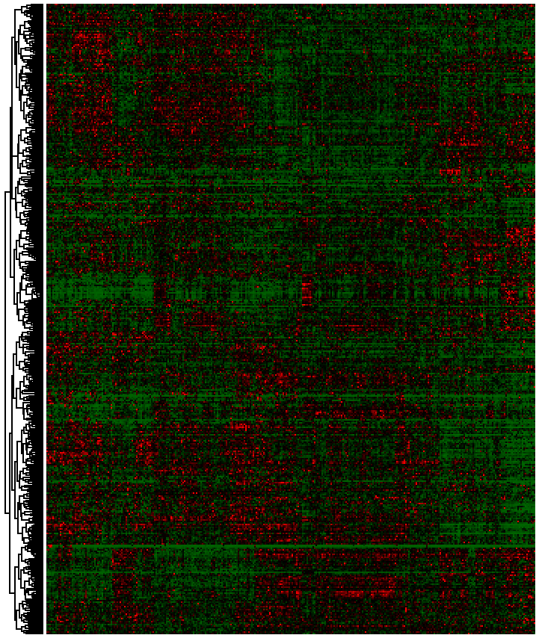
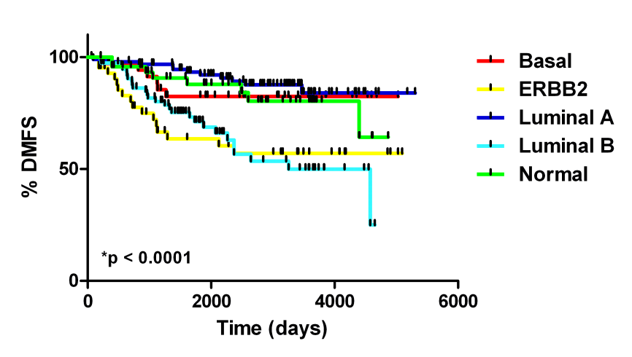

Hallett, et al., - Supplementary Figure 2
A
B
Ki67
Luminal A
Luminal B
ERBB2
Basal
Normal
C
D
100
90
80
70
60
50
40
30
20
10
0
 | Lum A | Lum B | Normal | Basal | ERBB2
All | 31 | 24 | 16 | 14 | 15
ER+ | 37 | 29 | 16 | 8 | 10
ER- | 22 | 22 | 22 | 40 | 34
% Memebership
Supplementary figure 2. PAM50 sub-typing of training cohort. A) Hierachical clustering with Sorlie intrinsic genes and subtype assignment based on distance to PAM50 subtype centroid. B) Ki67 is highest in Basal, ERBB2 and Luminal B subtypes . C) Subtypes display expected clinical outcomes based on previous reports. D) Subtype breakdown based on ER expression in training cohort.

Slide 3
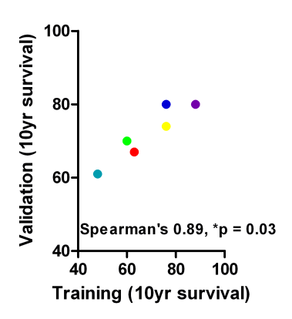
Hallett, et al., - Supplementary Figure 3
A
Supplementary figure 3. Survival characteristics are maintained between training (x-axis) and validation (y-axis) cohorts.

Slide 4
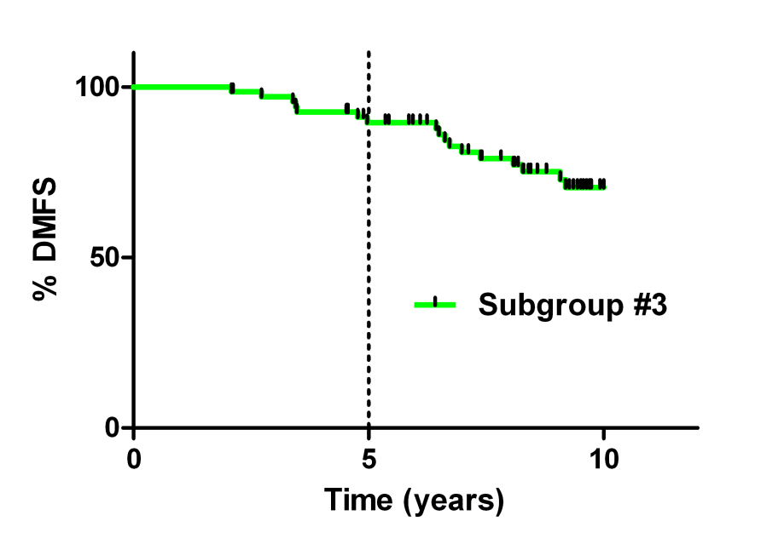
Hallett, et al., - Supplementary Figure 4
Supplementary figure 4. Majority of DMFS events occur after 5 years in subgroup #3 patients.

Slide 5
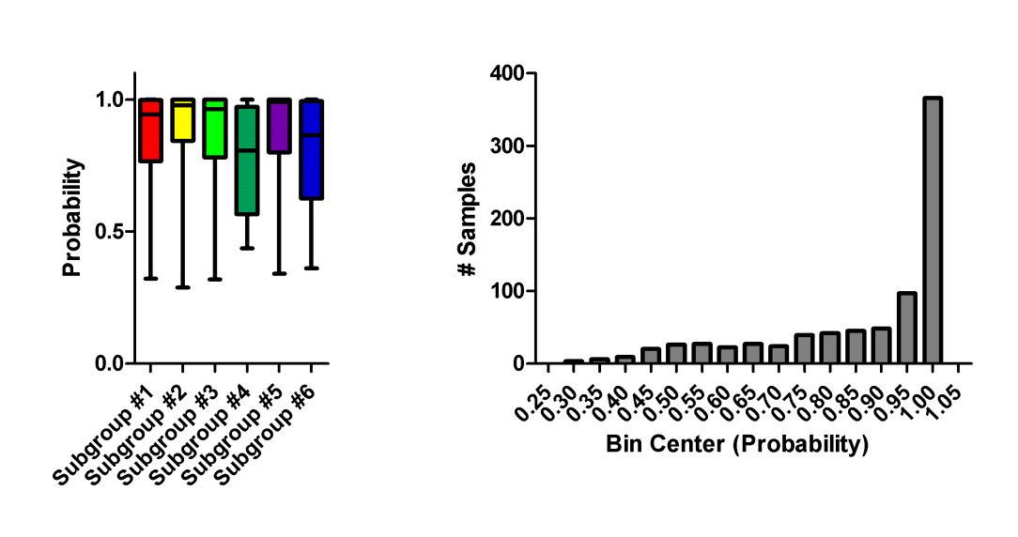
Hallett, et al., - Supplementary Figure 5
A
B
Supplementary figure 5. Probabilities of subgroup classification for TCGA samples.

Slide 6
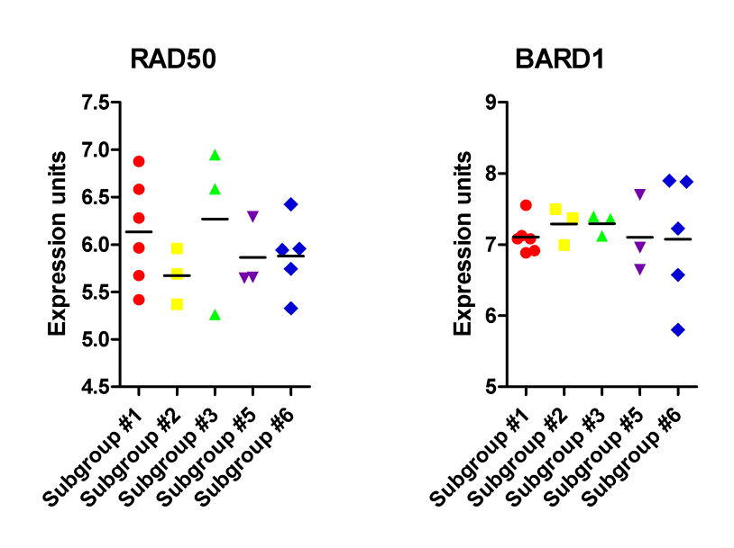
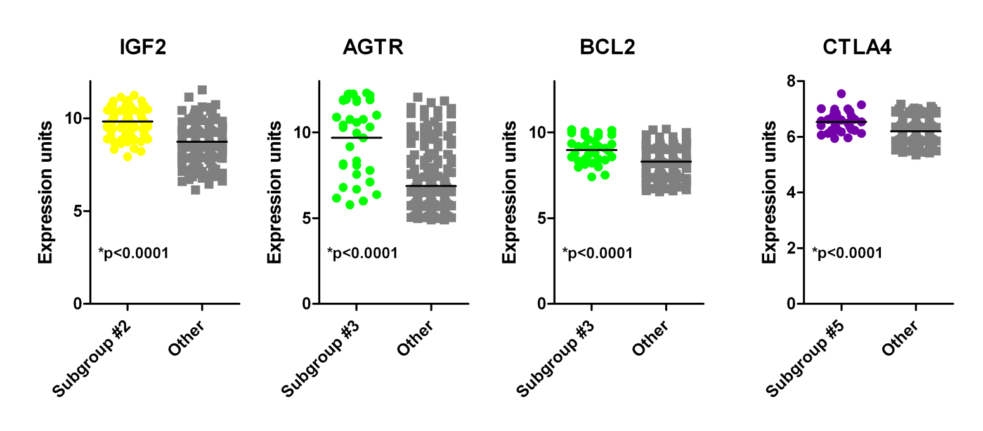
Hallett, et al., - Supplementary Figure 6
A
B
Supplementary figure 5. Gene expression of actionable targets among the ER+ subgroups. A) RAD50 and BARD1 expression in subgrouped cell lines. B) Expression of additional actionable targets in subgrouped patient samples.

