Slide 1
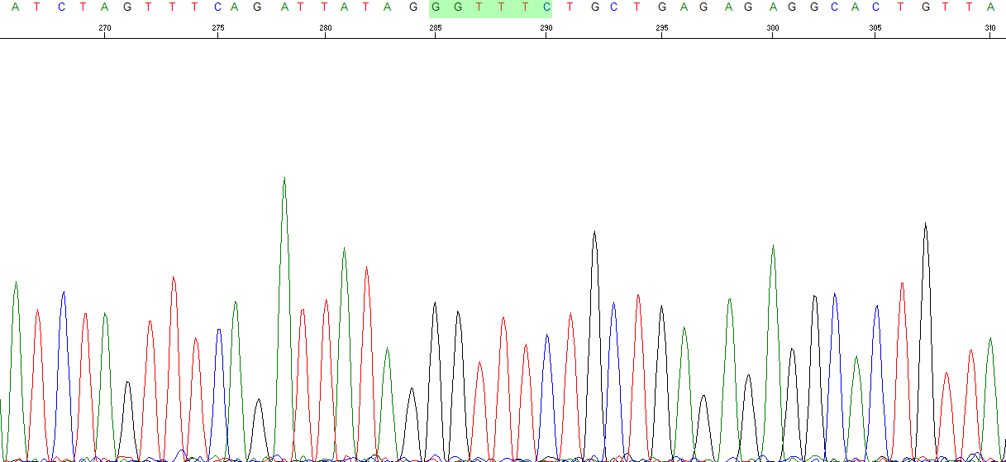
Chr10: 96,497,324
Chr10: 96,559,110
Notes:
Figure S1. Sequence of the CYP2C19 deletion breakpoint. The presumed breakpoint with microhomology is highlighted in green.

