Slide 1
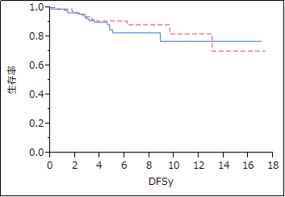
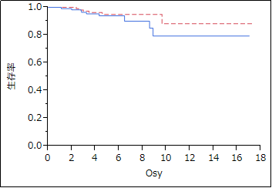
A
B
Probability of disease free survival
NAT1 positive
NAT1 negative
NAT1 positive
NAT1 negative
Probability of disease free survival
Probability of overall survival
Probability of disease free survival
Probability of disease free survival
P=0.4292
P=0.4916
Time (years)
Time (years)
Notes:
Supplementary Figure 2 Kaplan-Meier survival analyses of the lymph node negative breast cancer patients. Disease free survival (A) and overall survival (B) of the 161 lymph node positive breast cancer patients according to protein expression levels of NAT1. NAT1 positivity was no significantly associated with favorable DFS (P = 0.4292) and OS (P = 0.4916).

