Slide 1
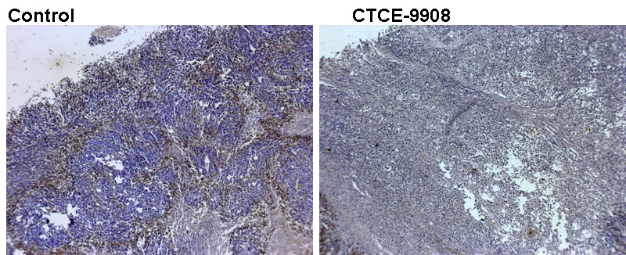
Supplement Figure 2

