Slide 1
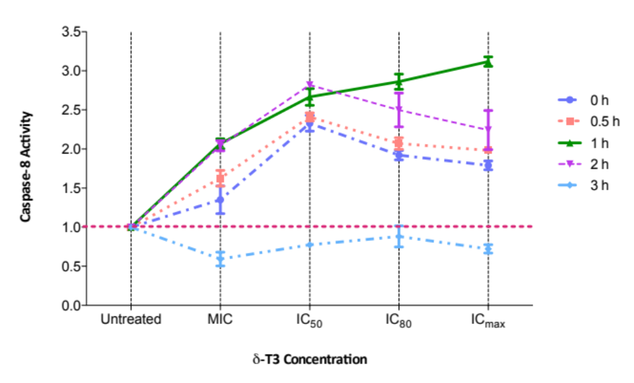
Additional File 1 Kinetic study of caspase-8 activity in delta-tocotrienol treated A549 cells.
In order to acquire the most optimum treatment time point for determining the caspase-8 initiation, a kinetic study was carried out in A549 cells receiving delta-tocotrienol at MIC (1 µM), IC₅₀ (2 µM), IC₈₀ (10 µM) and IC_{max} (100 µM) concentrations for different time intervals, i.e. 0 h, 0.5 h, 1 h, 2 h and 3 h. The 1-h incubation period was chosen for subsequent evaluation of cellular caspase-8 activity. MIC: minimum inhibitory concentration.

