Slide 1
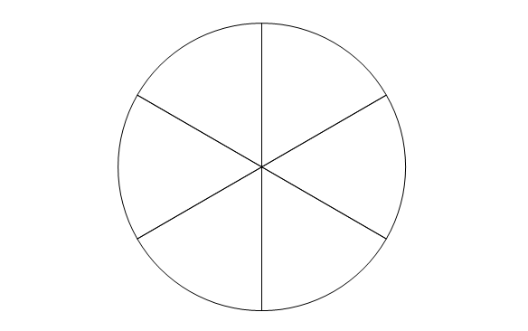
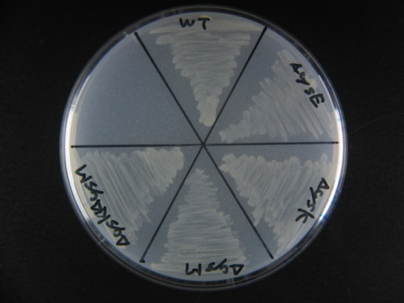
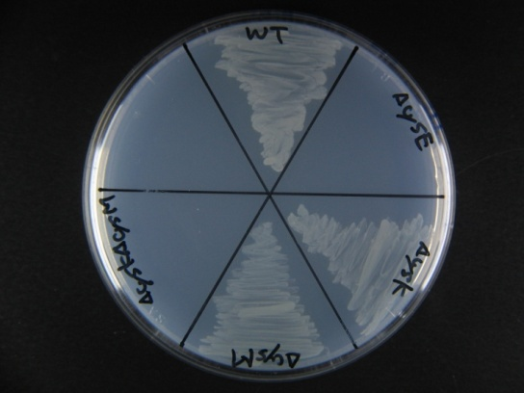
Supplemental Figure 3
WT
ΔｃｙｓE
ΔｃｙｓK
ΔｃｙｓM
ΔｃｙｓK
ΔｃｙｓM
M9+Cystine （5 mM）
M9
Supplemental Figure 3 Growth of ΔcysKΔcysM double knockout mutant on minimum medium
WT (BW25113), ΔcysE, ΔcysK, ΔcysM and ΔcysKΔcysM were cultivated in M9 medium until OD660=0.4 at 37°C. The cultures were streaked and cultured on M9 and M9+ 5 mM cystine plate at 37°C. M9 and M9+ 5 mM cystine plate contains 1 mM Na₂S₂O₃ and 1 mM MgSO₄ as inorganic sulfur sources.

