Slide 1
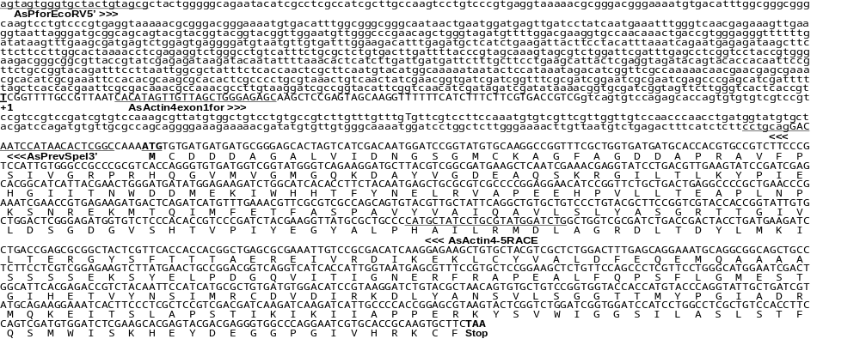
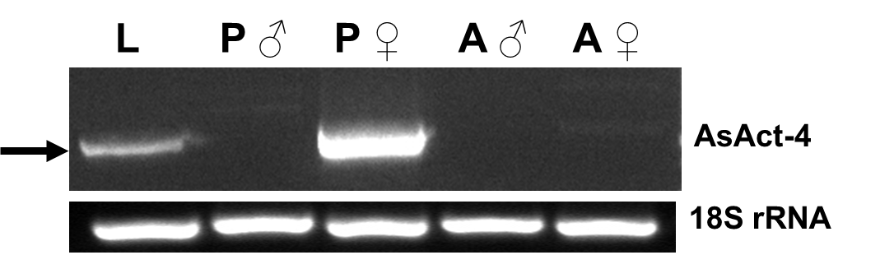
Figure S1
A
B
TSS
ATG
1014 96 271 1155
1400 nt Actin 4 regulatory sequence
Stop
5’RACE product
RT-PCR product
C
536 nt

