Slide 1
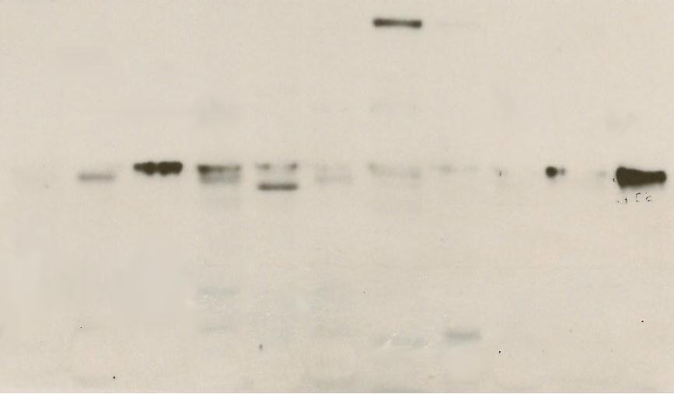
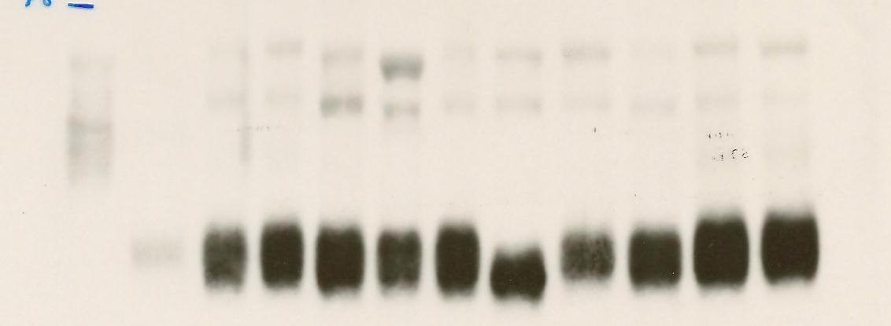
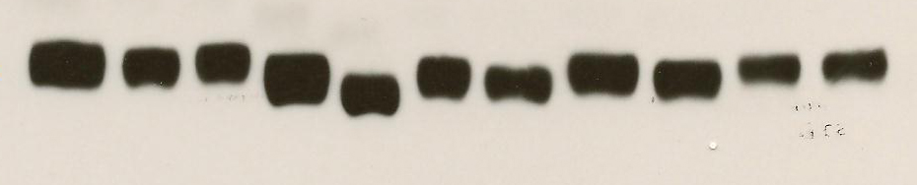
100 kD
MCT4
50 kD
37 kD
88 kD
MCT1
50 kD
α-tubulin
HEMs
MV3
M233
C32
WM852
Lu1205
ATCC72
WM983-A
WM1158
TPF10-741
WM983-B
B-Raf WT
B-Raf^{V600E}
Vemurafenib resistant

Slide 2
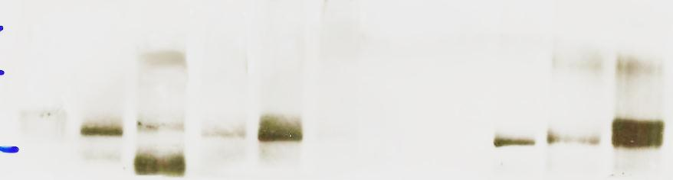
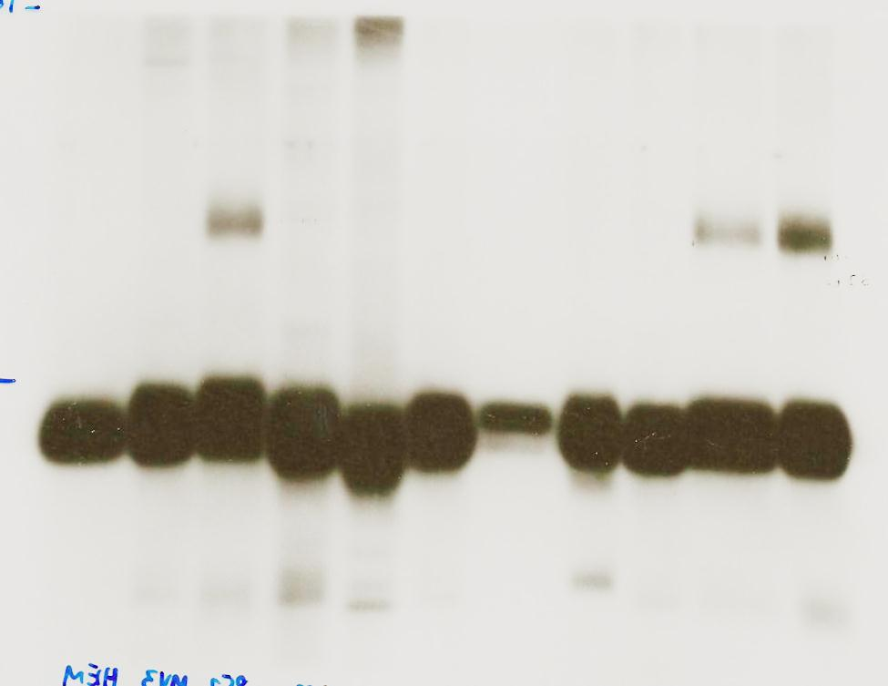
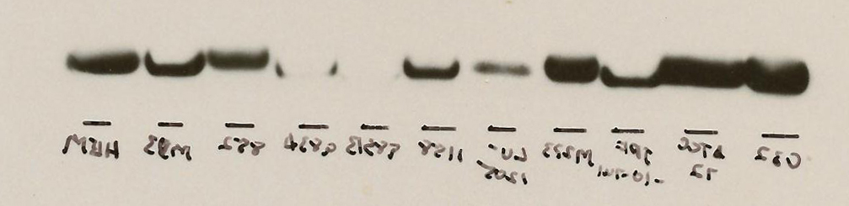
250 kD
150 kD
HIF-1α
}
100 kD
100 kD
LDHB
37 kD
37 kD
LDHA
50 kD
α-tubulin
HEMs
MV3
M233
C32
WM852
Lu1205
ATCC72
WM983-A
WM1158
TPF10-741
WM983-B
B-Raf WT
B-Raf^{V600E}
Vemurafenib resistant

