Slide 1
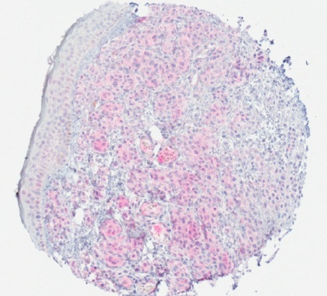
A
b
LDHA
a
Nevi
Primary
Melanoma
Metastatic
Melanoma
10x

Slide 2
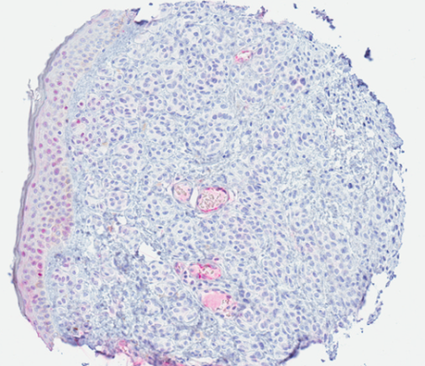
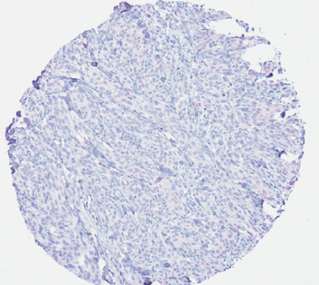
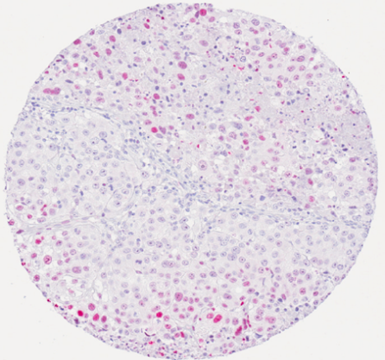
B
HIF-1α
b
a
Nevi
Primary
Melanoma
Metastatic
Melanoma
10x

