Slide 1
A
MCT1
b
a
Nevi
Primary
Melanoma
Metastatic
Melanoma
10x

Slide 2
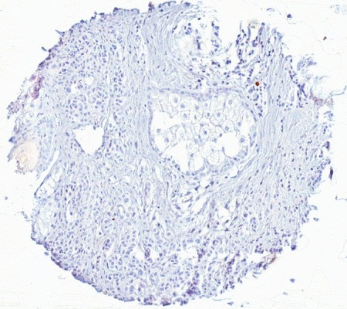
B
b
MCT4
a
Nevi
Primary
Melanoma
Metastatic
Melanoma
10x

