Slide 1

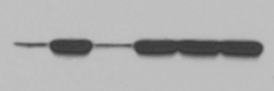


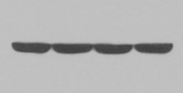

Figure S2
A
SnoN mRNA Levels
Untreated
1h IFN-2α
3h IFN-2α
B
C
HEY: IFN-2α
HEY: IFN-2α
Control
siRNA
SnoN
siRNA
IFN+NAC (1000)
6h
6h
IFN+NAC (100)
0h
0h
IFN+NAC (500)
NAC (1000)
IFN only
None
38 kDa
38 kDa
31 kDa
PLSCR1
31 kDa
PLSCR1
76 kDa
SnoN
76 kDa
SnoN
52 kDa
52 kDa
Pan-Actin
38 kDa
Pan-Actin
38 kDa

