Slide 1
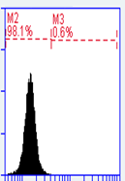
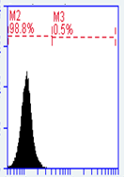
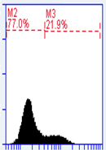
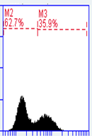
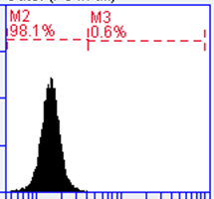
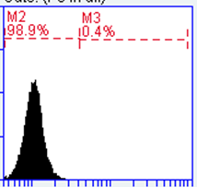
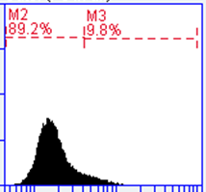
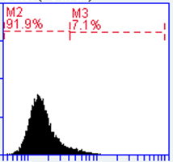
Figure S2
ITF2357
Pem
Combination
A
H460
H1975
H1650
Viability (%)
Pem->ITF2357
B
Doses (μM)
H1975
H460
H1650
Combination index
Pem->ITF2357
Fraction affected
C
ITF2357
Pem→
ITF2357
untreated
Pem
w/o zVAD
N° of Events
zVAD
PE Active Caspase-3 staining

