Slide 1







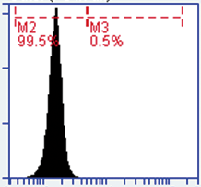
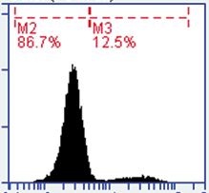
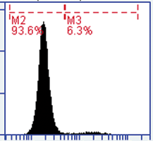
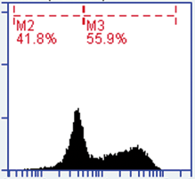
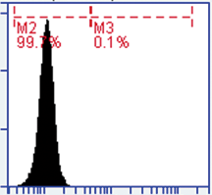
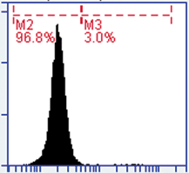
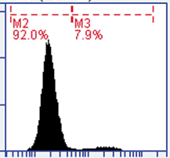
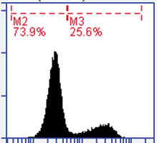
Figure S3
A
B
C
H1299 shBeclin1
H1299/siATG7
H1299 shCont
H1299/Cont
TS mRNA expression
(fold change)
Beclin1
ATG7
HSP72/73
HSP72/73
D
E
*
3MA
- +
Viability (%)
p-Akt
Hsp70/72
p-mTOR
Hsp70/72
untreated
Pem
ITF2357
Pem -> ITF2357
F
Pem→
ITF2357
untreated
Pem
ITF2357
H1299
N° of Events
H1299 shBeclin-1
PE Active Caspase-3 staining

