Slide 1
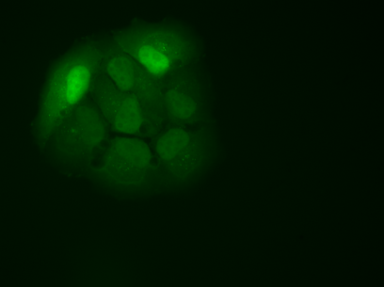
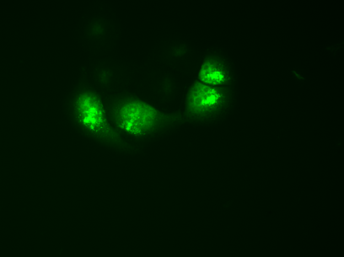
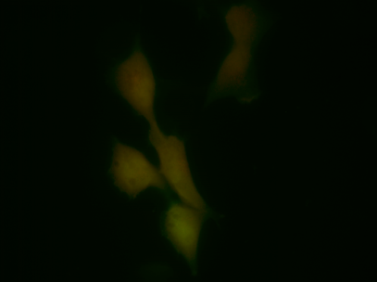
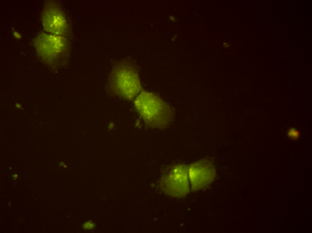


Figure S4
A
untreated
CQ
H1299/GFP-LC3
H1299/ptf-LC3
B
+CQ
Pem→ITF2357
Pem→ITF2357
untreated
ITF2357
untreated
ITF2357
Pem
Pem
p62/SQSTM1
LC3-I
LC3-II
β-actin

