Slide 1
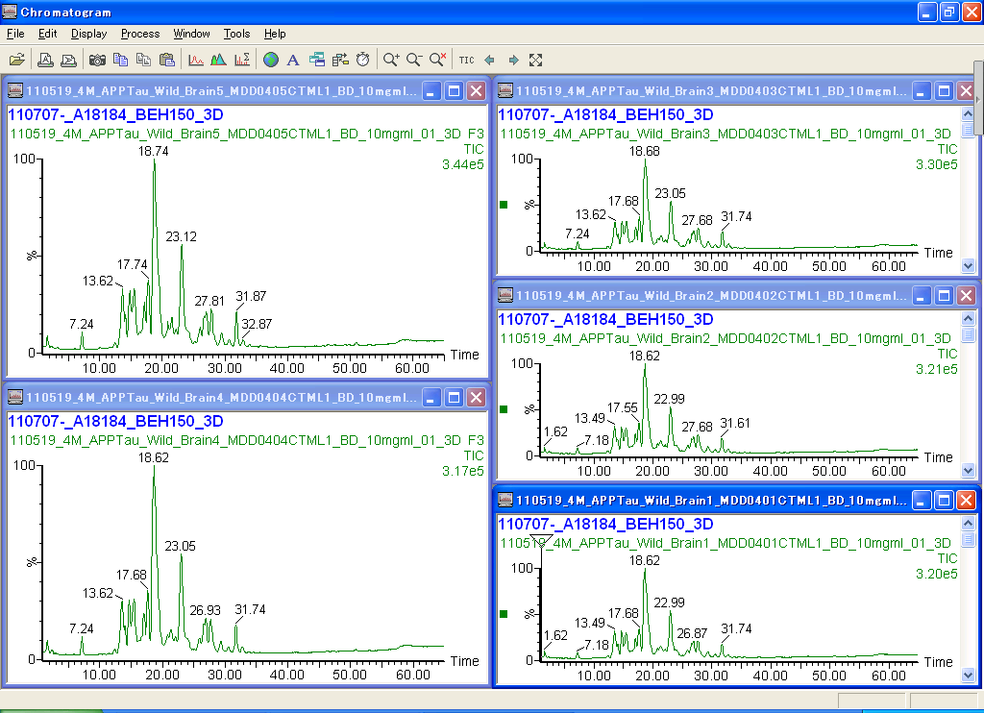
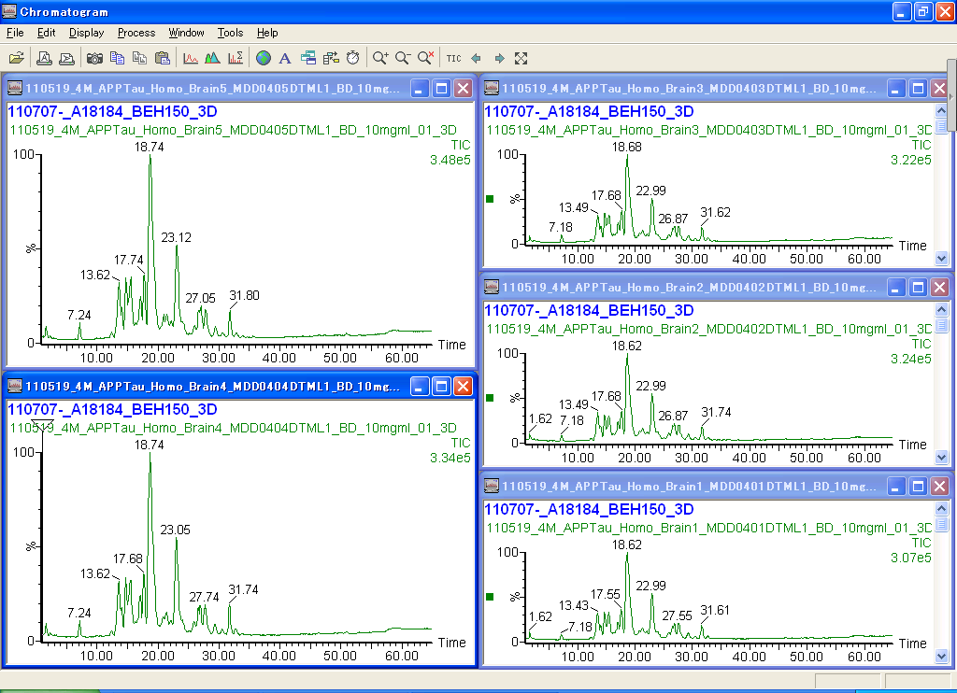
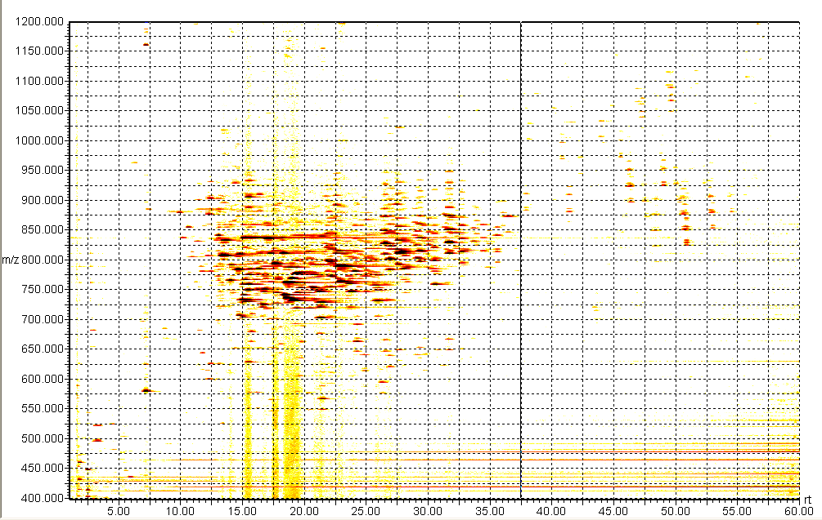
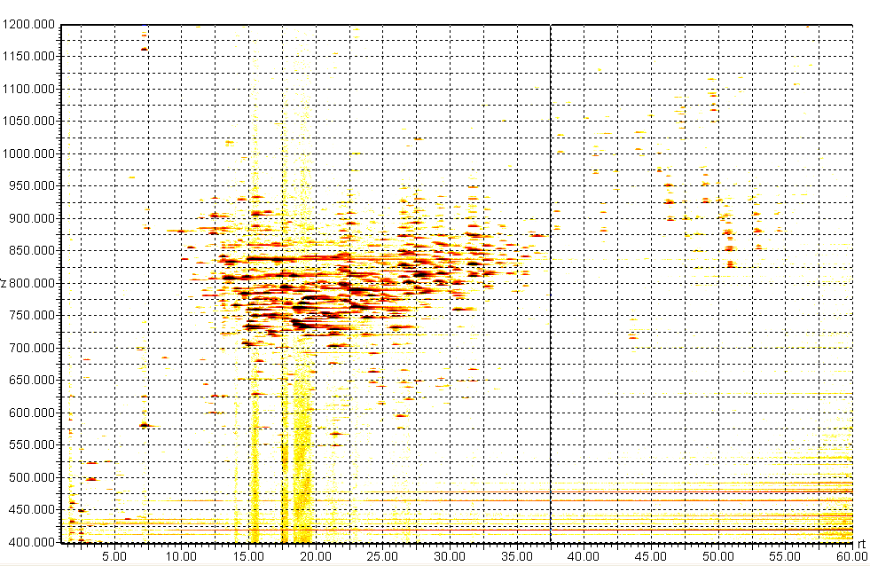
Supplementary figure 2
(A) Wild-type mouse
(B) APP/tau mouse
TIC
3.21x10⁵ (cps)
TIC
3.22x10⁵ (cps)
(m/z)
(m/z)
MAP
MAP
TAGs
TAGs
SMs,PLs
SMs,PLs
ChEs
Cers
Cers
lysoPLs
lysoPLs
RT (min)
RT (min)

