Slide 1
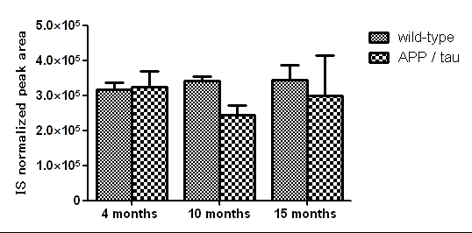
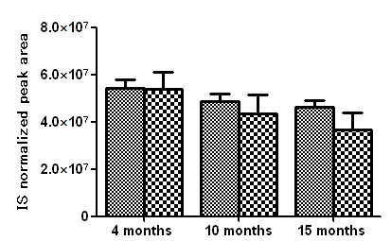
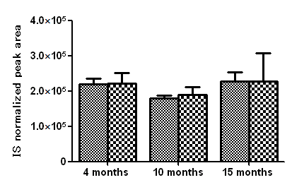
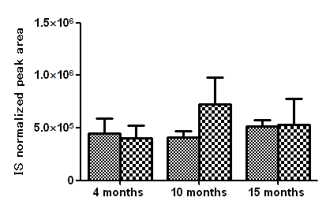
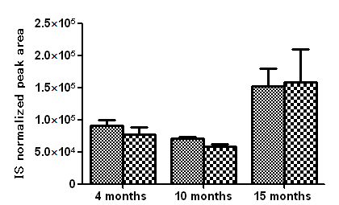
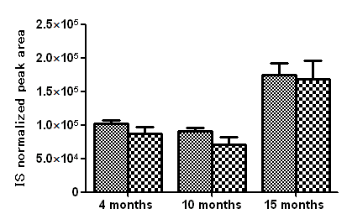
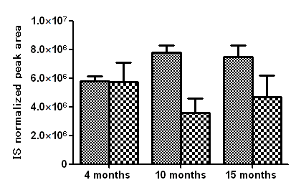
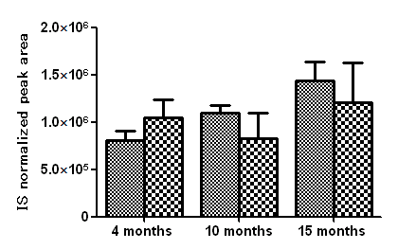
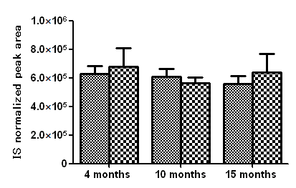
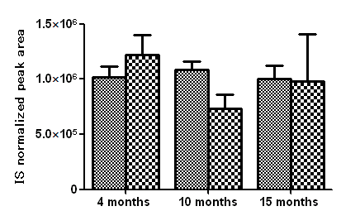
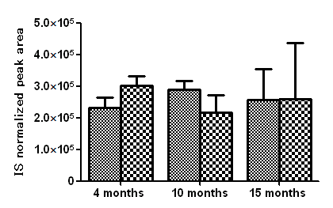
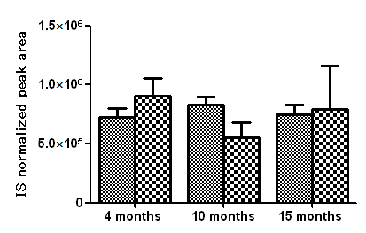
Supplemental Fig. 4
Arachidonic acid
(AA, 20:4FA)
Values are mean ±SD of N=3-5.
Welch’s t-test (*P<0.05, **P<0.01,***P<0.001).
COX 1, COX-2
5-LOX
12-LOXs
(12-LOX-p, 12-LOX-e, 12R-LOX, e-LOX-3
12/15-LOX-I )
12/15-LOX-I
5-HETE
12-HETE
15-HETE
*
***
PGG₂
PGH₂
CYP2C29, CYP2C37, CYP2C38, CYP2C40
CYP5A (TBXAS)
PTGDS
PTGES
CYP8A(PTGIS)
PGFS
11,12-EpETrE
14,15-EpEtrE
PGE₂
PGI₂
PGF_{2α}
12HHT
PGD₂
**
*
**
TXA₂
***
6-Keto-PGF_{1α}
TXB₂
*

