Slide 1
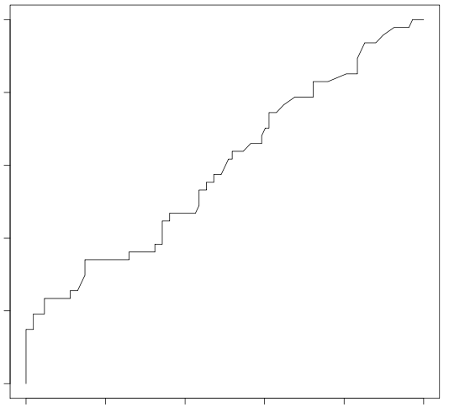
Supplemental Figure 1. ROC plot of CD177 expression as a predictor of GI irAE
1.0
0.8
0.6
True positive rate
0.4
0.2
0.0
0.0
0.2
0.4
0.6
0.8
1.0
False positive rate

