Slide 1
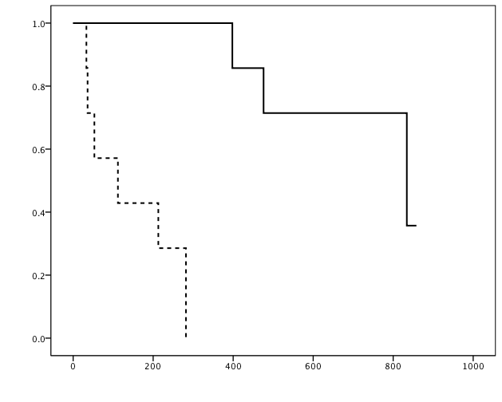
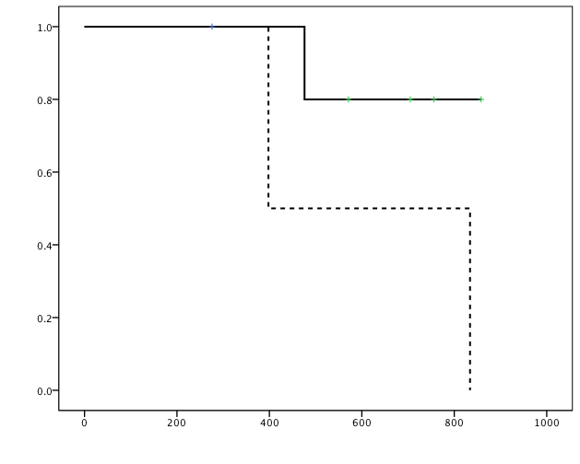
Supplemental Figure 1.
1a
1b
Multiple CTL induction
N=5
PS:0-1, N=8
Survival rate
No/ Single CTL induction
N=3
PS:2, N=7
Days
Days

